Slide 1
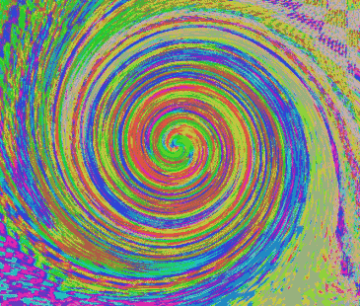
ART

Slide 2
The ancient Egyptians believed each person was made up of five distinct parts - the physical body, the Ba, the Ka, the Name, and the Shadow.
Akh: The physical body was called the Akh. The Akh was most often used to mean a complete person, whether living or dead. While living, the Akh was composed of all five elements - your body, Ba, Ka, Name, and Shadow. When dead, the Akh referred to the reunion of the Ba and the Ka, which they believed happened each night.
Ba: The Ba was your personality, whatever made each person unique that was not physical - your humour, your warmth, your charm, yourself. The Ba is pictured in hieroglyphics as a bird with a human head. The Egyptians thought birds were able to fly between worlds, that of the living and the afterlife.
Ka: They believed every ancient Egyptians was born with a Ka that was uniquely theirs. Each Ka was a life force. The Ka is sometimes represented in ancient Egyptian hieroglyphics by a drawing of a very little person standing next to a picture of the same person drawn much larger. Sometimes the Ka was represented by two arms, outstretched. This was to ward off evil. When a person died, their Ka continued to live. A Ka needed the same nourishment that a person needed, even after they died. That's why the ancient Egyptians painted pictures of food on the walls of their tombs. They believed the Ka did not actually eat these paintings, but rather absorbed the life giving force they represented, so the Ka could live forever.
The ancient Egyptians believed that your soul split into two parts after you died. One part, the Ba, flew off every morning to keep watch over your living family. The other part, the Ka, flew happily off to enjoy life in the Land of Two Fields. At night, both the Ba and the Ka returned home to your tomb to rest up for the next heavenly day.

Slide 3
Name: If something happened to your preserved body, or if your Name was not written down somewhere, the Ba and the Ka would get lost. They would not be able to find their way home to your tomb. You would disappear. Forever. You would not be able to watch over your family or to enjoy your afterlife.
That's why the use of a cartouche was so popular. A cartouche is nothing more than a name plate attached to your coffin. A cartouche made it easy for your Ba and Ka to find their way home.
That's also why grave robbing and the destruction of mummies to get at the treasures hidden inside the folds of wrapping was such a vile crime in ancient Egypt. Grave goods could be replaced. But there was nothing your family could do if robbers disturbed your preserved body. The ancient Egyptians believed you would be lost forever. There was no worse crime.
Shadow: The 5th part, the shadow, was the shadow of a body reflected by the sun. In ancient Egypt, each shadow was considered powerful. Actually, pretty much anything that offered shade from the sun was considered powerful. Your shadow was considered your protection, rather like a body guard.

Slide 4
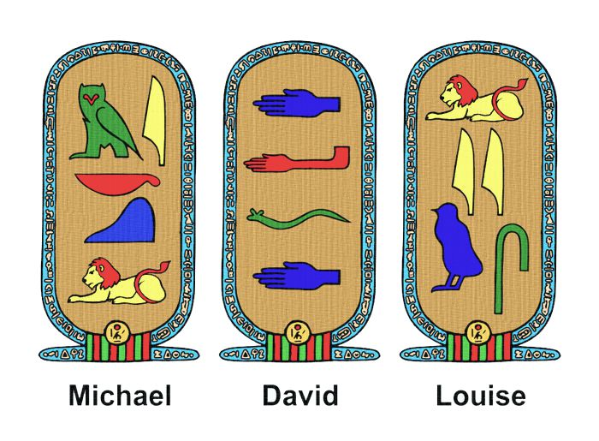
A cartouche is a name plate. It's usually oval with your name written in the middle of it. A cartouche is attached to your coffin. The ancient Egyptians wanted to make sure that their two souls - the Ba and the Ka - could find their way back to their tomb at night, after they died. No one wanted their Ba or Ka to get lost. A cartouche made it very easy for a Ba and Ka to find their way home.
Have a go at drawing your own cartouche.

