Slide 1
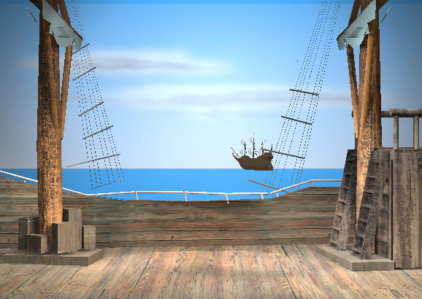
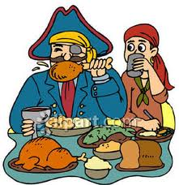
What did Pirates eat?

Slide 2
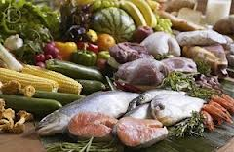
When pirates first left the port they would have lots of fresh fruit, vegetables and meat to eat…
…but it wouldn’t take long for these things to run out.

Slide 3
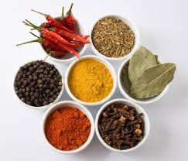
Before long the nice, fresh food would go off and the ship’s cook would have to use lots of herbs and spices to cover up the bad tastes!

Slide 4
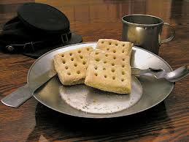
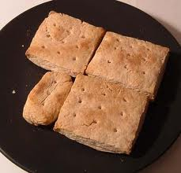
Hard tack
These were sometimes called ship’s biscuits. They were a very hard, dry bread. You had to keep an eye out for maggots in them too!

Slide 5
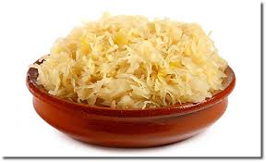
Sauerkraut
This is a German name and it means ‘sour cabbage’. They boiled cabbage in salty sea-water so it would last a long time!

Slide 6
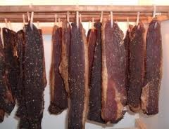
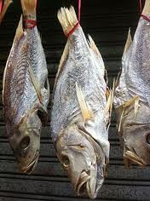
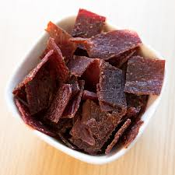
Salted Meat
Pork, beef and fish was covered in salt so it went hard and dry. This meant it would last a long time instead of going rotten.

Slide 7
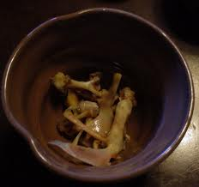
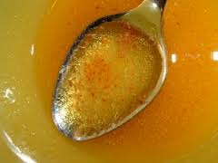
Bone soup
When the meat ran out completely the cook would boil up all the bones from the meat and make bone soup. This was very thin and watery.

Slide 8
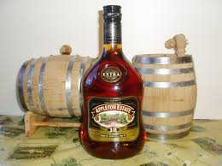
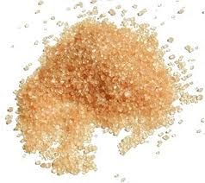
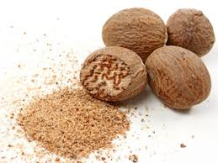
Bombo
This was a drink made from rum, water, sugar and a spice called nutmeg. Pirates also enjoyed beer, wine or rum on its own.

