Slide 1
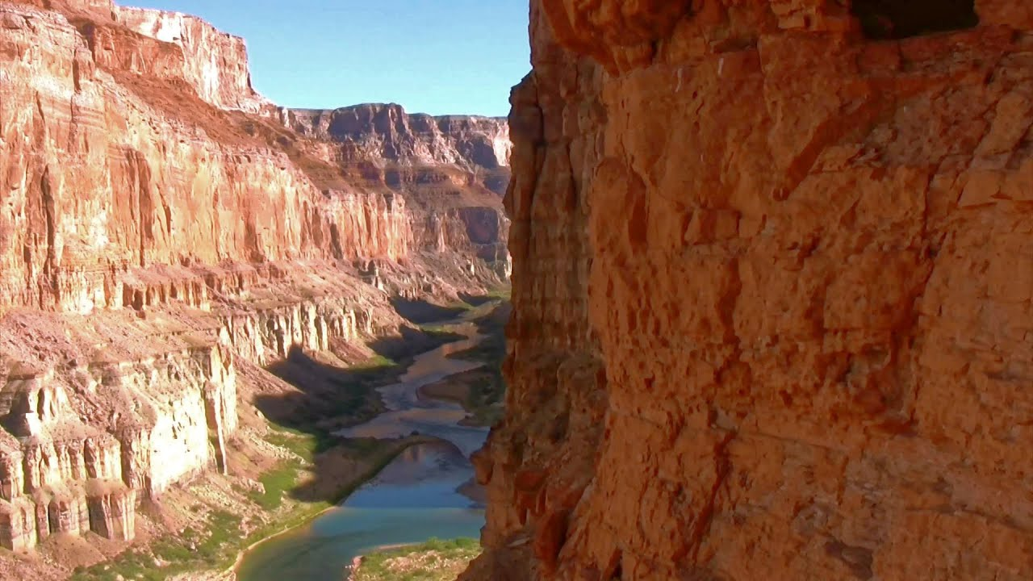
I am a valley
I am
I see
I hear
I want
I wonder
I worry
I hope
I dream
I am

Slide 2
I am a valley
(Mrs Richardson’s attempt!)
I am a majestic, sweeping valley
I see a river at my depths, writhing like a snake
I hear eagles screeching as they circle above me
I want future generations to wonder at my towering heights
I wonder how long they can last?
I worry about the thundering traffic getting ever closer
I hope I can survive encroaching threats
I dream of fresh air and teeming wildlife
I am hopeful.

Slide 3
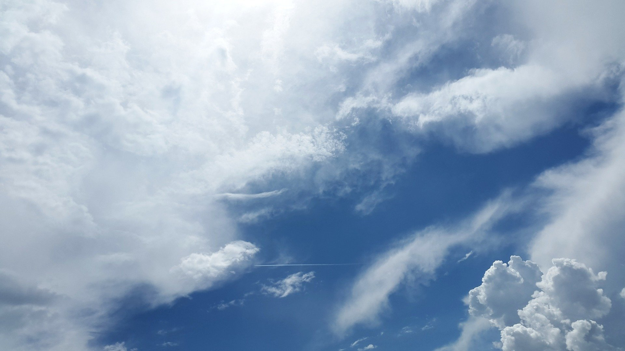
I am the air
I am
I see
I hear
I want
I wonder
I worry
I hope
I dream
I am

Slide 4
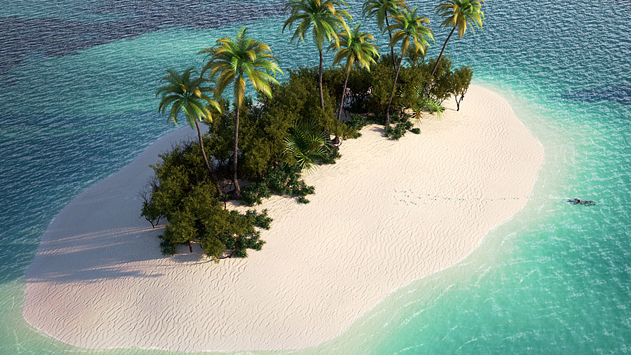
I am an island
I am
I see
I hear
I want
I wonder
I worry
I hope
I dream
I am

Slide 5
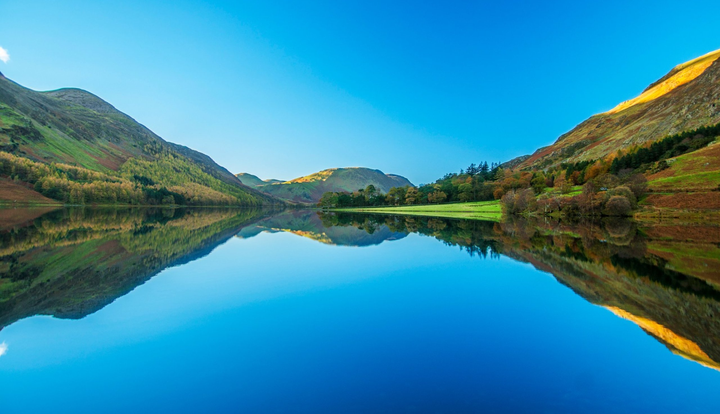
I am a lake
I am
I see
I hear
I want
I wonder
I worry
I hope
I dream
I am

Slide 6
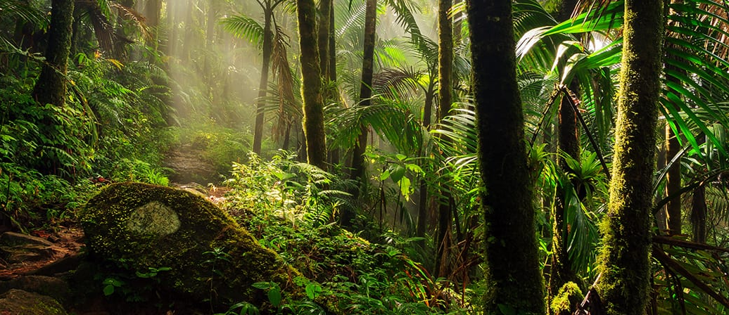
I am a rainforest
I am
I see
I hear
I want
I wonder
I worry
I hope
I dream
I am

Slide 7
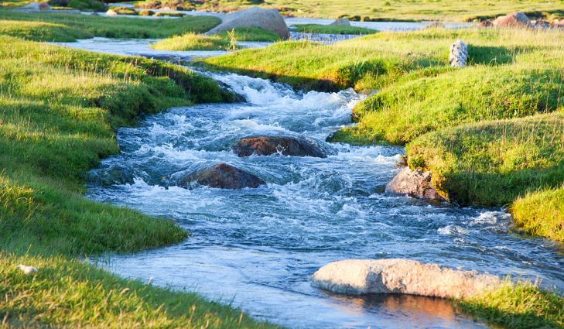
I am a stream
I am
I see
I hear
I want
I wonder
I worry
I hope
I dream
I am

