Slide 1
The Importance and Relevance of Religious Leaders in today’s society
WALT
Investigate why believers look up to their leaders
Reflect on the importance and value of leadership in our society
WILF
Can identify the qualities of what makes a leader
Can identify what qualities make a religious leader
Can describe the importance and relevance of religious leaders

Slide 2
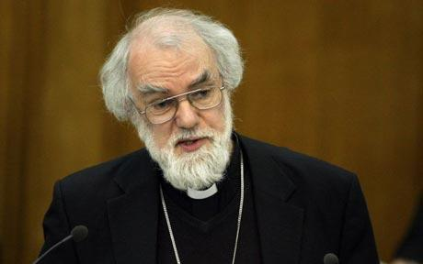
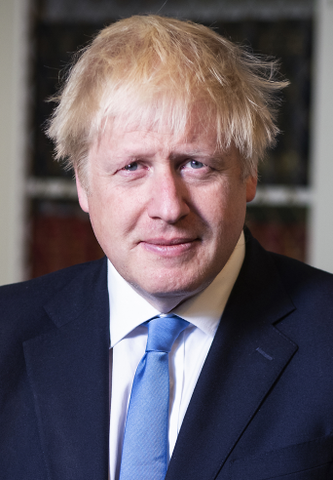
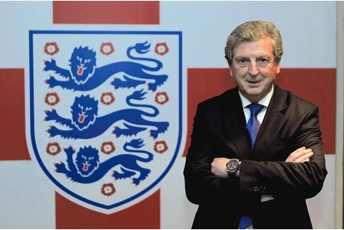
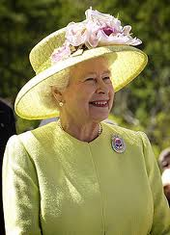
Introduction
Can you name any of the above?
What do they have in common?
Can you think of a word to describe what they do?

Slide 3
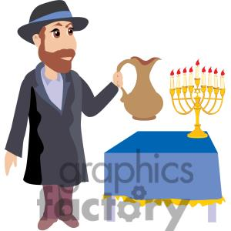
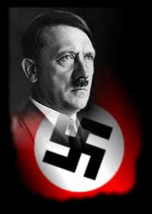
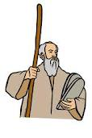
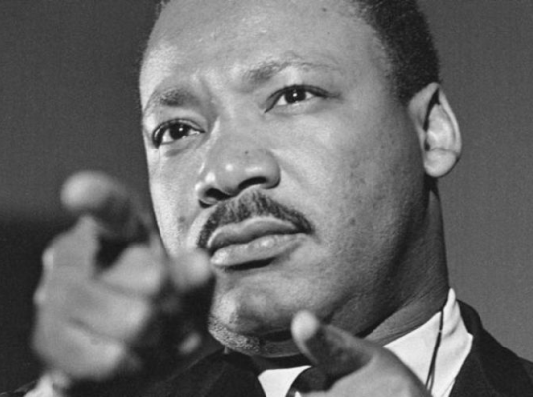
What qualities makes a good leader?
Why have you chosen those qualities?

Slide 4
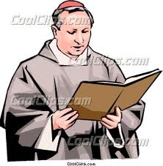
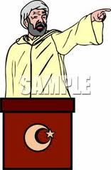
Religious groups have leaders. They all share similar roles.
Christians have priests/vicars
Muslims have an Imam
Jewish people have a Rabbi.

Slide 5
Main task
You need to create a guide/leaflet for someone who is attending a conference to find out information on what Jewish people will be looking for in their Rabbis.
You should explain what believers are expecting in their Rabbi and why.
There is information on the following slides to help you.

Slide 6
The Jewish community is led by a rabbi. Rabbi means master or teacher. Rabbis are important and respected members of the Jewish community. The Jewish community turn to them in times of need or when they need guidance in different matters of their life, this is why they are so important.
Rabbis must have leadership qualities in them such as being caring, kind, strong and courageous. They need to be patient and calm as people will be asking them lots of questions and for help at all times of the day and night. With all these qualities, the people will be able to respect them and look up to them.

Slide 7
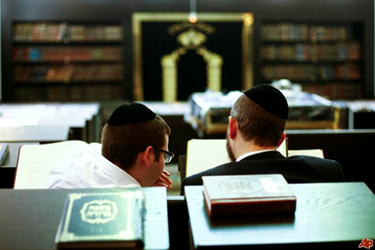
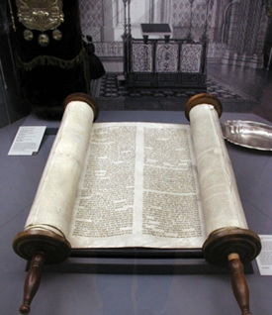
Jews believe that rabbis are special and important as they know the law of God and have spent years learning it.
It takes many years to train as a rabbi as they must be able to read and explain the teachings of the Torah and Talmud (the Jewish holy books). This means that they are experts in Jewish law and are able to guide people in their faith. Without rabbis, many Jewish people would be lost as they would not truly understand their religion.

Slide 8
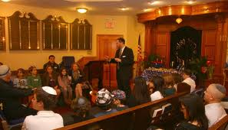
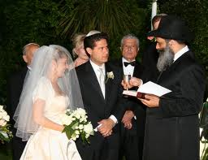
Many rabbis have normal jobs and work as rabbis too.
Rabbis lead worship and also provide guidance and support. They might run classes for children and adults at the synagogue, lead important ceremonies and help the community by visiting the sick and those in prison, giving them hope.
Rabbis also marry people and lead funeral prayers
too. Rabbis are very important as
leaders for the Jewish community.

