Slide 1
Tuesday

Slide 2
We are extending World Book Day to cover a week, so this week we are looking at this fabulous book called
Dreamer

Slide 3
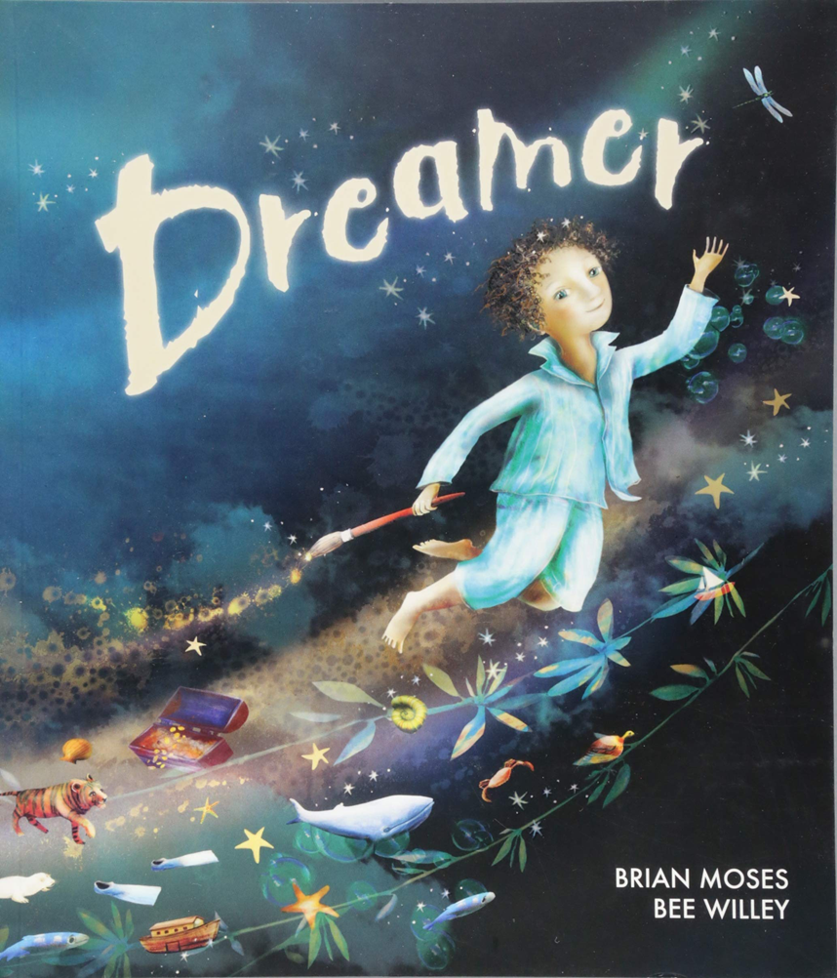

Slide 4
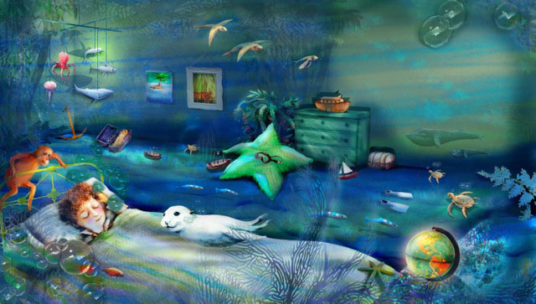
Once I had a dream, a special dream. A dream about our world.

Slide 5
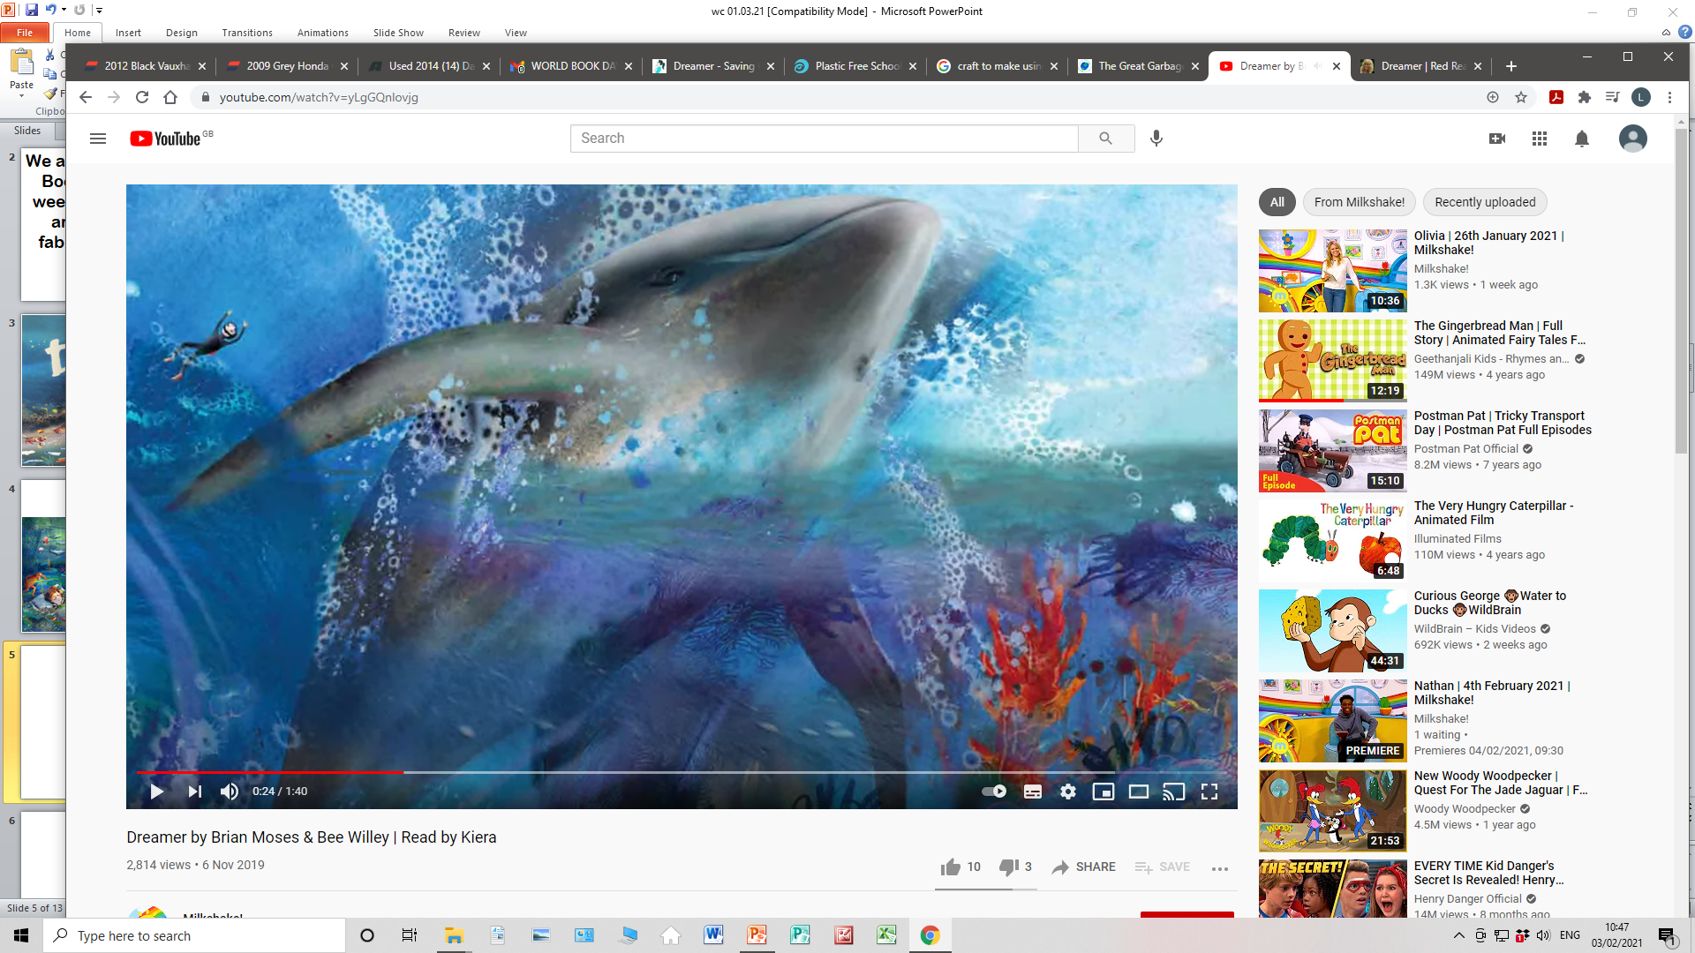
I dreamt I was a whale,
And no hunters chased after me.

Slide 6
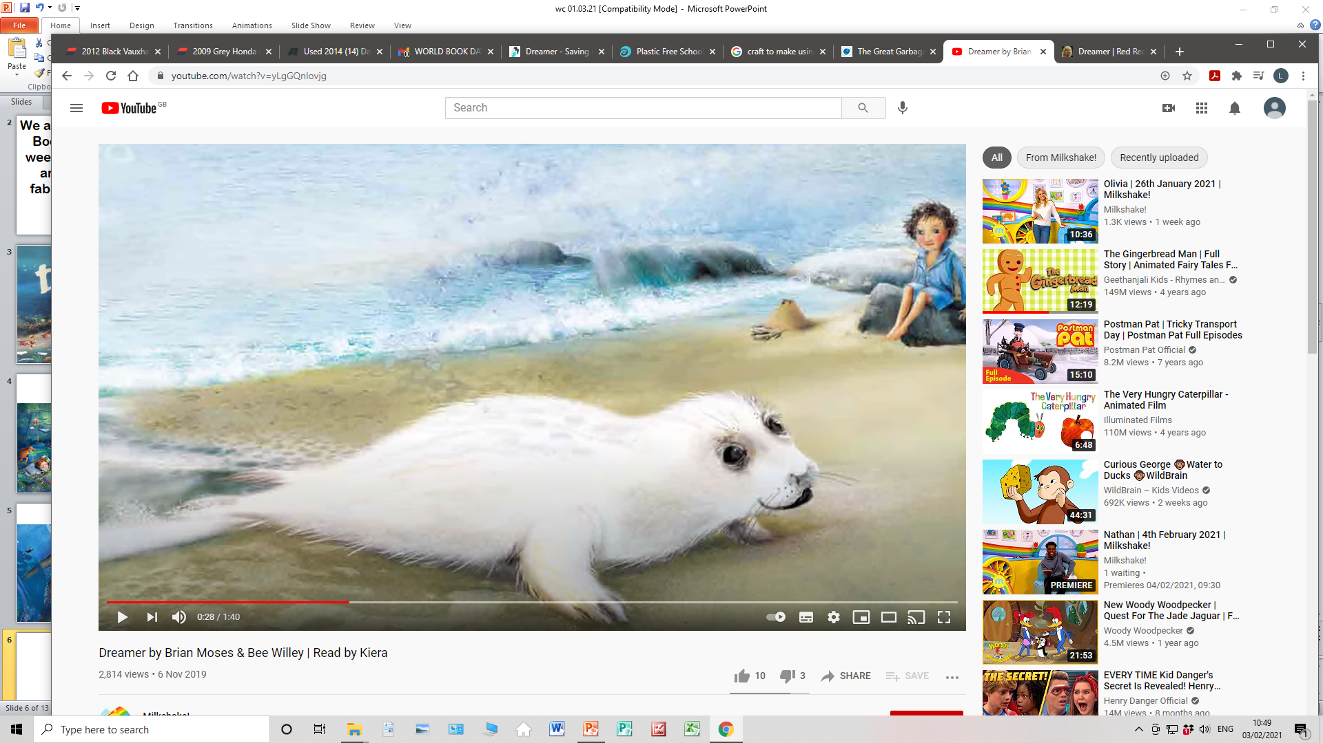
I dreamt I was a seal,
And no one wanted fur from me.

Slide 7
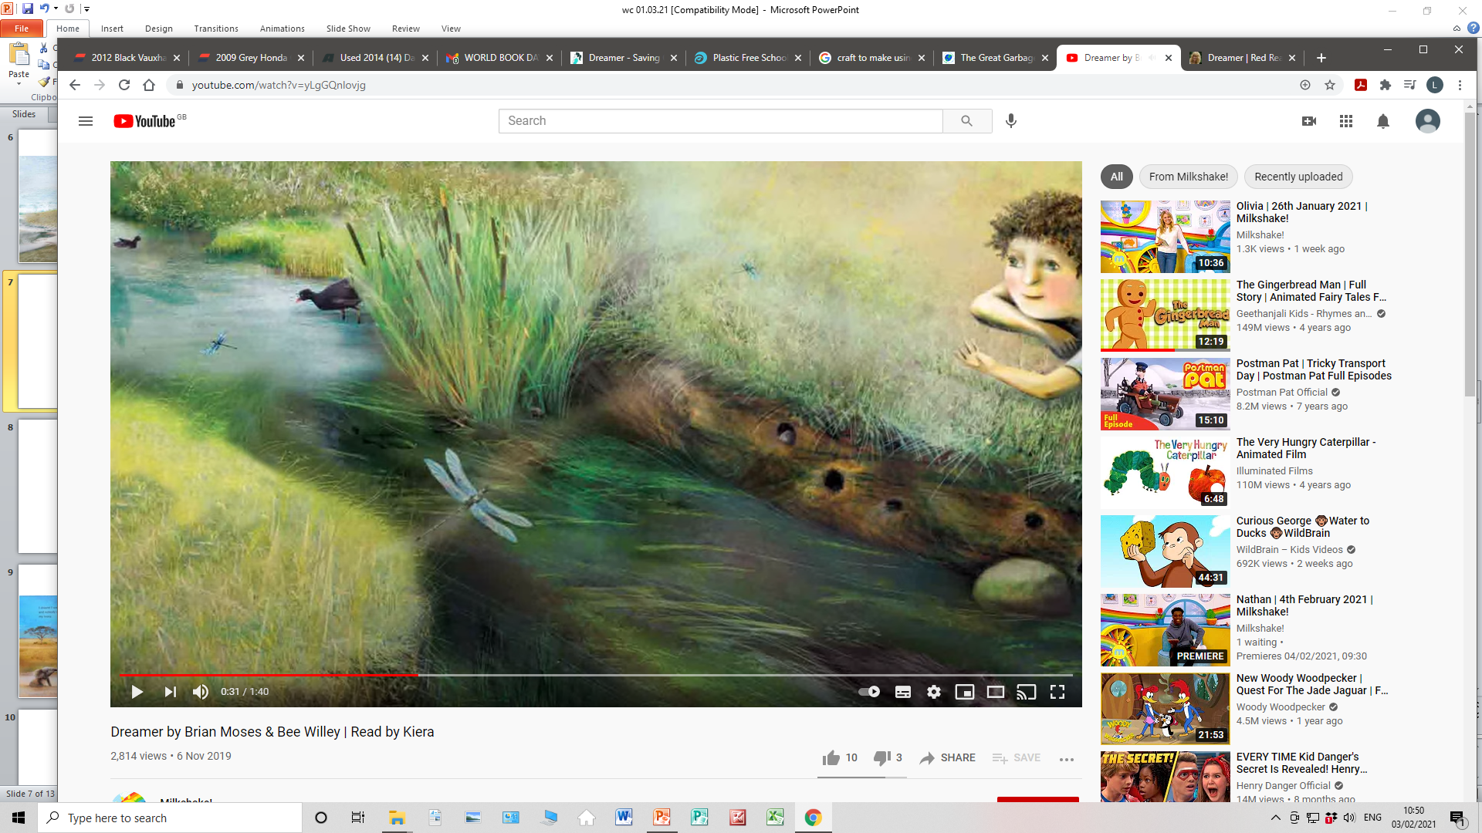
I dreamt I was a stream,
And no one poisoned me.

Slide 8
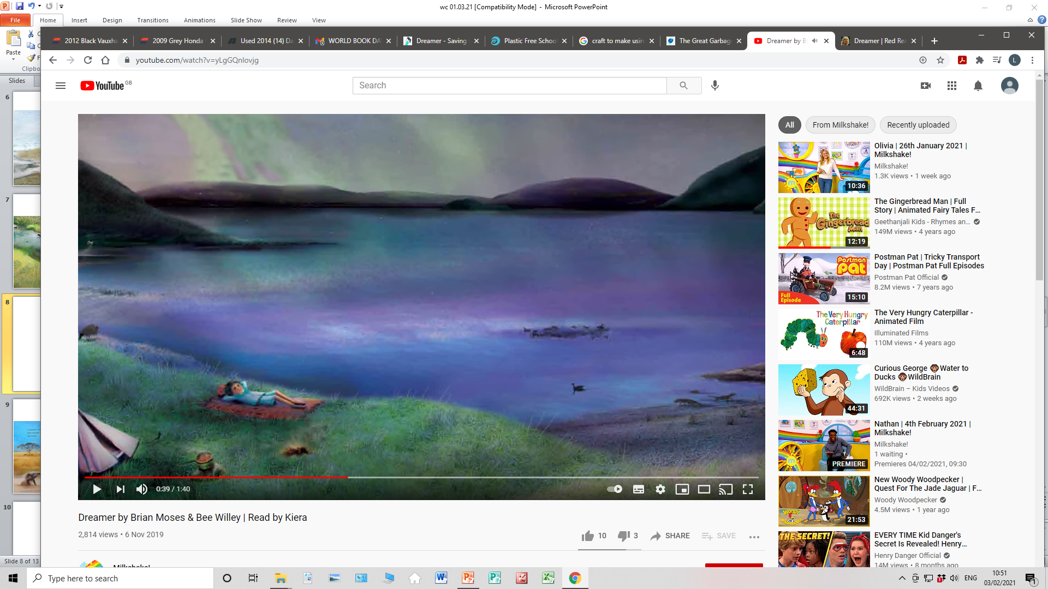
I dreamt I was a lake,
And no one filled me with junk.

Slide 9
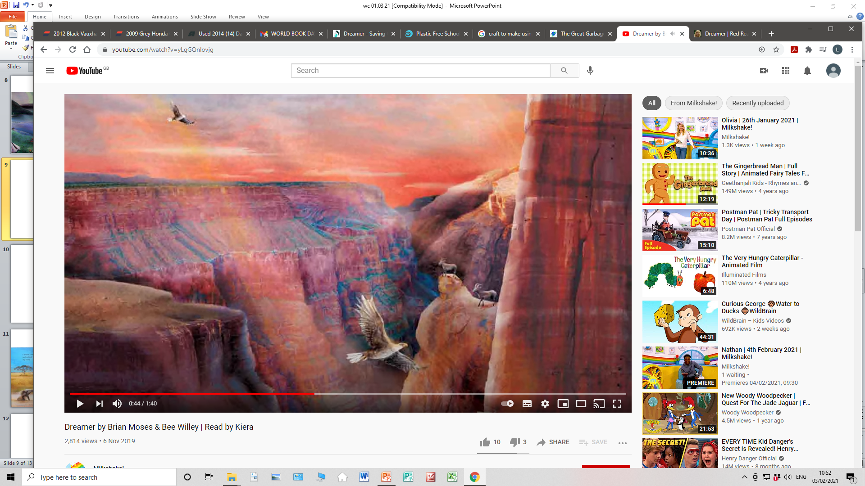
I dreamt I was a valley,
And no one built a road across me.

Slide 10
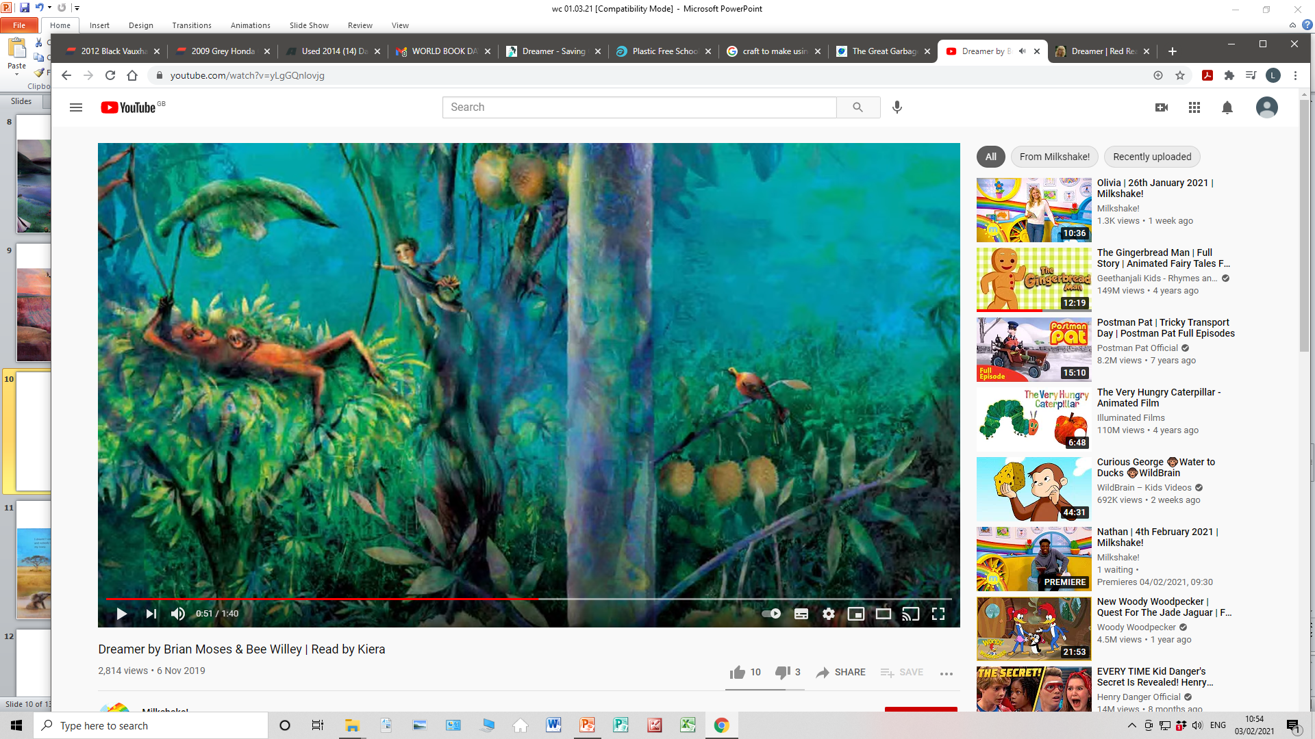
I dreamt I was a rainforest,
And nobody felled a single tree.

Slide 11
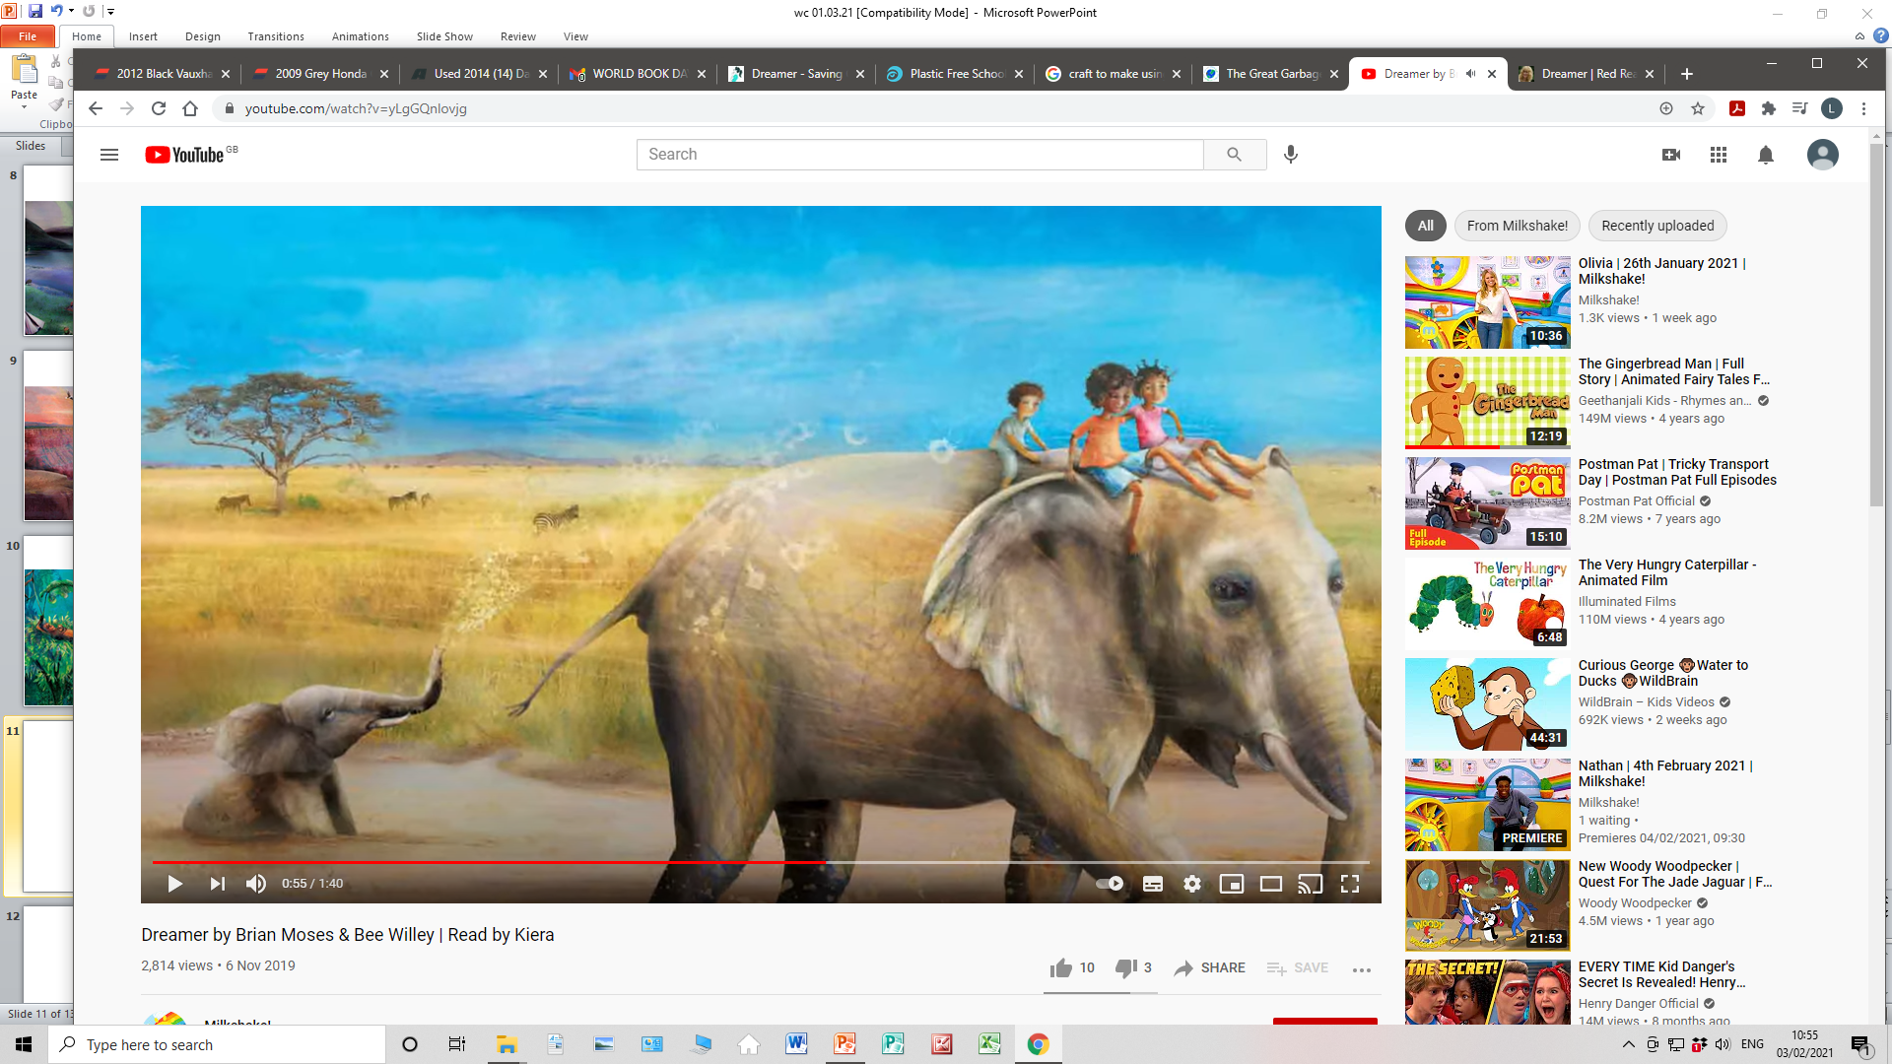
I dreamt I was an elephant,
And nobody stole my ivory.

Slide 12
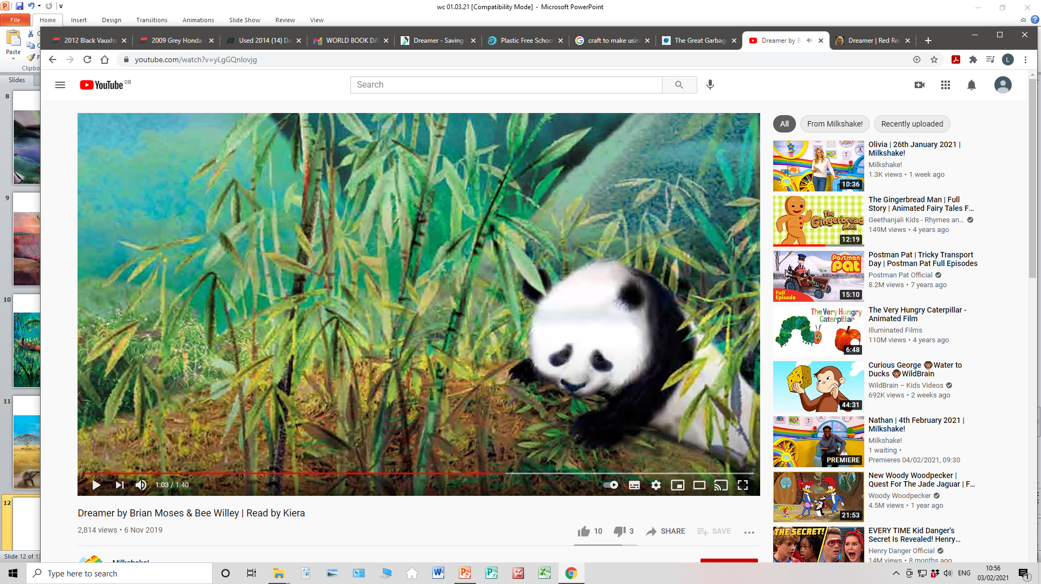
I dreamt I was a panda,
And no one took my territory.

Slide 13
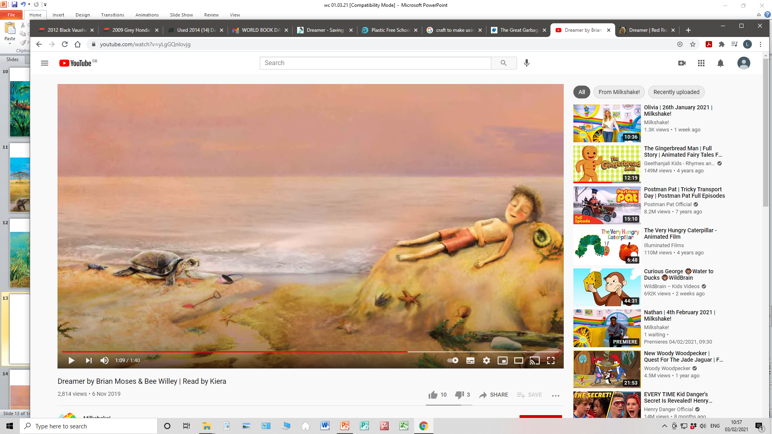
I dreamt I was an island,
And no one ever discovered me.

Slide 15
Tuesday
Task 1 – read Clean Air then produce a poster about the effects of air pollution (there are lots of lovely examples on Google images as well as the ones on slide 20)
Task 2 - to create a grouped bar graph (we have done these in class before – I will put an example on slide 21) Using your data collected when counting vehicles, input your information in a grouped bar graph, remembering to label the axes. Once you have done that, answer the questions on slide 22
Task 3 - read The Science of Plastic (slides 23 to 42) to get an understanding of plastic, then I would like you to choose 4 marine animals and research how they have been affected by plastics. Produce a non-chronological report with your findings, remember to include sub-headings and images. For the final paragraph, state what we could do to reduce/prevent this from happening.
Task 4 - make a craft using a plastic bottle. It must be something that will stay in situ for a long time; not just made then thrown away. There are lots of lovely ideas on Google images as well as the ones on slide 43.

Slide 16
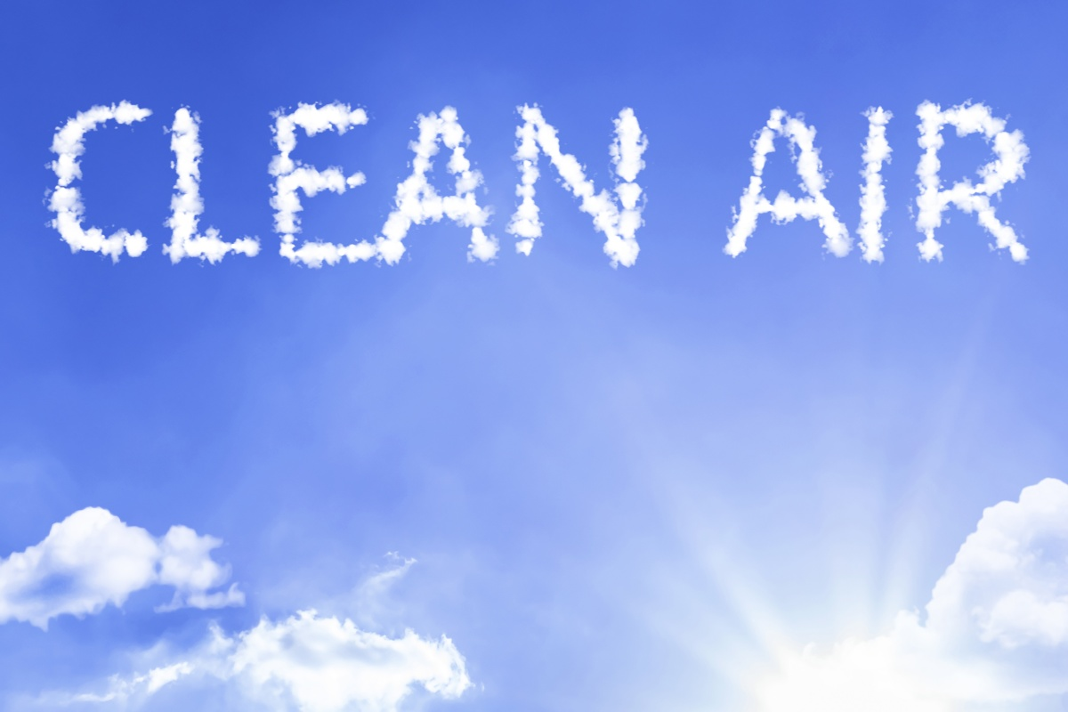

Slide 17
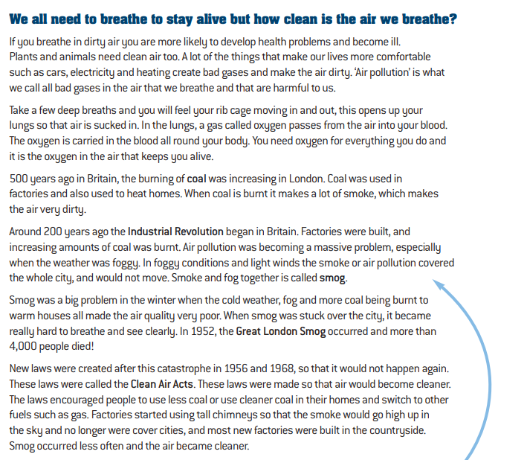
C
L
E
A
N
A
I
R

Slide 18
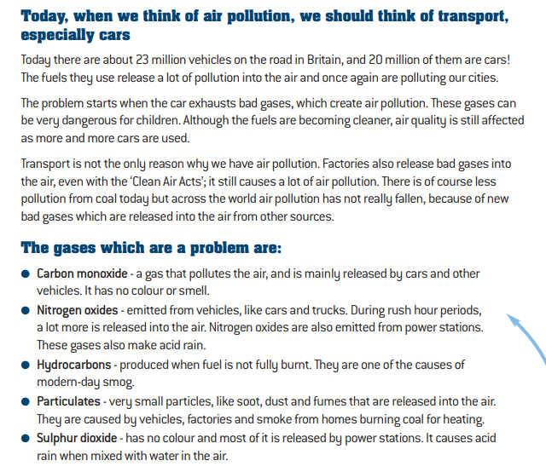
C
L
E
A
N
A
I
R

Slide 19
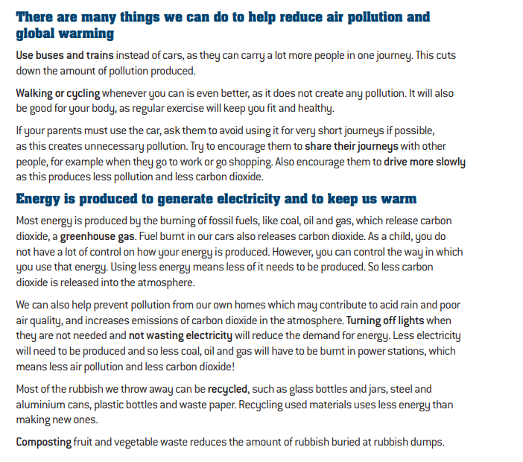
C
L
E
A
N
A
I
R

Slide 20
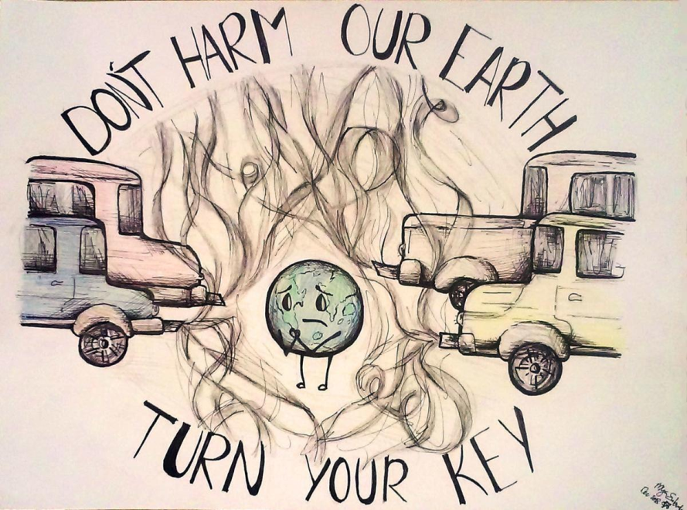
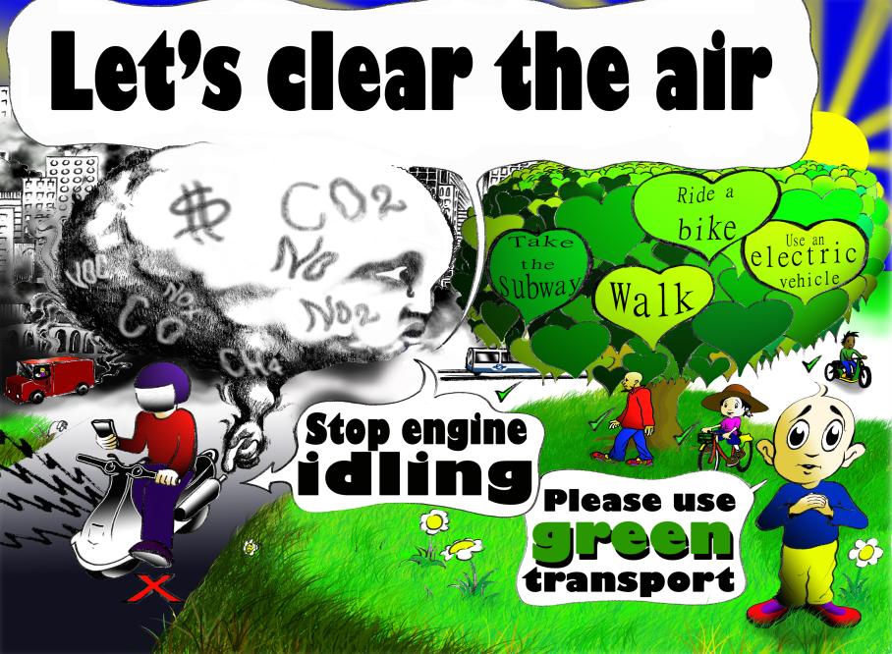
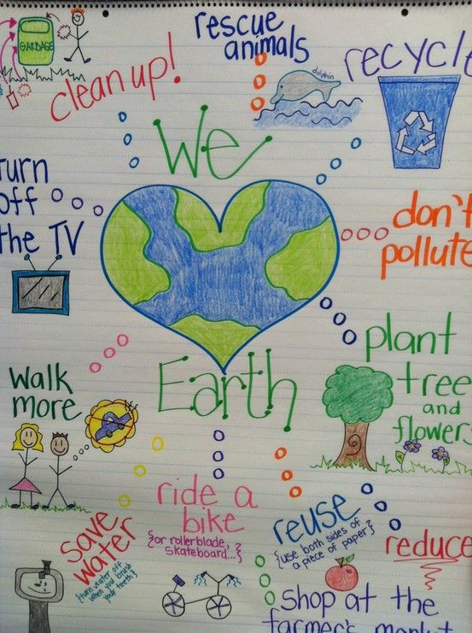
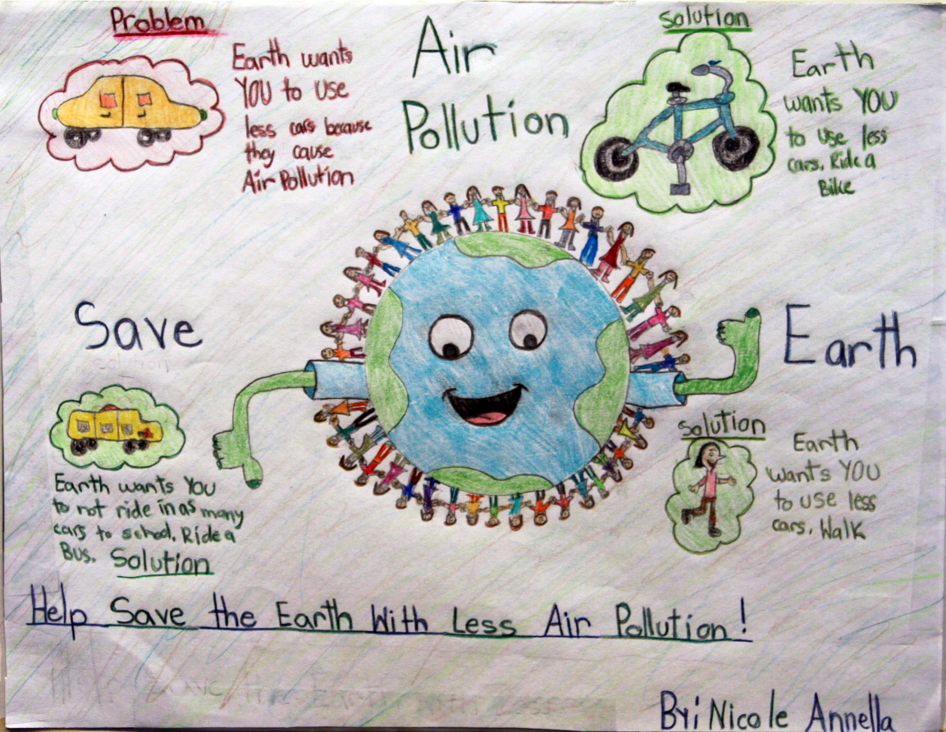
C
L
E
A
N
A
I
R

Slide 21
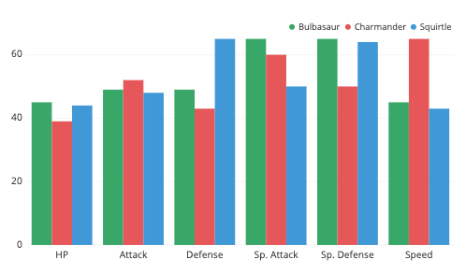
Example of a grouped bar graph
Grouped bar graph showing skills of Pokemon characters
Points awarded
Skills

Slide 22
What time had the highest count of vehicles
and pedestrians?
2. Which category had the most overall?
3. What time had the highest count of cars?
4. Which had a greater number overall between
pedestrians and buses?

Slide 23
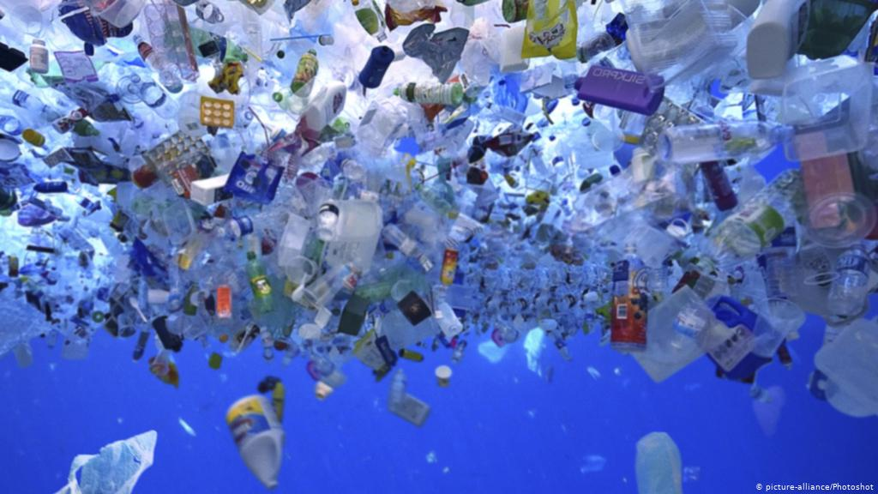
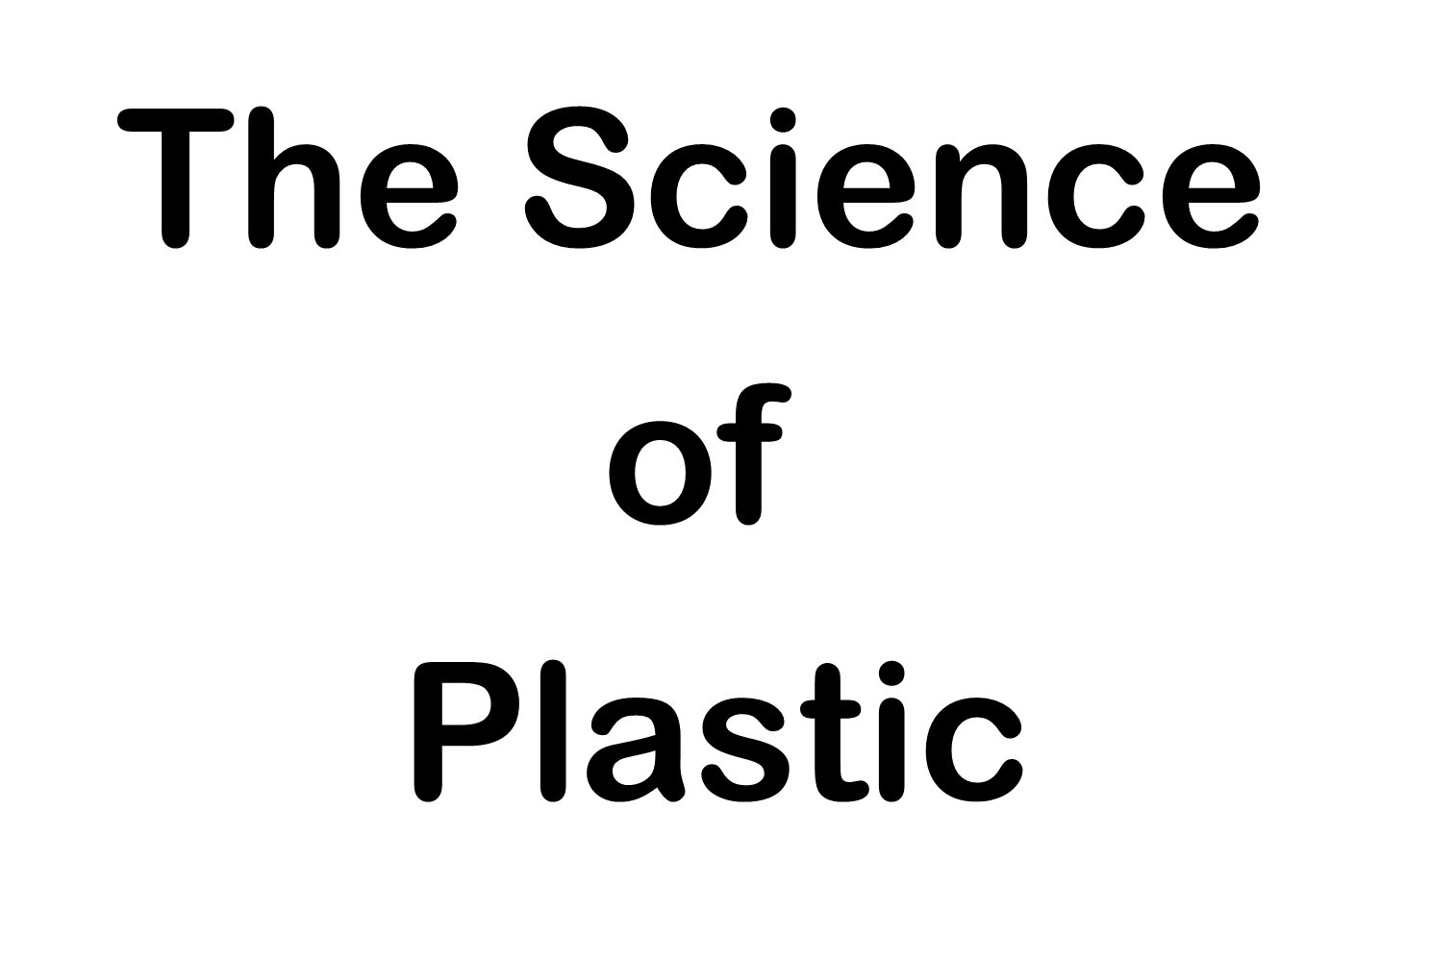

Slide 24

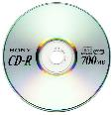
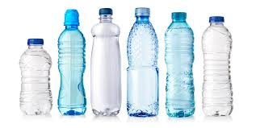
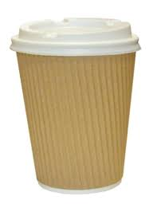
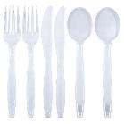
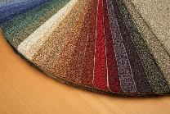
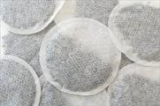
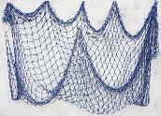
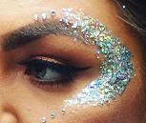
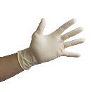
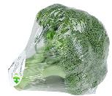
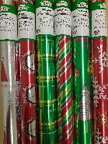
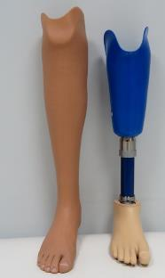
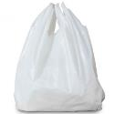
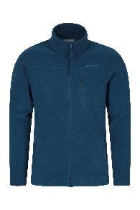
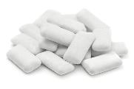
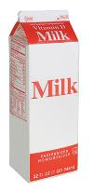
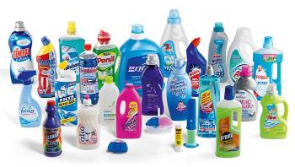

What do all of these items have in common?
Notes:
MAKE SURE TO READ THE NOTES SECTION AT THE BOTTOM OF SOME OF THE SLIDES PLEASE.

Slide 25
They are ALL made from PLASTIC

Slide 26
What is plastic?
An artificial substance that can be shaped when soft into many different forms and has many different uses.
Notes:
Ask students to work with a partner to try to define what plastic is. It may be useful to have a wide variety of plastic products available or pointed out such as water bottle, pen, chair, bag, computer etc
Share answers before revealing the dicionary definition.

Slide 27

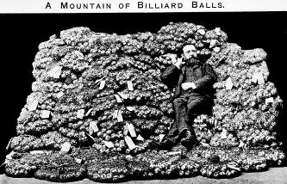




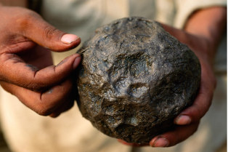


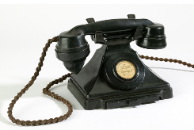
The history of plastics
The FIRST synthetic plastic was created. Called Bakelite, this material was advertised as the ‘material of a thousand uses’.
Over 3,600 years ago natural plastic, a rubber ball was created by Mesoamericans.
1600 BC
1869
1907
Semi-synthetic plastic was made as an alternative to ivory from elephant tusks to make billiard balls.
© National Geographic
Notes:
Mayan people of Mesoamerica are known to have made rubber using natural latex—a milky, sap-like fluid found in some plants. Ancient rubber makers harvested latex from rubber trees and mixed it with juice from morning glory vines, which contains a chemical that makes the solidified latex less brittle.
By mixing up rubber using different proportions of the two ingredients, researchers at the Massachusetts Institute of Technology found that tweaking the formula led to rubber products with different properties.
Some of the rubber came out more bouncy, suggesting it may have been used to make balls for the legendary Mesoamerican ball games.
Other natural plastics include tortoiseshell and horn, that was used in the middle ages and can be shaped when pressure and heat added.
1869
John Hyatt accidentally discovered semi-synthetic plastic. This means that some of the ingredients were chemicals and others natural. He spilt some chemicals whilst trying to find a mouldable product that cools to a solid, when making an alternative to ivory billiard balls (as elephant ivory was becoming more scarce).
1907
The first fully synthetic plastic was made. This made telephones and radios and was mouldable and these products were considered the height of glamour.

Slide 28
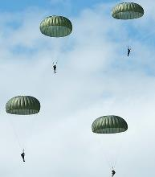
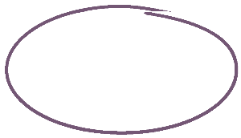
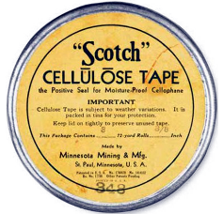
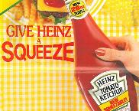
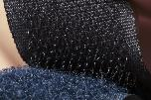
The history of plastics
The first sticky tape
was made
Squeezy bottles and
Velcro invented
1930
1935
1945
Nylon invented and used in World War II parachutes.
Notes:
1930 – The first sticky tape was created. The transparent sticky tape offered opportunities to seal packages in new ways and as a tool to paste and repair items.
1935 – Nylon rapidly replaced silk in clothing and military applications during World War II.
Medical gloves and equipment helped to reduce infections etc.
1945 – Squeezy bottles and Velcro inventions offered a whole new way of using packaging and sealing products.
Images sourced from Creative Commons
Images from Creative Commons

Slide 29
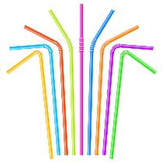
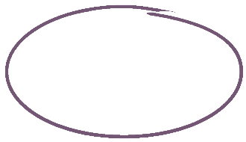
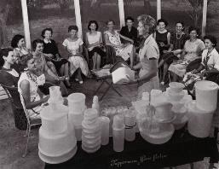


The history of plastics
Tupperware was invented. They even held parties to show the latest designs
The plastic bag was invented and over the next decade introduced to supermarkets.
1948
1960’s
1965
Drinking straws made from Rye Grass were phased out, and replaced with plastic straws.
Notes:
1948 – Tupperware was a huge success. It was designed to contain food and keep it airtight, that featured a then-patented "burping seal".
Tupperware developed a direct marketing strategy, known as the Tupperware party, to sell their products. The party plan built on characteristics generally developed by being a housewife (e.g., party planning, hosting a party, sociable relations with friends and neighbours) and created an alternative choice for women who either needed or wanted to work.
1960’s The first straws were made from Rye Grass, then paper and then plastic. Rye grass disintegrated and inventors found a way to mould plastic straws. Manufacture took off with straight straws, bendy straws and scoop straws (straws with spoons on the end).
1965 – plastic bags were invented to be a waterproof and strong way to carry shopping. Initially these were not liked by shoppers as they preferred the paper ones as they stood upright in the boot of their car!
Images from Creative Commons

Slide 30




The history of plastics
Neil Armstrong lands on the moon…..and leaves a nylon flag behind.
Triangle codes are added to products to assist sorting and recycling
© Creative Commons
1969
1973
1988
PET bottles are patented. These are the first bottles that can contain the pressure of carbonation, creating a cheaper alternative to glass bottles.
Notes:
1969 – How do your class feel about there being a nylon flag on the moon?
1973 – The first plastic bottles that can contain the pressue of carbonation exist and the market for bottled water and single-use bottles increases.
1988 – These identification codes assist in the recycling process. Only some of these types of plastics are recyclable.
Images from Creative Commons

Slide 31




The history of plastics
The Flipflopi Dhow (made from collected plastic waste including 200,000 flip flops) travels from Kenya to Zanzibar
Plastic inventions reach new levels of creativity. Including lightweight bullet proof vests.
2010
2015
2018
Awareness of the damage of plastics increases. The UK introduces a charge for plastic bags in shops.
Notes:
Change is happening with plastics….more inventive uses replacing other materials and now bioplastics are being created and the use of single use plastics is more widely frowned upon.

Slide 32



Where does plastic come from?
Plastics are made from natural materials such as natural gas, oil, coal, and minerals.
300 to 400 million years ago
50 to 100 million years ago
Sand, silt
and rock
Sand and Silt
Dead marine plankton sunk to the ocean floor. Over time, they were covered by layers of silt and sand.
Plant and animal remains
Oil and natural gas deposits
Over millions of years, the remains bury deeper. Heat and pressure turns them into oil and gas.
We drill down through layers of sand, silt and rock to reach oil and natural gas.
Notes:
Contrary to popular belief, oil isn’t made from decomposed dinosaurs! In fact, it was the smallest organisms and plants that creat these fuels.
Oil formed from the remains of marine plants and animals that lived millions of years ago, even before the dinosaurs. The microscopic organisms (mostly plankton as seen in the image above) fell to the bottom of the sea and were squashed which removed the oxygen. Over millions of years, layers of sand and silt piled on top and this pressure and heat changed the sludge into crude oil and natural gas.
Images © Creative Commons

Slide 33

What kind of FUEL is crude oil?
Notes:
Discuss that crude oil is a FOSSIL fuel. Ask students to explain what that means. Discuss that this resource is finite and once it is gone, it is gone forever. What damage does this mean for the world? How is the extraction of crude oil a major contributor to global climate change? What impact would it have if it all runs out or can no longer be accessed?
This Photo by Unknown Author is licensed under CC BY-NC

Slide 34




How do we create plastic?
These natural materials go through a series of man made processes to create plastic.
Extraction
Refinement
Polymerisation.
Extraction can be challenging. Deep below the ocean floor, ice or desert.
1 in 10 barrels of oil are used to manufacture plastic.
Hydrocarbon molecules are broken down and then re-joined together in chains to make polymers. Polymers make plastic.
Crude oil is refined into more useful products such as petroleum and gasoline.
Notes:
This discusses virgin plastic created from natural raw materials (rather than recycled plastic)
Plastics are derived from natural, organic materials such as cellulose, coal, natural gas, salt and crude oil. This slide focuses on crude oil and simplifies the process for a brief explanation.
Extraction of oil. This can be from under the ocean floor, frozen land or desert. The average Texan oil well is 900 feet deeper than the Grand Canyon. The world’s deepest oil well - Sakhalin-I in Russia - reaches an incredible 40,604 feet. That’s 7.7 miles or 15 times the height of the world’s tallest building: the Burj Khalifa in Dubai.
2) Crude oil needs to be processed before it can be used. First, the oil is heated at the bottom of a column which causes it to vaporise. The vapours rise and separate into different molecules of different weights and the heaviest molecules remain at the bottom. At various heights there are different collecting trays to give a variety of end products. Finally, it is cleaned up to reduce the amount of corrosives or pollutants.
3) Polymerisation changes hydrocarbon molecules (monomers) so that they all link together in a chain, usually by applying a catalyst. A bit like a bicycle chain made up of lots of links. When 1000's of monomers are linked together this is called 'Polymerisation' - the compounds formed are called Polymers - and plastic is the common name for Polymers!
Refinement image © Theresa Knott on Wikipedia

Slide 35




How do we create plastic?
Heated and moulded into shapes in factories
Nurdles of plastic transported
Used by consumers. Some single-use items are used for just minutes!
Notes:
Nurdles are small pellets of plastic that are transported to factories around the world. Factories then melt and mould the pellets into their product.
Emphasise that single-use plastics have gone through this whole process and can be used for just minutes! Ask students to reflect on how much work and natural resources have gone in to making that one item. You can display one of those items to help explain this. For example a plastic straw, water bottle or plastic cutlery.
Images pixabay

Slide 36

© Sustainable Packaging Coalition
Notes:
The diversity of plastics created is huge! Plastics are categorised to show their main ingredients. These symbols are included on packaging and assist with the sorting and recycling of waste.

Slide 37


Time to investigate

Slide 38

Question 11 How does plastic end up in the ocean?
Notes:
There are a number of ways that plastic can end up in the ocean. Two-thirds of it comes straight from land based sources: litter being left on the beach or washed down rivers and drains from litter being dropped in towns and cities. It comes from industry spills, badly managed landfill sites and bins near the coast or by being flushed down the loo.
The majority of these items are single-use plastic such as drinks bottles, plastic bags, cotton bud sticks, sanitary items and wet wipes.
The remainder is lost at sea such as containers going overboard or lost fishing gear.
Only 1% of marine litter floats, with the vast majority sinking to the sea floor. Some people question why isn’t marine litter just collected? Even if we tried to ‘scoop’ up that 1%, in international waters who would pay for it? To further complicate matters, the majority of it is microscopic.
There is no ‘away’ because even if miraculously we managed to get all of these pieces, most smaller than a grain of rice out of the sea, what would we do with it then? All we can do is stop using more.

Slide 39




How does plastic end up in the ocean?
Ocean accidents
Lego
5 million pieces of Lego were washed overboard in 1997
Nurdles
(aka Mermaid Tears)
Rubber ducks
In 1992 shipping containers were washed overboard, containing thousands of rubber ducks.
They have since been found all around the world.
Notes:
Nurdles (also known as mermaid tears) are what plastic factories produce and then distribute to the factories that mould the plastic. A huge number of nurdles are seen on beaches all over the world, some from accidents where shipping containers have been washed overboard, some from poor waste management from industry.
Lego – in 1997 almost 5 million pieces of Lego were washed overboard. Regular sightings occur in Cornwall and around the UK, some pieces have even been found on American and Australian coastlines.
Ducks – In 1992 a container ship departing from Hong Kong was hit by a storm in the North Pacific Ocean. Twelve containers were washed overboard, one of these containers held 28,000 bath ducks. At some point this container opened and the contents were released. Although each toy was inside plastic, it was backed onto cardboard which quickly broke apart and released the ducks. Unlike many bath toys these ducks did not have holes in them so they do not take on water.
Ten months after the incident the first ducks were washed up along the Alaskan coast. They have also been found on other American shorelines, Canada, Iceland, Greenland and are still being found today.
These aren’t the only incidences of plastic items being washed overboard/sunken ships. In 1990 61,000 Nike running shoes were lost overboard.
These one-off incidences are extreme and make news headlines, but the extent of the problem of every day single-use plastics polluting marine environments is of serious concern.

Slide 40






Question 12 Damage to the environment
Plastic pollution is the accumulation of plastic objects in the Earth's environment that damages habitats and kills wildlife.
Over 150 single-use
plastic bottles litter each mile of UK beaches.
Approx. 5,000 items of marine plastic pollution have been found per mile of beach in the UK.
Plastics consistently make up 60 to 90% of all marine debris studied.
Every day approximately 8 million pieces of plastic pollution find their way into our oceans. Many of these are items that may have only be used for minutes!
100,000 marine mammals and turtles and 1 million sea birds are killed by marine plastic pollution each year.
Recent studies have revealed marine plastic pollution in 100% of marine turtles, 59% of whales and 40% of seabird species examined.
Notes:
Plastic pollution can be seen in different areas of the oceans:
Large items of plastic floating on the surface initially. Most plastic is lighter than water so it floats.
Suspended in water (and easily mistaken for jellyfish)
On the seabed. Plastics can sink depending on their density and if they have any holes for water to get in, or contain any liquid. As fish, birds and organisms peck at it and the sunlight breaks it down, it can break up into smaller pieces or bottles etc. can open up and allow water in.
Microplastics are suspended in the water and easily ingested by animals. Some people call areas of high plastic pollution ‘plastic soup’ as it is thick with small fragments of plastic in the water.

Slide 41

Why is plastic considered to be a problem?
All plastic that has ever been made is still around somewhere.
It is now either new plastic products after recycling, rubbish in landfill, or plastic pollution. The problem is bigger because of our throw-away culture and our reliance on single-use plastic.
There is no such thing as AWAY because plastic is so permanent and so indestructible that when you cast it into the ocean it does not go AWAY. Sir David Attenborough
Notes:
Plastic is considered to have made the modern world possible.
Many things we take for granted totally depend on it.
Ask students to think of as many lifechanging plastics that they couldn’t imagine life without.
For example:
Medical gloves to prevent spread of infection and surgery instruments
Food storage and protection to preserve and improve shelf lives
Water pipes
Prosthetic limbs
Wires and cables
Telephones
TV!
However the problem is that all of plastic that has been created since 1907 is still around. And this is a big problem!
David Attenborough quote – what does he mean?
He is highlighting the fact that plastic never goes away. It can be broken up into much smaller pieces by sunlight, wave action and some wildlife but this turns into microplastic. Some as small as a width of hair. This causes significant issues in clearing up plastic waste and impacts food chains.

Slide 42





Notes:
Images from Creative Commons and Wikipedia Commons

Slide 43











