Slide 1
The Shema
Lesson Objective: to understand what the Shema is and its importance.

Slide 2
What do Jews believe?
The religion of the Jews is known as J………………...
Judaism is M…………………… as they believe in one God.
When Jews pray to God they call him A……………. – which means Lord.
Jews believe that God is eternal.
God made the world and e……………………………
Jews believe they have a special r……………………………….. with God.
He has given them l……… which they must obey.
The most important is to love God.
The S……………… is a Jewish prayer which shows the importance of this.
Everything
Laws
Relationship
Shema
Judaism
Adonai
Monotheism

Slide 3
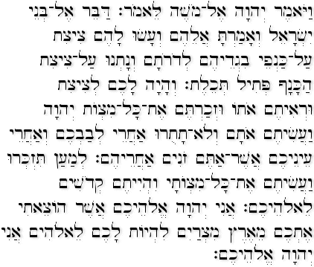
http://www.bbc.co.uk/learningzone/clips/the-shema/4746.html

Slide 4
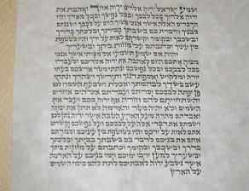
The Shema is a declaration of the Jewish faith.
It is written in Hebrew.
The Shema is recited every morning and evening.
Listen Israel:
The Lord is our God: the Lord is One.
And you shall love the Lord your God with all your heart, soul and resources.
And these words which I command you this day shall be in your heart.
You shall impress them on your children, and you shall speak of them when you sit at home, and on a journey, when you lie down and when you rise up…
The Shema translated

Slide 5
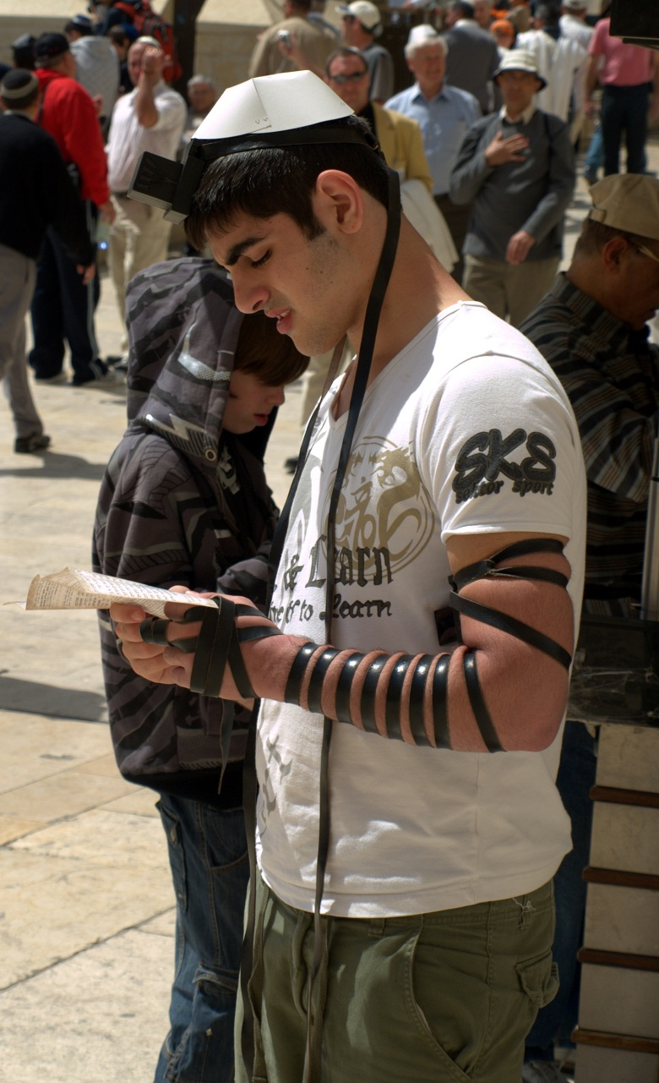
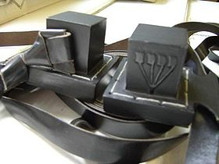
Tefillin
The Shema can be found inside the Tefillin.
The Tefillin are two small leather boxes containing the scripture.
They are strapped to the left arm and the forehead.
As a constant reminder that God is in their minds and their hearts.

Slide 6
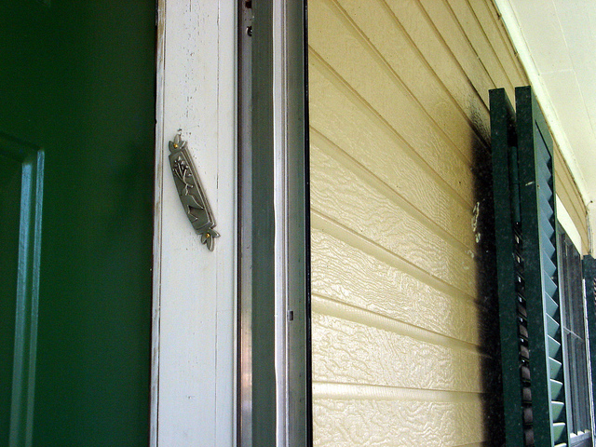
Mezuzah
The Mezuzah is placed on every door post of a Jewish house .
Every door apart from the toilet door as that would be disrespectful to God.
The Mezuzah also contains the Shema prayer.
When Jews pass the Mezuzah they kiss it.

Slide 7
Your Task
Please access this web address to be able to make a mezuzah for your door. https://www.pdffiller.com/jsfiller-desk18/?projectId=468261314#2cae2c9f21f8d95cf30a2a2c90605b2e

