Slide 1
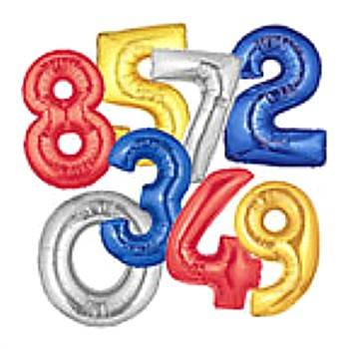
Numeracy
Notes:
1
1
1
1

Slide 2
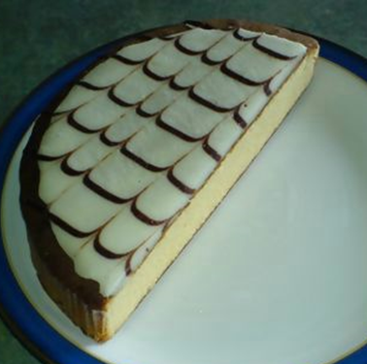
A fraction is less than a whole number.
Think of a cake.
Half a cake is less than a whole cake.
Half a cake is just a part,
or a fraction of the whole
cake.

Slide 3
The numerator tells you how many parts are in our fraction.
1
Numerator
2
Denominator
The denominator tells us how many the
whole has been divided into.

Slide 4
1
3

Slide 5
1
4

Slide 6
2
5

Slide 7
3
8

Slide 8
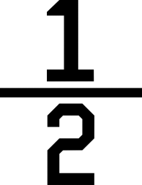
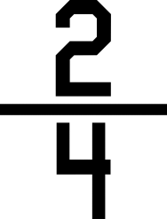
We are trying to find equivalent fractions.
Can you see on the next slide that the fractions are written differently but the pieces that are shaded equal the same amount – this is because
and
are equivalent fractions

Slide 9
1
2
2
4

Slide 10
1/3 and 2/6 are equivalent fractions – can you see a pattern yet?
1
2
3
6

Slide 11
We are trying to find equivalent fractions.
Sometimes it is quite difficult to keep drawing circles and dividing them accurately, so we can look at a pattern or use multiplication.
Let’s look at the pattern first.

Slide 12
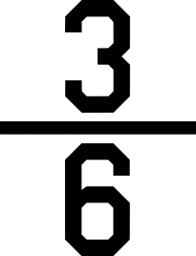
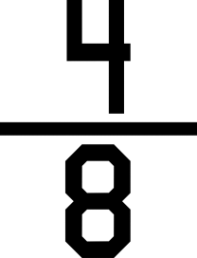
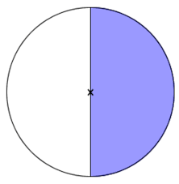
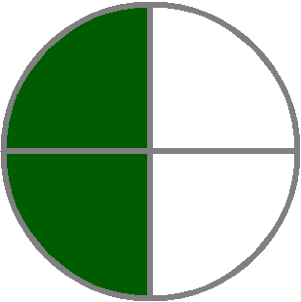
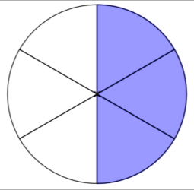
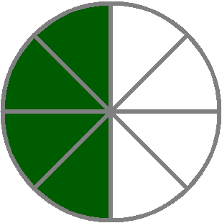
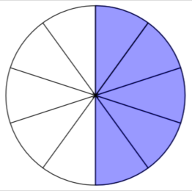
We are trying to find equivalent fractions.
When we look at a pattern, you are looking at the times tables on the denominator number.

Slide 13
We are trying to find equivalent fractions.
What would be the next three equivalent fractions to a half?

Slide 14
We are trying to find equivalent fractions.
If you are going to use the pattern, you need to know your times tables.
If you use multiplication, you also need to know your times tables – so guess what, you need to know your times tables to work out equivalent fractions, which ever method you use ☺
Let’s have a look at the multiplication way.

Slide 15
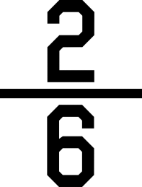
We are trying to find equivalent fractions.
To find equivalent fractions to 1/3 – to keep it simple, the numerator you would use next would be 2 and then you would say 2 x 3 is 6 because you are multiplying by the 3 from the 1/3 fraction, so the next equivalent fraction is
the next numerator would be
3 – what would the denominator be?

Slide 16
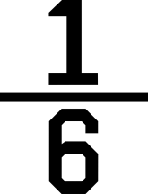
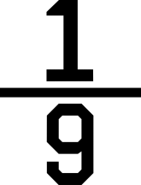
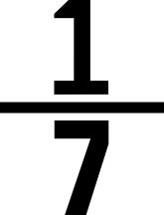
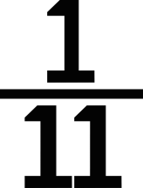
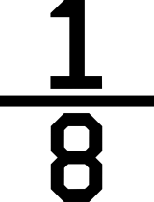
We are trying to find equivalent fractions.
Have a go at calculating the next three equivalent fractions for the six fractions below.

Slide 17
We are trying to find equivalent fractions.
Super challenge!
Sometimes, I like to be a bit mean and give you tricky sums. ☺

Slide 18
We are trying to find equivalent fractions.
What would 25 be in the simplest form?
50
All I’m asking here is I want you to get that
fraction down so that 1 is the numerator.
The way to do that is to say how many 25s
go into 50 and that answer would be the
denominator number and 1 would be the
numerator ?

Slide 19
We are trying to find equivalent fractions.
Super challenge!
25 in the simplest form? 1
50 2
Are you up for a challenge?
Of course you are! ☺

Slide 20
We are trying to find equivalent fractions.
Super challenge!
Sometimes for trickier ones you have to divide with numbers that you may not know the times tables of, such as 13
65
13 65 you may need to work out
the times tables on a scrap
piece of paper

Slide 21
We are trying to find equivalent fractions.
Super challenge!
Find the equivalent fractions in their simplest form for the 6 fractions below.
21 21
105 147
18 32
72 256
15 36
90 324

