Slide 2
Aim
To describe how evidence is used to solve crimes.
To use chromatography to separate mixtures.
Success Criteria
I can identify different types of evidence.
I can explain how evidence is used to support or refute ideas.
I can explain how chromatography separates mixtures.
I can identify a mixture by separating it and observing its components.

Slide 3
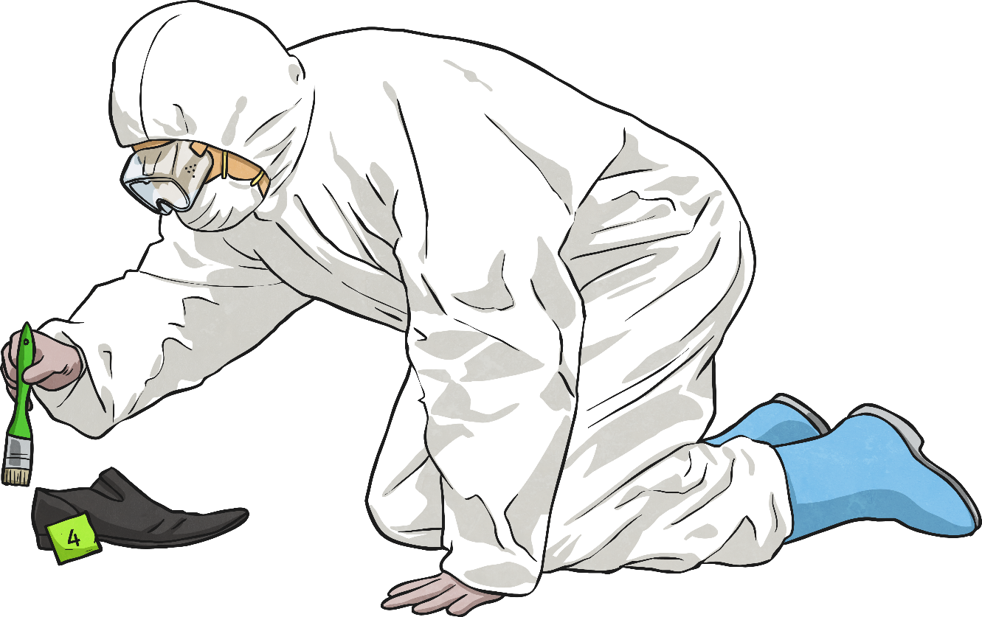
What Is a CSI Technician?
CSI stands for crime scene investigation. CSI technicians are sometimes also called forensic scientists.
CSI technicians are very important members of criminal investigations. They search for and analyse evidence left at crime scenes. They carry out scientific tests on the evidence they find, and use their results to either link a suspect to a crime, or to prove that a suspect did not commit a crime.

Slide 4
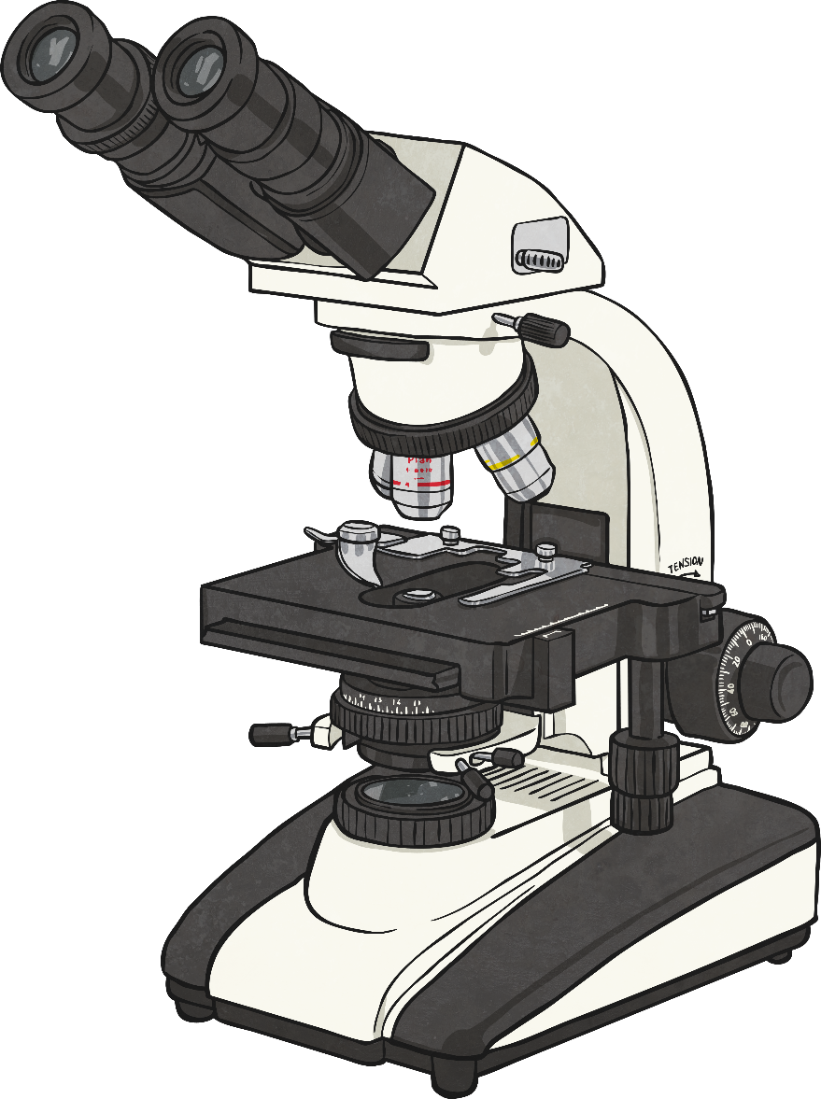
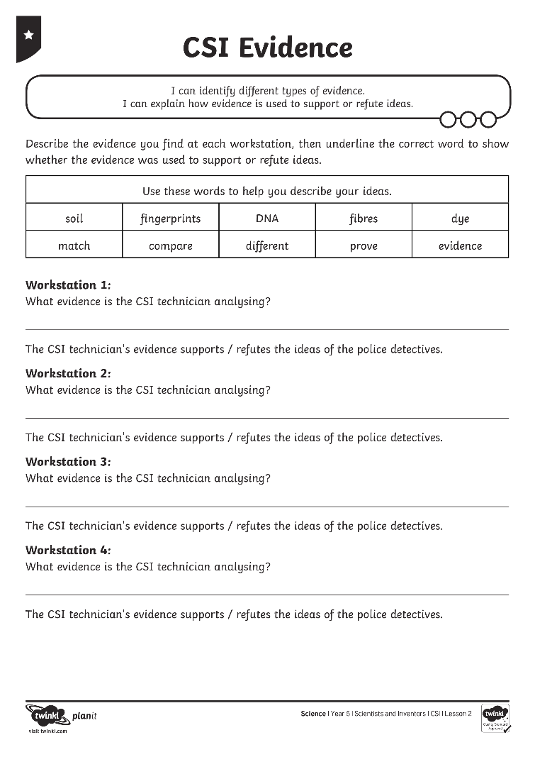
CSI Evidence
CSI technicians use skills from all areas of science, including chemistry, biology, physics and geology.
There are 4 CSI ‘work station’ information sheets. Read the sheets to find out about the different sorts of work CSI technicians do.
Complete your CSI Evidence Activity Sheet to describe the evidence they find, and whether their analysis of this evidence is used to prove or refute ideas.

Slide 5
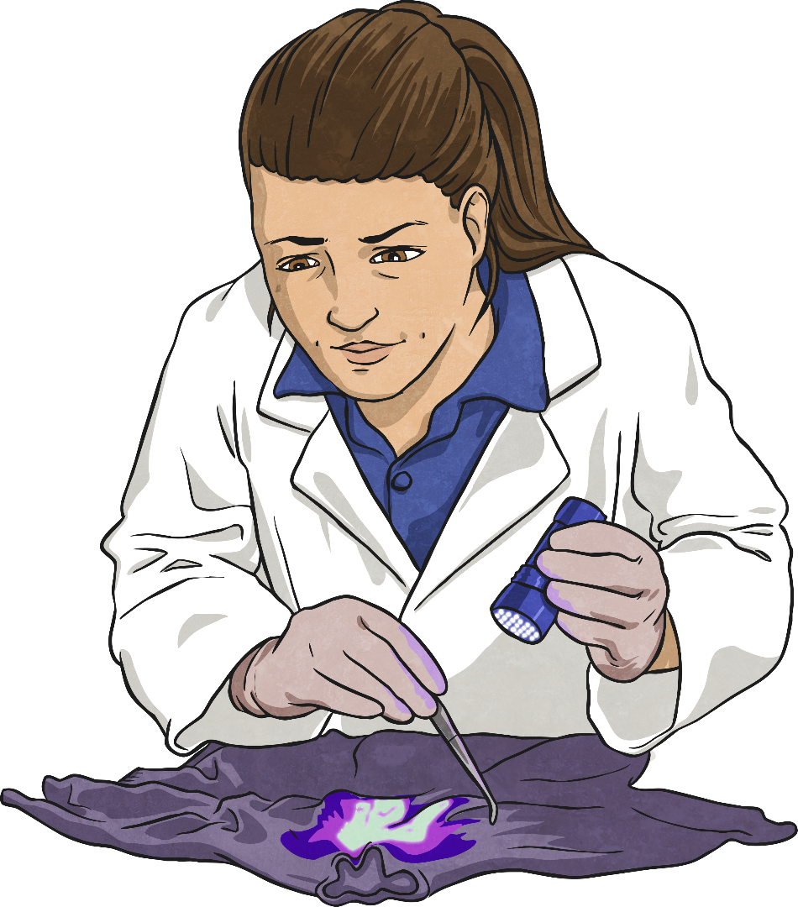
Chromatography
Chromatography is a scientific technique used by CSI technicians. It is used to separate the components, or parts, of a mixture.
Chemicals, such as poisons or drugs, can be separated using chromatography to find out exactly what they are.
If a CSI technician finds fibres from clothes, they can use chromatography to separate the dyes used to colour the fibres. They can then see if they can match the special mixture of dyes to clothes worn by the suspect.

Slide 6
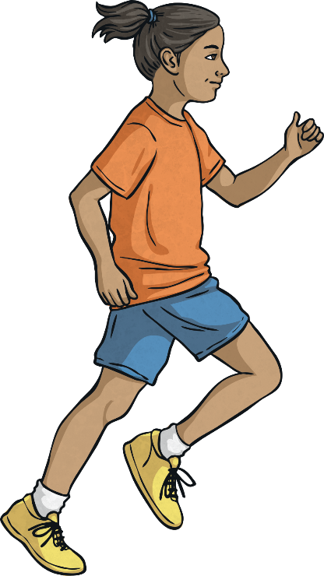
Chromatography
In chromatography, the unknown or suspicious mixture is separated by letting it move over a surface. This surface should be in a different state of matter than the suspicious mixture.
Think of chemicals in the mixture as runners in a race. They all start at the same point, mixed up together. Some of the chemicals can move faster than others, so they move across the surface quicker.
Other chemicals in the mixture move more slowly across the surface. This way, the chemicals spread out over the surface, and can each be seen and identified.

Slide 7
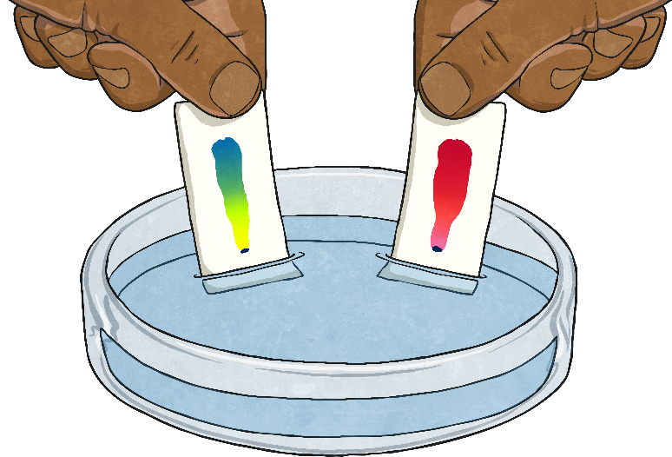
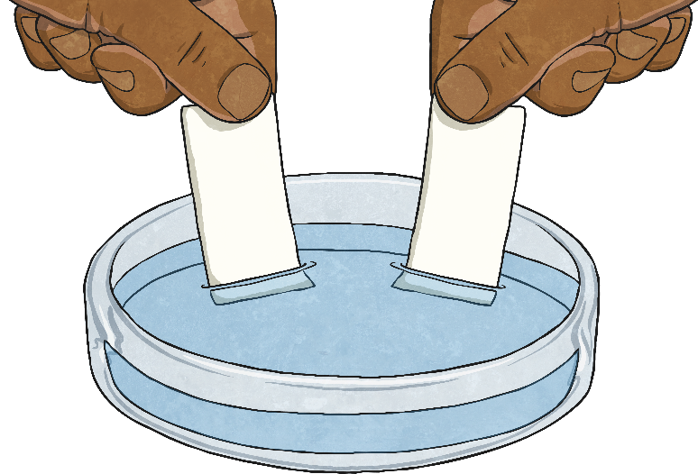
Chromatography
Paper chromatography is one technique that CSI technicians use. A suspicious mixture of liquids is placed onto paper, a solid. The paper is dipped into water, causing the liquid mixture to move across the surface of the paper.
The chemicals in the mixture spread out as they move across the paper, appearing as different colours on the paper.
The CSI technician can then match this special pattern to other known mixtures or clothes to identify what the suspicious mixture is, or where it has come from.

Slide 8
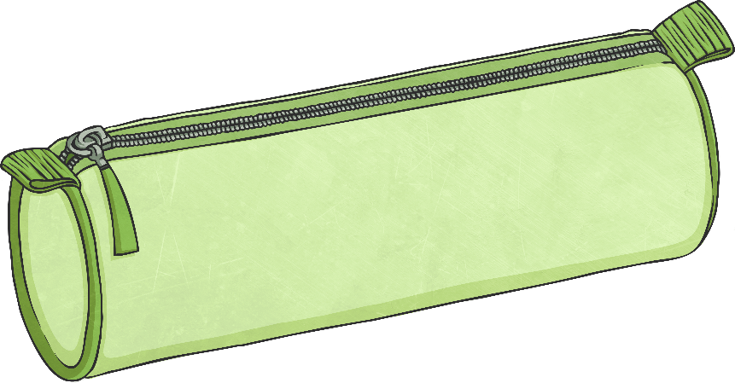
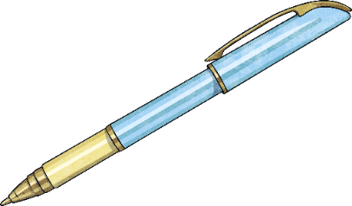
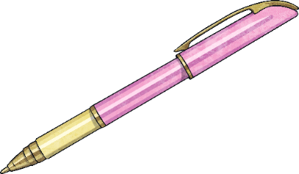
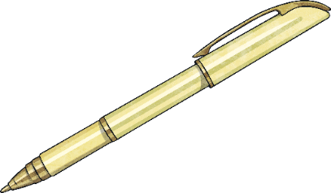
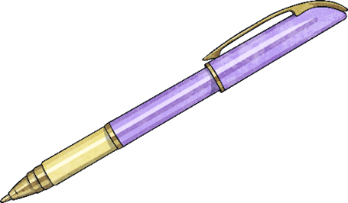
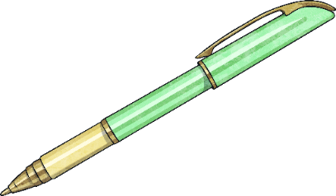
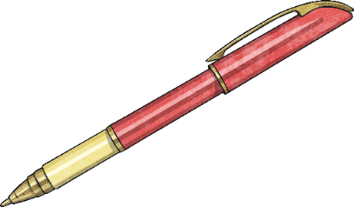
Experiment Time
Can you try out one of these techniques at home?
Chromatography:
If you have filter paper (often used for coffee) and several different brands of black felt tip pens, you could try a chromatography experiment. You could ask someone to write a note on the filter paper without showing you which pen they use. Dip the end of the note into water and watch the ink spread up the paper. This is your evidence! Now test each of the pens in the same way. Can you work out which pen was used to write the note?
Finger prints:
Could you take some finger prints? You could do this by pressing an oily or sticky finger onto a glass. Dust your fingerprint with cocoa powder and gently brush it off with a soft paint brush. Place a piece of sticky tape over the fingerprint. Lift the fingerprint on the tape and stick it to some light coloured paper. If possible, repeat this with the fingerprints of other people in your household. Does your fingerprint look like anyone else’s? (or record and compare finger prints in a more messy way using ink pads or paint!)

Slide 9
Aim
To describe how evidence is used to solve crimes.
To use chromatography to separate mixtures.
Success Criteria
I can identify different types of evidence.
I can explain how evidence is used to support or refute ideas.
I can explain how chromatography separates mixtures.
I can identify a mixture by separating it and observing its components.

