Slide 1
Wednesday

Slide 2
We are extending World Book Day to cover a week, so this week we are looking at this fabulous book called
Dreamer

Slide 4
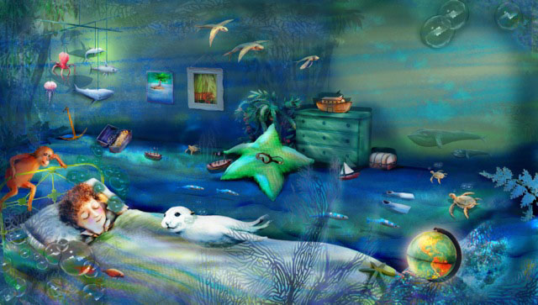
Once I had a dream, a special dream. A dream about our world.

Slide 5
I dreamt I was a whale,
And no hunters chased after me.

Slide 6
I dreamt I was a seal,
And no one wanted fur from me.

Slide 7
I dreamt I was a stream,
And no one poisoned me.

Slide 8
I dreamt I was a lake,
And no one filled me with junk.

Slide 9
I dreamt I was a valley,
And no one built a road across me.

Slide 10
I dreamt I was a rainforest,
And nobody felled a single tree.

Slide 11
I dreamt I was an elephant,
And nobody stole my ivory.

Slide 12
I dreamt I was a panda,
And no one took my territory.

Slide 13
I dreamt I was an island,
And no one ever discovered me.

Slide 15
Wednesday
Task 1 – access https://www.youtube.com/watch?v=I4QNolP7Khc (WARNING _ IT IS A LITTLE DISTRESSING) to see the effect of plastic. Then please read 16.
Task 2 – please complete a stacked graph showing how long it takes for certain products to bio-degrade. Please see example on slide 17 and then products I would like you to research on slide 18.
Task 3 – to be able to create a storyboard about the production of Fairtrade chocolate. Please see slides 19 to 26.
Task 4 – litter pick; please read slide 27.

Slide 16
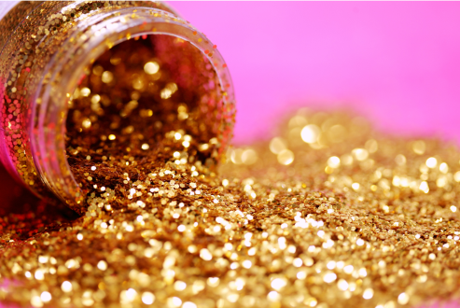
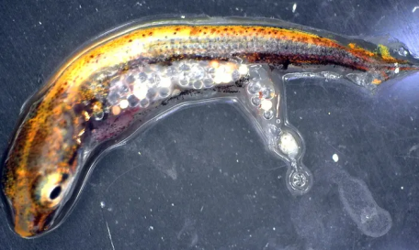
Well, as you all know, glitter is an absolute hate of mine!
As well as watching the youtube clip, I would like you to research the effect that glitter has on our rivers, seas and wildlife. Once you have done that, I would like you to write a formal letter to
Meadowbrook Inventions
PO Box 960
260 Mine Brook Road (Route 202)
Bernardsville
NJ07924
They are the top manufacturer of glitter.
Asking them to either stop manufacturing glitter or find a environmentally friendly replacement.
I will send them the letters!
Little fish with glitter in its tummy! ☹

Slide 17
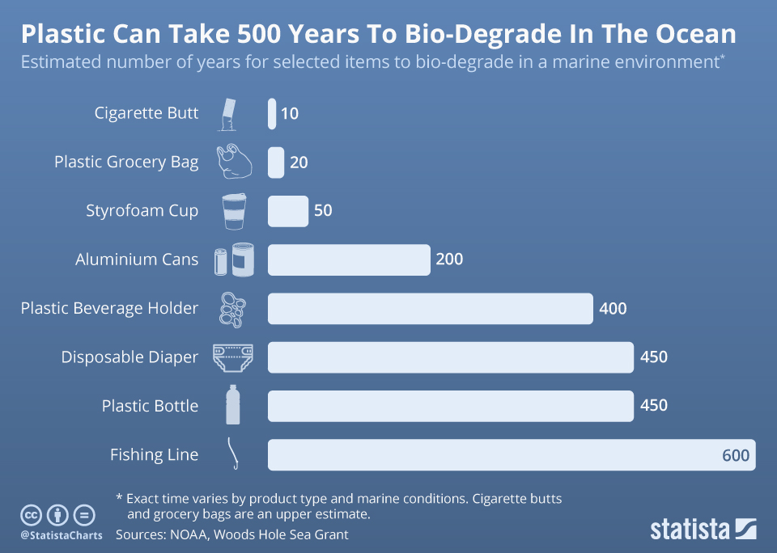
Each one of these numbers means number of years

Slide 18
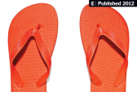
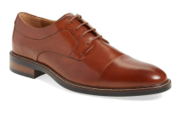
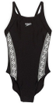
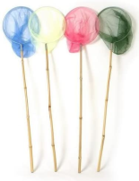
Google search these products to find out how long it takes for them to bio-degrade. Show your findings in a stacked bar graph.
Plastic straw
Chewing gum
Apple core
Rubber Flip flops
Newspaper
Leather shoe
Swimming costume
Woollen socks
Nylon child’s fishing net (just the net part)

Slide 20
The history of chocolate?

Slide 21
The main ingredient is cocoa (cacao)
Farmers grow cocoa pods, each roughly the size of an American football
Inside the pod is cocoa butter and cocoa beans (that’s what makes the chocolate!)

Slide 22
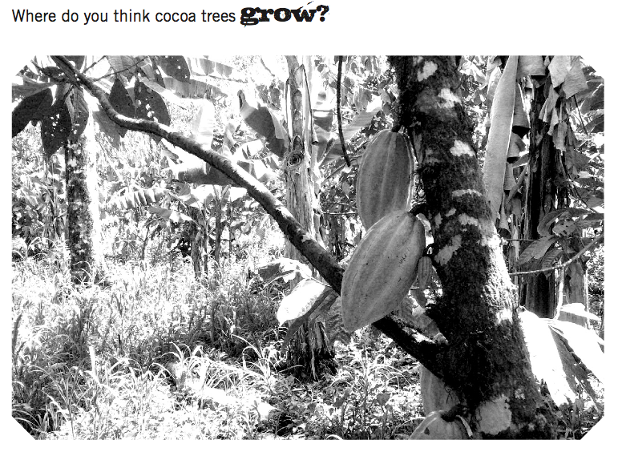

Slide 23
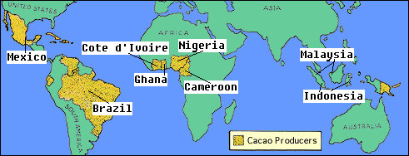
Chocolate growing regions

Slide 24
Please watch the following clip about chocolate farming
https://schools.fairtrade.org.uk/teaching-resources/the-story-of-chocolate-unwrapping-the-bar/
Notes:
http://www.youtube.com/watch?v=qV4ywE_gPSU

Slide 25
Percentage of how much the various people get in the manufacturing of chocolate Non Fairtrade chocolate Fairtrade chocolate Farmer 2% Farmer 6% Cocoa buyer 8% Cocoa buyer 10% Shipper 12% Shipper 12% Importer 27% Importer 27% Supermarket 51% Supermarket 45%
Notes:
http://www.youtube.com/watch?v=qV4ywE_gPSU

Slide 26
Fairtrade chocolate is more expensive if you buy products like Divine which works out at £2.65 for 100g but Cadbury chocolate is also Fairtrade and it is £1.00 for 100g But as you can see the grower (who I think works extremely hard) would get 16p per 100g if you bought Divine rather than Cadbury, which would give him 6p per 100g. See if you can save up to buy a bar of Divine chocolate.
Notes:
http://www.youtube.com/watch?v=qV4ywE_gPSU

Slide 27
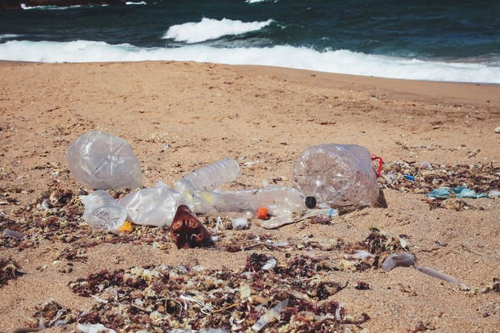
It is essential that we keep our beaches free of our rubbish, as it all gets washed into the sea and then sadly some of the sea creatures are either trapped by it or poisoned by it.
The Northumberland County Council will happily give you the equipment to be able to pick up litter safely; all you have to do is get your adult to contact them on https://www.northumberland.gov.uk/Highways/Street.aspx#communitylitterpicking to be able to get the equipment needed.
If you do arrange a day to clean up the beach, get your adult to contact me and I’ll come and join you to pick up litter and take some photos for our website.

