Slide 1
Thursday

Slide 2
We are extending World Book Day to cover a week, so this week we are looking at this fabulous book called
Dreamer

Slide 3
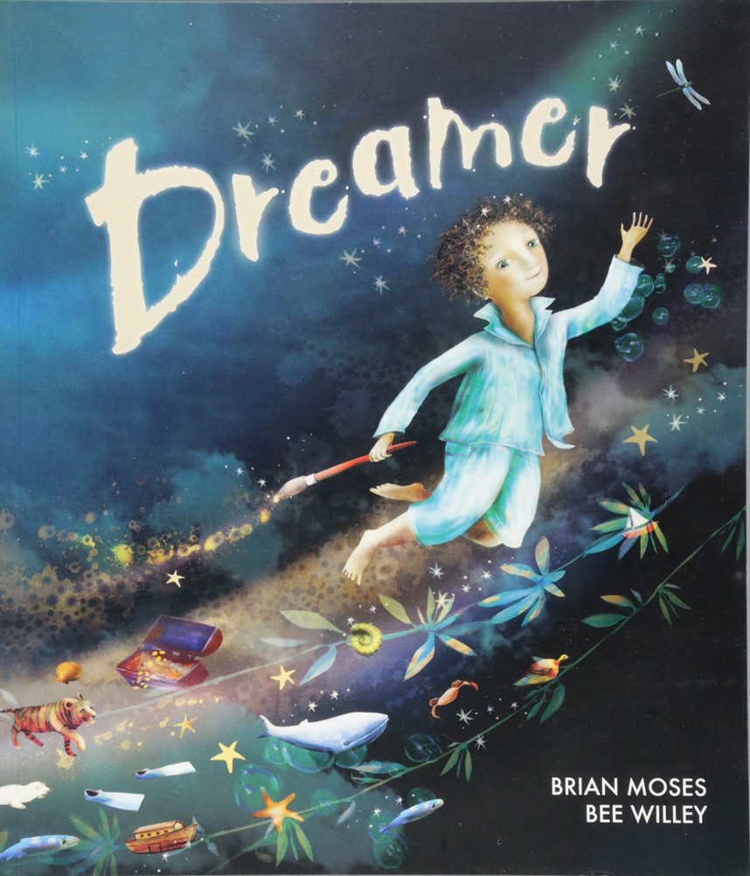

Slide 4
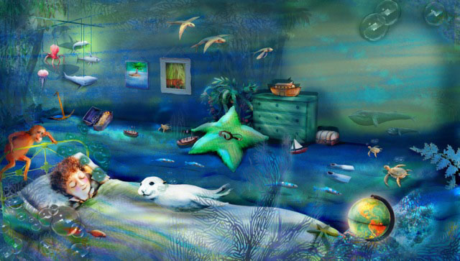
Once I had a dream, a special dream. A dream about our world.

Slide 5
I dreamt I was a whale,
And no hunters chased after me.

Slide 6
I dreamt I was a seal,
And no one wanted fur from me.

Slide 7
I dreamt I was a stream,
And no one poisoned me.

Slide 8
I dreamt I was a lake,
And no one filled me with junk.

Slide 9
I dreamt I was a valley,
And no one built a road across me.

Slide 10
I dreamt I was a rainforest,
And nobody felled a single tree.

Slide 11
I dreamt I was an elephant,
And nobody stole my ivory.

Slide 12
I dreamt I was a panda,
And no one took my territory.

Slide 13
I dreamt I was an island,
And no one ever discovered me.

Slide 15
Thursday
Task 1 – draw an illustration for your Dreamer poem that you wrote on Monday (see slide 26 for details).
Task 2 – to be able to complete a venn diagram (see slides 17 to 19)
Task 3- plants are essential for our air, so get some seeds from your local supermarket or garden centre (they can either we plants or vegetables, whichever Mum or Dad would prefer), plant them up and watch them grow. If you have grown vegetables and you eat them , you will have become self-sustainable! ☺

Slide 16
Look back at slides 4 to 13.
Do you notice how the illustrator has used soft natural colours with blurred lines/edges?
See if you can replicate this style when drawing an illustration for your Dreamer poem.

Slide 17
This is an example of a 3 circle venn diagram.
I would like you to print off the venn diagram on slide 18 and then input the data, which is on slide 19, onto the venn diagram. You may need to Google search some of the items.

Slide 18
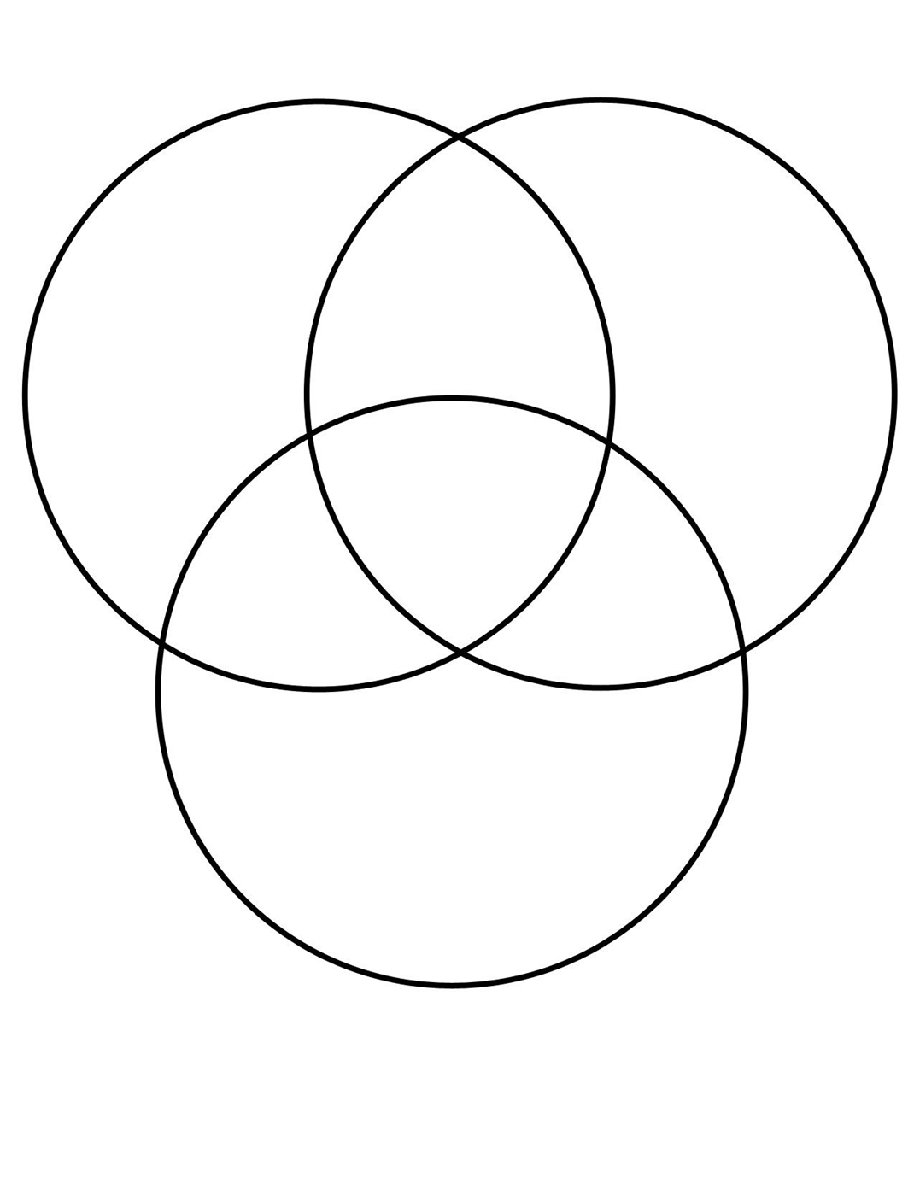
biodegradable
recycle
non biodegradable

Slide 19
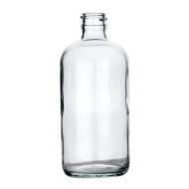
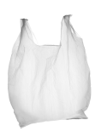
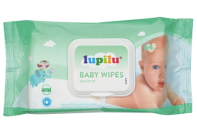
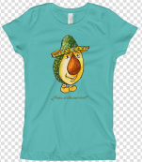
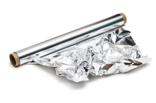
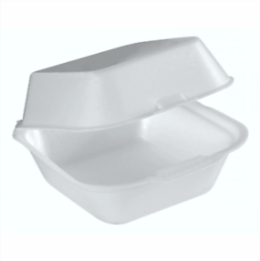
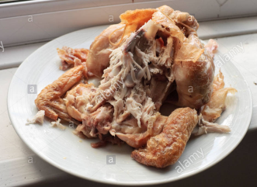
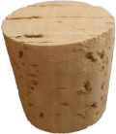
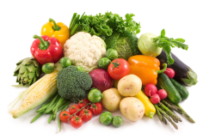
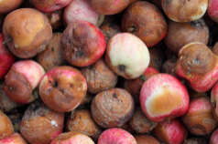
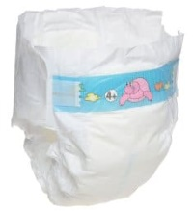
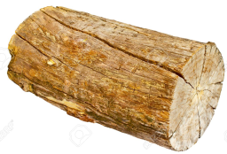
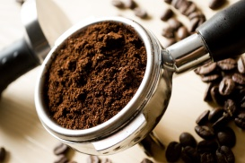
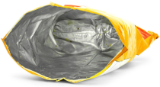
M
Glass bottle tin foil aerosol plastic bag inner of toilet roll baby wipes t-shirt
Concrete cork polysterene vegetables rotten apples chicken carcass
Crisp packet tin can nappy toothbrush battery wood ground coffee

