Slide 1
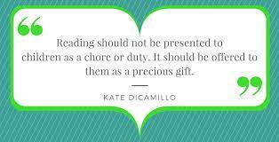
Reading at Ellington Primary School
Key Stage One
Tuesday 10th October 2023

Slide 2
What have I just seen?
Year 1 - You will have joined your child in their current phonics group and been part of a “Speed Sounds” session as well as possibly hearing their book for the week being modelled.
Year 2 - Some of you will have joined your child in their current phonics group and also been part of a “Speed Sounds” session as well as possibly hearing their book for the week being modelled.
Others will have been part of our reading comprehension lessons. Here, you should have been involved in reading some of the class novel and discussing questions about it.

Slide 3
Why Read, Write, Inc Phonics?
Teach a child to read and keep that child reading and we will change everything.
And I mean everything.
Jeanette Winterson

Slide 4
Why Read, Write, Inc Phonics?
44 sounds
26 letters
Over 150+ graphemes (letter combinations)
One of the most complex alphabetic codes in the world.

Slide 5
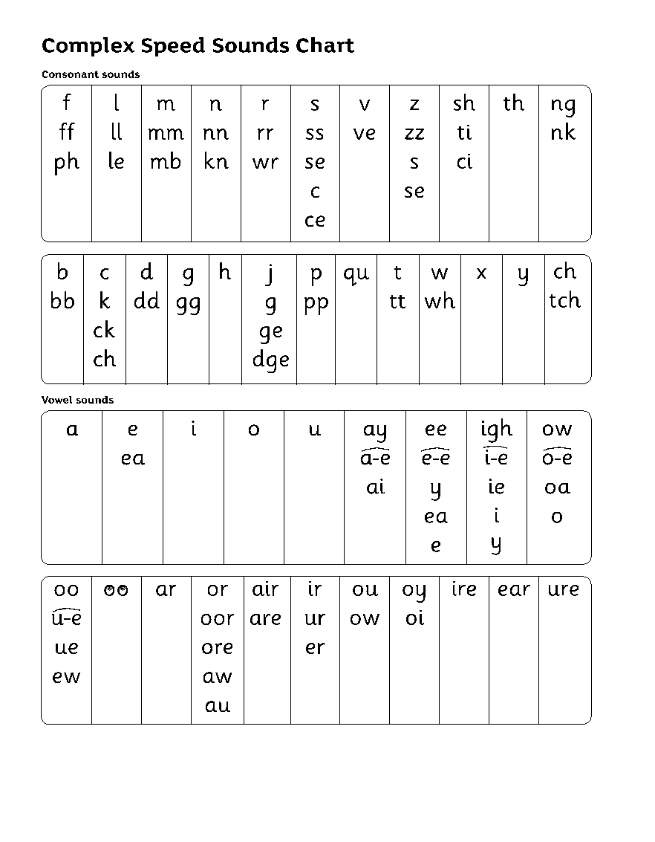
Why Read, Write, Inc Phonics?
Group children by phonic stages.
Teach to the group’s challenge level.
Re-assess all children every half term.

Slide 6
Why Read, Write, Inc Phonics?

Slide 7
Reading Comprehension at Ellington Primary
Exciting, language-rich class novel
Teachers encouraging expression and enthusiasm
Opportunities for children to read aloud
Verbal discussions and questions that target a range of skills
Written activities to develop specific skills
Practical activities e.g. “Role on the Wall”, Readers’ Theatre, drama
Fortnightly “unseen” texts and questions

Slide 8
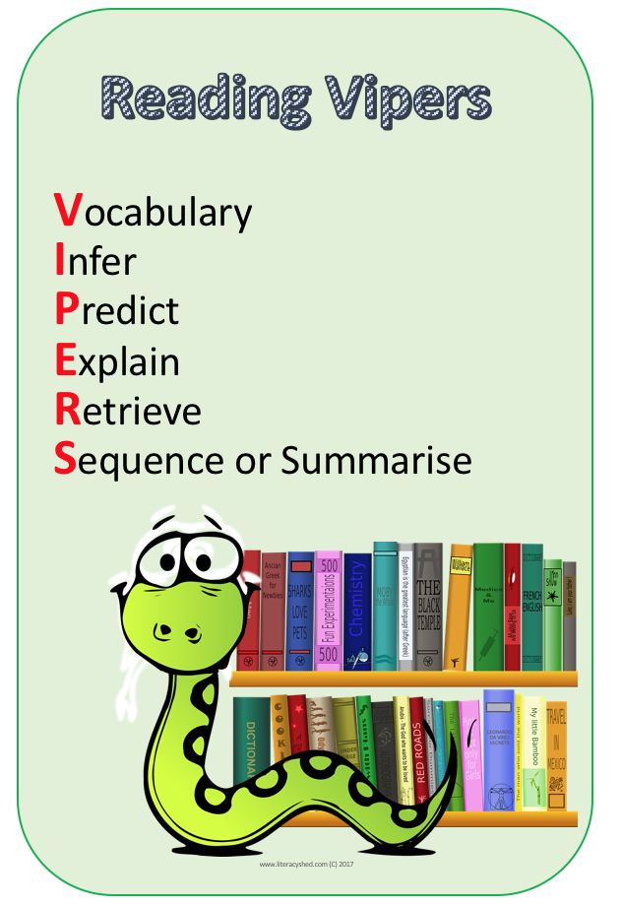
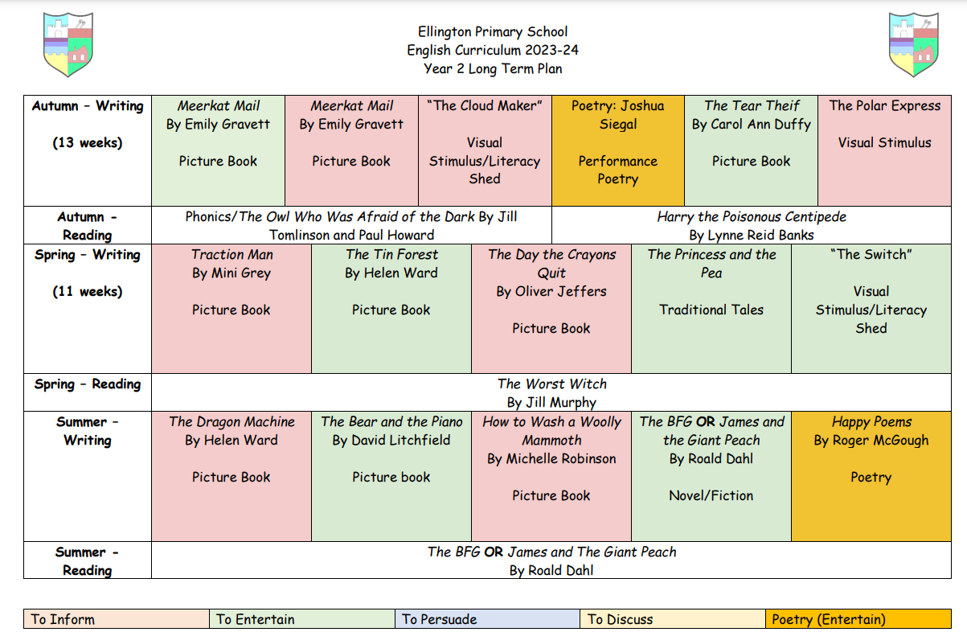
Reading Comprehension at Ellington Primary

Slide 9
Opportunities to read at Ellington
Daily reading or phonics session (30 - 45 mins)
Morning reading when the children come in
Daily storytime following lunch
Books tied into our English lessons
Cross-curricular reading
Library times
Reading interventions

Slide 10
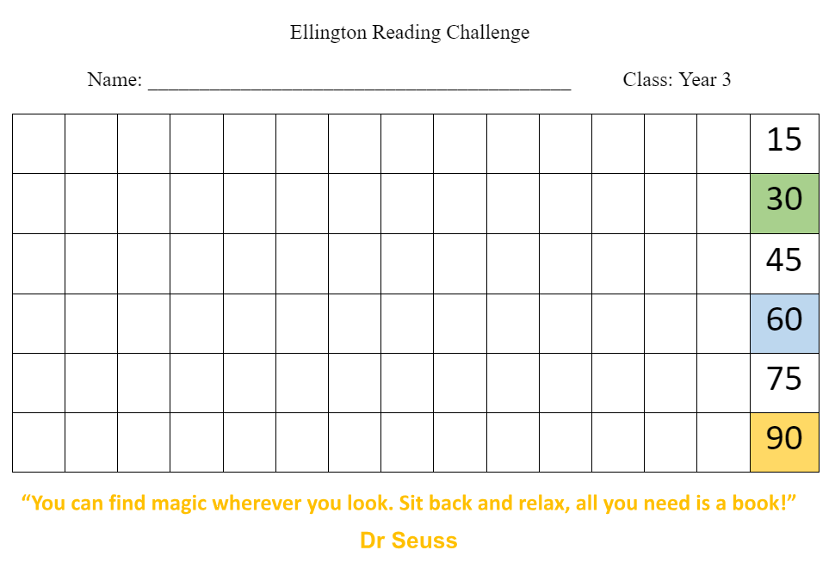
Home Reading
Phonics - 1 storybook, 1 book bag book, 1 reading for pleasure book
After that - Accelerated reader book and, if they like, a reading for pleasure book from school or home. To change their book, must score 80% or more on their quiz.
Rewards in School
Children must read 3 times a week but 5 is the
ideal. Children can earn stamps on their rewards
grid and earn prizes throughout the year.

Slide 11
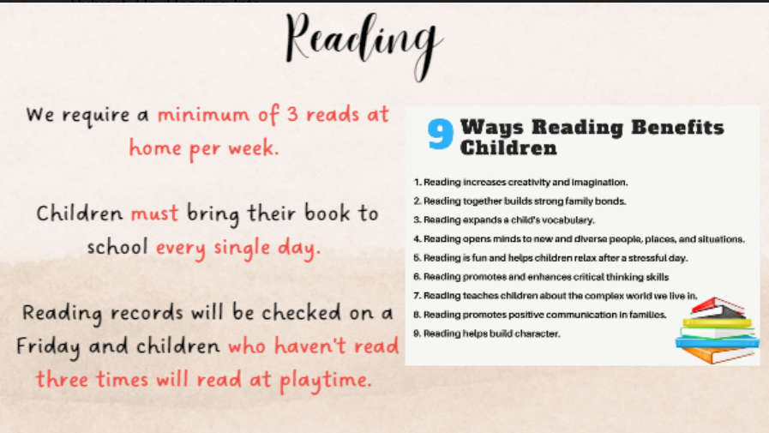

Slide 12
Why read to your child?
A study says parents who read to their children are not only strengthening their bond but also increasing their chances at school. The study shows that kids who are read one short book a day enter their first school years hearing almost 300,000 more words than those whose parents didn’t read to them at all. Of course, when parents read more than one book, the number increases again; five books per day increases their vocabulary by 1.4 million words!
Never read to - 4,662 words
1-2 times per week - 63,570 words
3-5 times per week- 169,520 words
Daily - 296,660 words
Five books a day - 1,483,300 words.

Slide 15
If books are lost, this comes at a great expense to the school. Therefore, the following charges will be applied:
Reading record - £1
Spelling log book - £2
Reading book - £5

Slide 16
Ruth Miskin Parents’ Page:
https://www.ruthmiskin.com/parents/
Ruth Miskin Facebook:
https://www.facebook.com/miskin.education
Free e-books for home reading:
http://www.oxfordowl.co.uk/Reading/
Visit the English page on our website:
http://www.ellingtonprimaryschool.co.uk/web/english/636481

