Slide 1
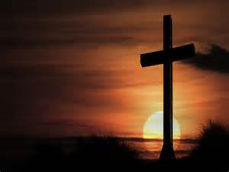
Religious education

Slide 2
How is a Torah scroll made?
How is the Torah revered?

Slide 3
Torah means "teaching" and refers to the five books of Moses – Genesis, Exodus, Leviticus, Numbers and Deuteronomy.

Slide 4
A Torah scroll is made from sheets of parchment, which is made from the skin of a kosher animal.
It is written by hand in Hebrew by a professional scribe, called a sofer. Hebrew is read right to left.

Slide 5
The sofer takes at least one year to write out the Torah.
He is not allowed to write from memory. He must copy from a book of the Torah, and keep checking for mistakes. Letters must not be smudged or touch another letter.

Slide 6
If the sofer makes a mistake, he scrapes off the letters using a glass tool.
The most sacred word that he writes is the Hebrew name for God. He cannot correct this – he must start the whole sheet of parchment again. The sheet with the error on is buried in a Jewish cemetery.

Slide 7
When all the sheets of parchment are finished, they are sewn together and wound around wooden rollers.
The Torah is regarded as holy, and is decorated as beautifully as possible.

Slide 8
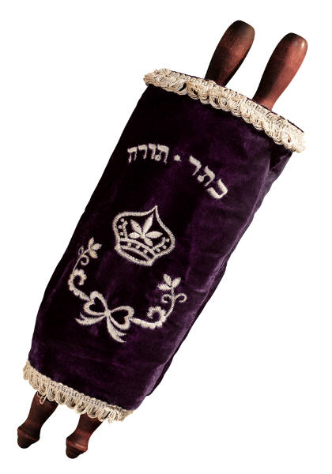
It has a velvet cover called a mantle.
A silver breastplate is hung on the front of it, like the one worn by High Priests in Biblical times.
This is decorated with Jewish symbols.

Slide 9
Bells are attached so people hear it being carried around the synagogue.
There is also a silver pointer called a yad.

Slide 10
A yad (meaning hand) is used by Jews to keep their place when reading from the Torah scroll. They are not allowed to touch the Torah with their hands.
This is to show respect for the scroll and to prevent the parchment being spoiled by oil from their fingers.

Slide 11
When the Torah is not being used, it is kept in a special cupboard at the front of the synagogue, called an Ark.
This reminds Jews of the Ark of the Covenant in which Moses and his people carried the Ten Commandments.

Slide 12
Can you remember how a Torah is made?
Can you remember how it is decorated?
How do the Jews show they revere the Torah?

Slide 13
Your Task
Can you make a Torah? What would you like people to do in their lives? Would you like them to show kindness to others? Would you like them to pray? Would you like them to give to charity? You decide what you would like people to do in their lives to make this a nice world.

