Slide 2
Aim
To carry out an inquiry to answer a question.
To use my results to make new predictions.
Success Criteria
I can describe Leonardo da Vinci’s inventions.
I can describe what da Vinci’s Vitruvian Man shows us about the human body.
I can carry out an inquiry to test the accuracy of the Vitruvian Man.
I can record my results accurately.
I can explain what my results show.
I can predict information by looking for patterns in my results.

Slide 3
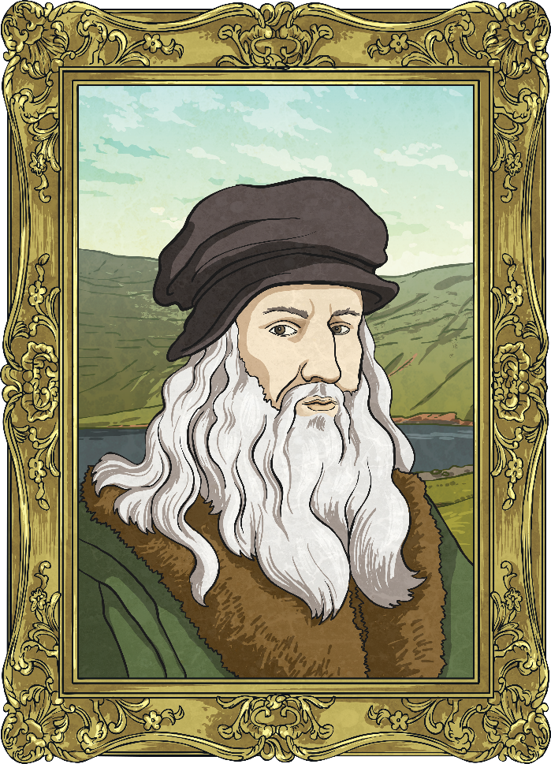
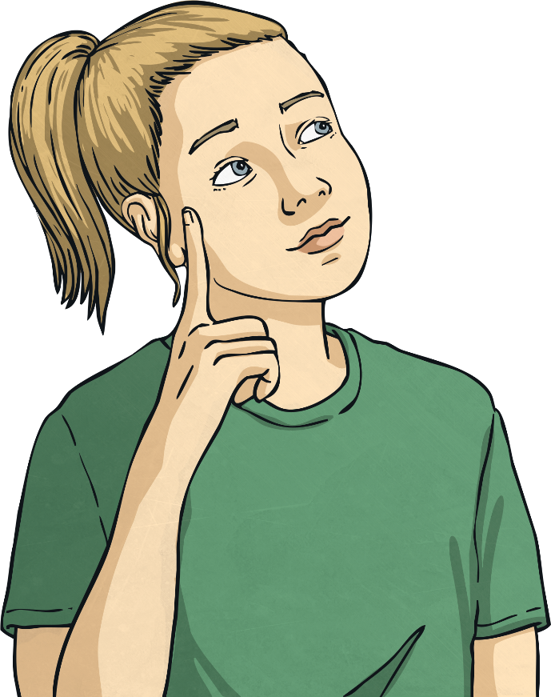
Who Was Leonardo da Vinci?
You may have heard of Leonardo da Vinci or his works. Do you already know any facts about him?

Slide 4
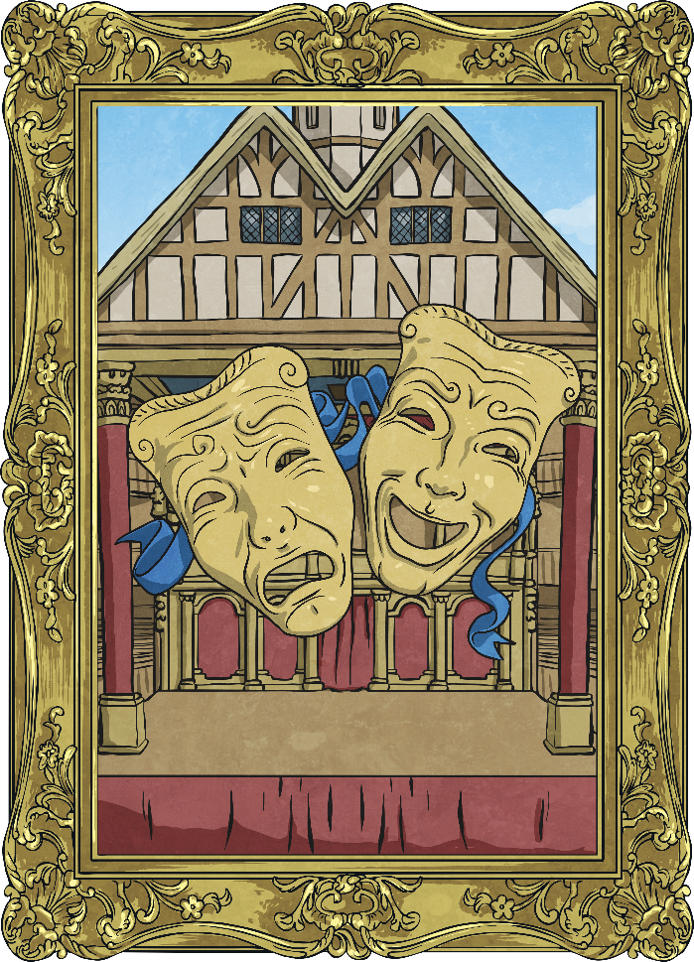
Leonardo da Vinci?
Leonardo da Vinci was an artist, scientist and inventor who lived in Italy. He was born in 1452 and died in 1519.
This time period in Europe is known as the Renaissance. It was a time when many advances were made in education, science, art, literature and music.
Da Vinci is sometimes called a 'Renaissance Man'. This is because he was a master of many different areas. He was an expert painter, sculptor, architect, engineer, scientist, inventor and writer!
Leonardo da Vinci is considered by many people to be one of the most intelligent people of all time.

Slide 5
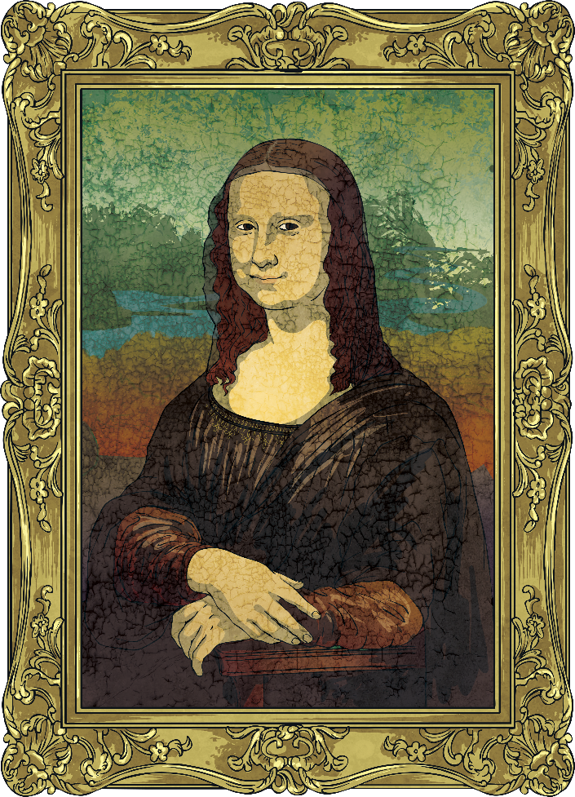
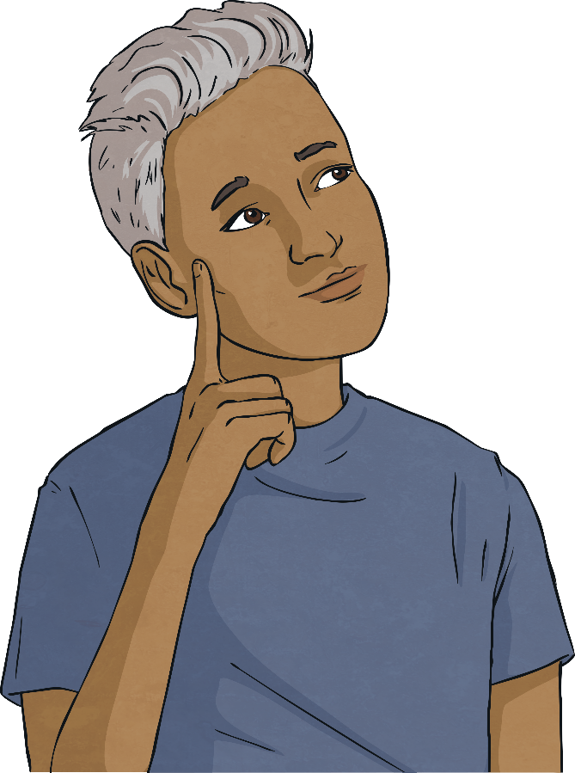
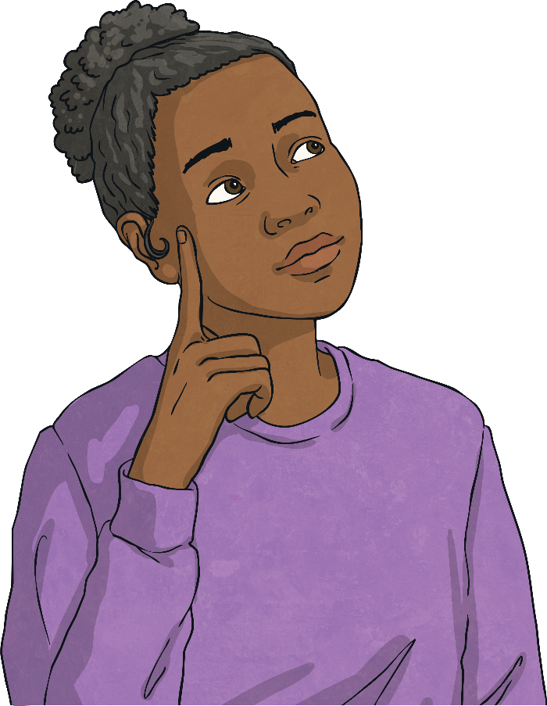
What Is da Vinci Famous For?
This may be da Vinci's most famous painting. Do you recognise it? Do you know what it is called?
It is called The Mona Lisa.
Do you know where it is on display?

Slide 6
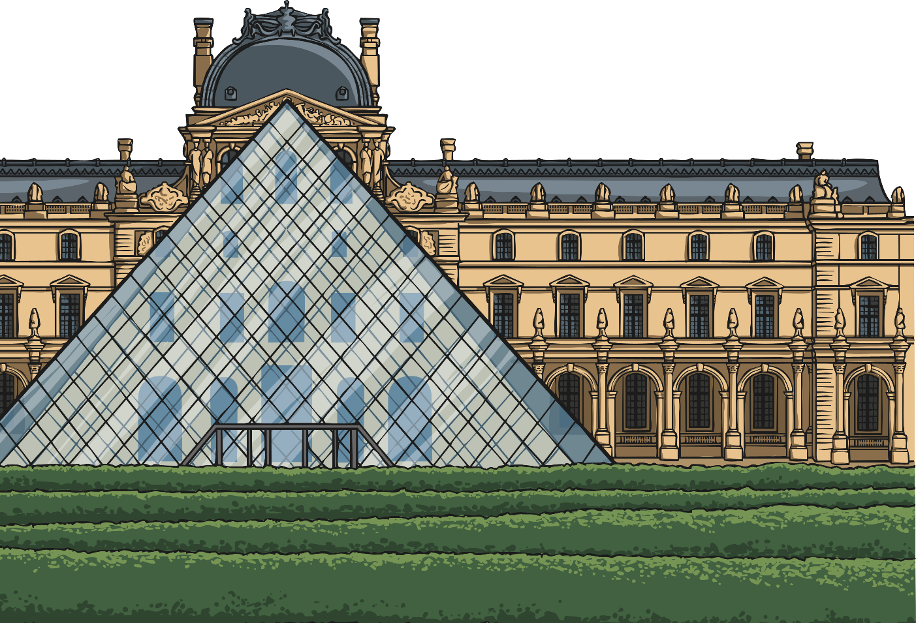
What Is da Vinci Famous For?
The Mona Lisa is on display in the Louvre Museum in France. Some consider it to be the best known and most visited work of art in the world.
Da Vinci created many more works of art, including the painting of ‘The Last Supper’ in Milan.

Slide 7
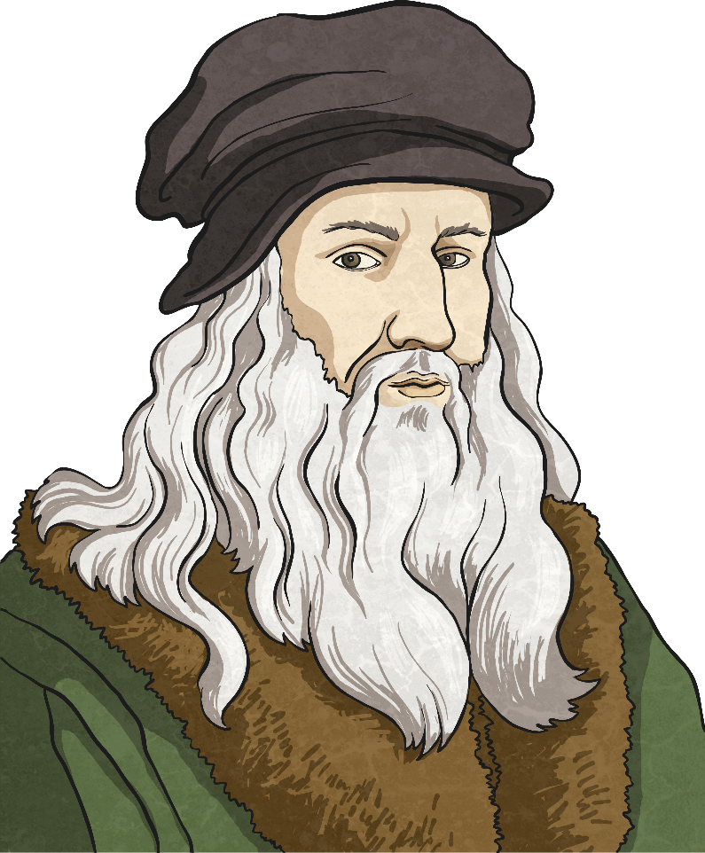
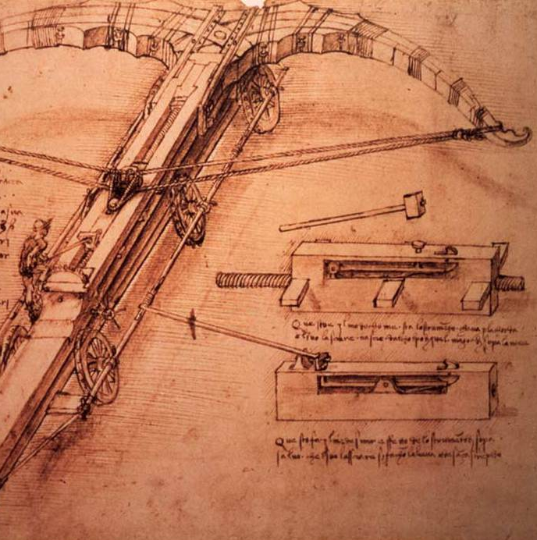
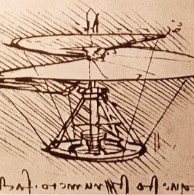
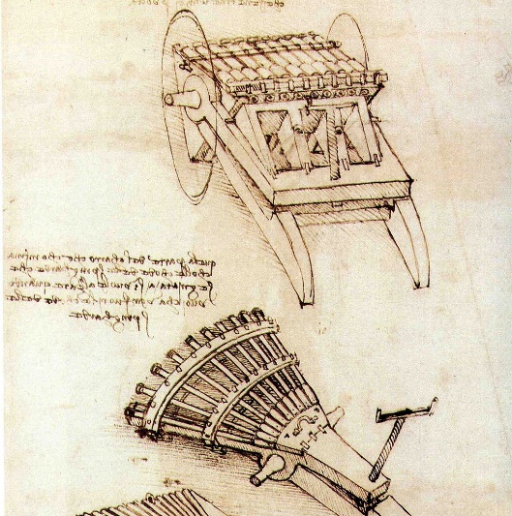
What Is da Vinci Famous For?
Da Vinci is also famous for his sketches of his inventions. This sketch is of his 'Helical Air Screw', which was a flying machine. It was designed to work in a similar way to modern-day helicopters.
Da Vinci sketched many other designs for inventions, including a diving suit, a machine gun and an armoured chariot.

Slide 8
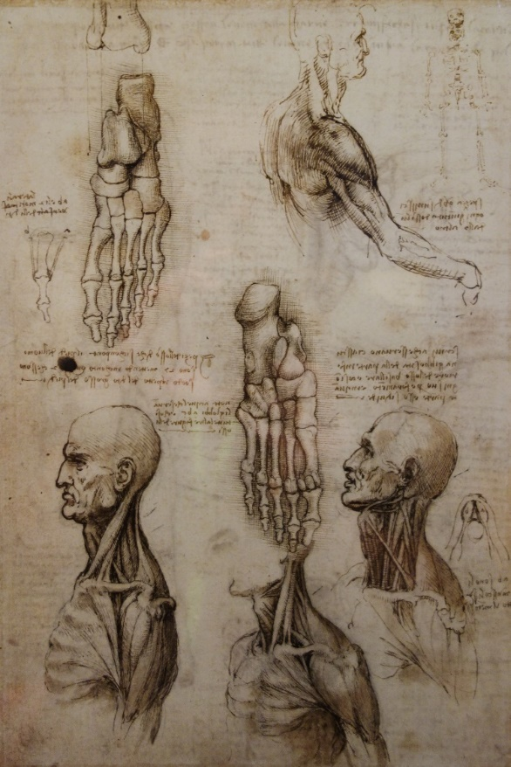
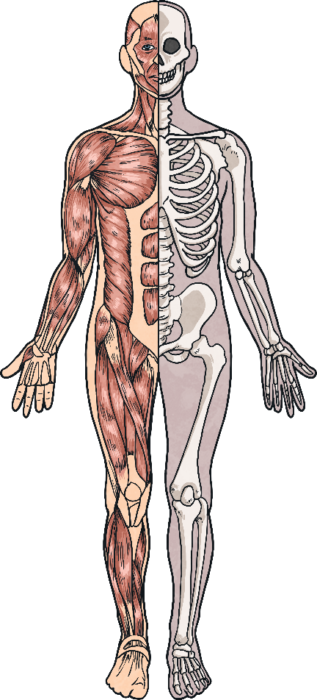
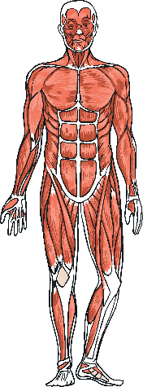
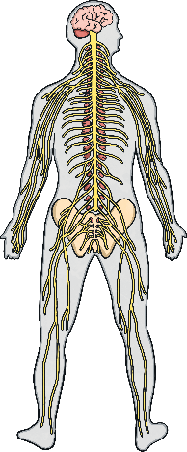
What Is da Vinci Famous For?
Anatomy, or the structure of the human body, was another of da Vinci's interests. He wanted to understand how the human body worked, and made thousands of pages of notes and sketches.
Scientists today recognise that da Vinci's work was hundreds of years ahead of its time.

Slide 9
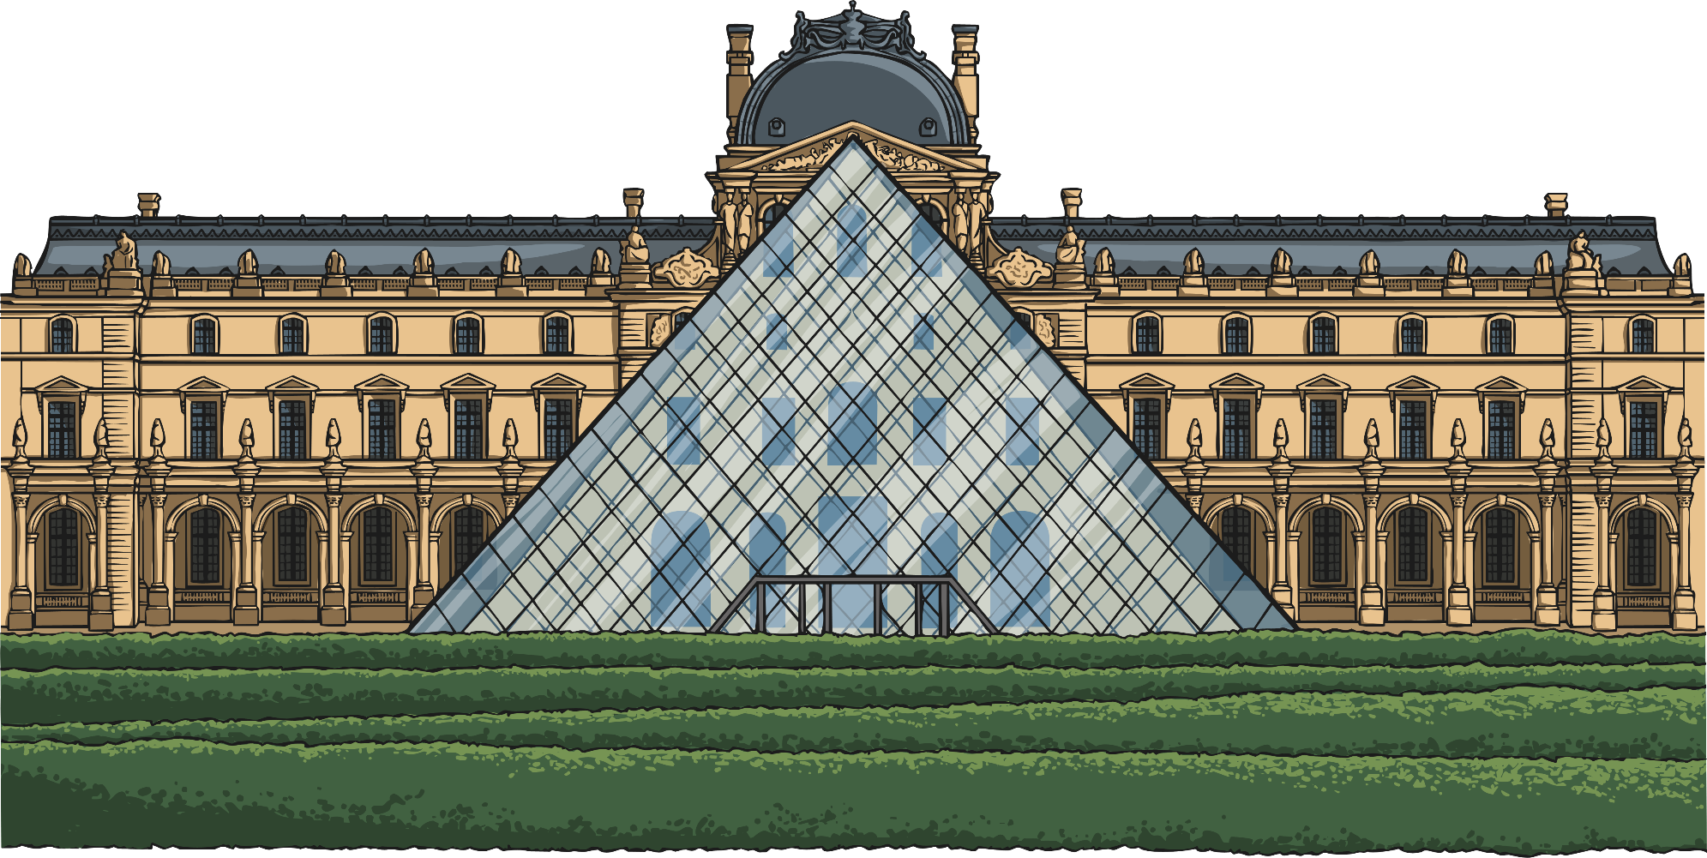
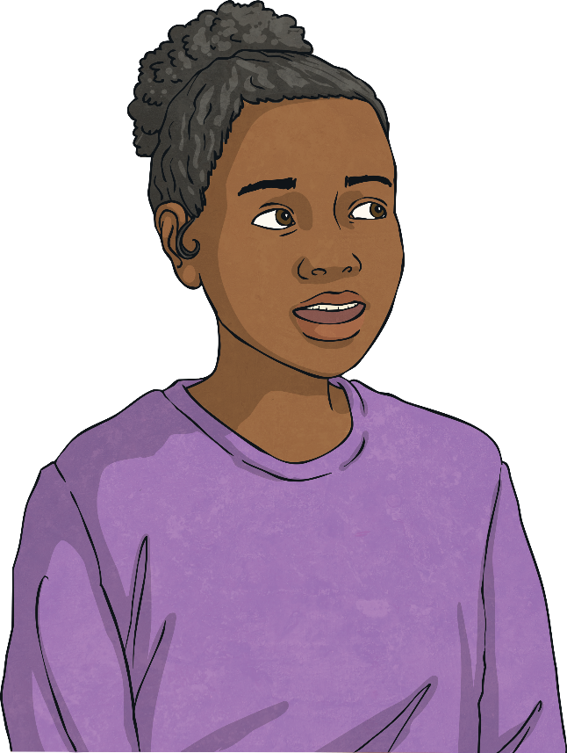
True or False
Read these statements about Leonard da Vinci's life and work. Two of the statements are true and one is false! Click on the questions to reveal the answers.
Leonardo da Vinci's painting 'The Last Supper' is on display in the Louvre in France.
'The Last Supper' is in its original spot, covering an end wall of the dining hall at the monastery of Santa Maria delle Grazie in Milan, Italy.
It is actually Leonardo da Vinci’s painting, ‘The Mona Lisa’ which is on display in the Louvre.
False
Da Vinci was a master of many different things, including painting, sculpture and engineering.
True
Da Vinci lived in Italy.
True

Slide 10
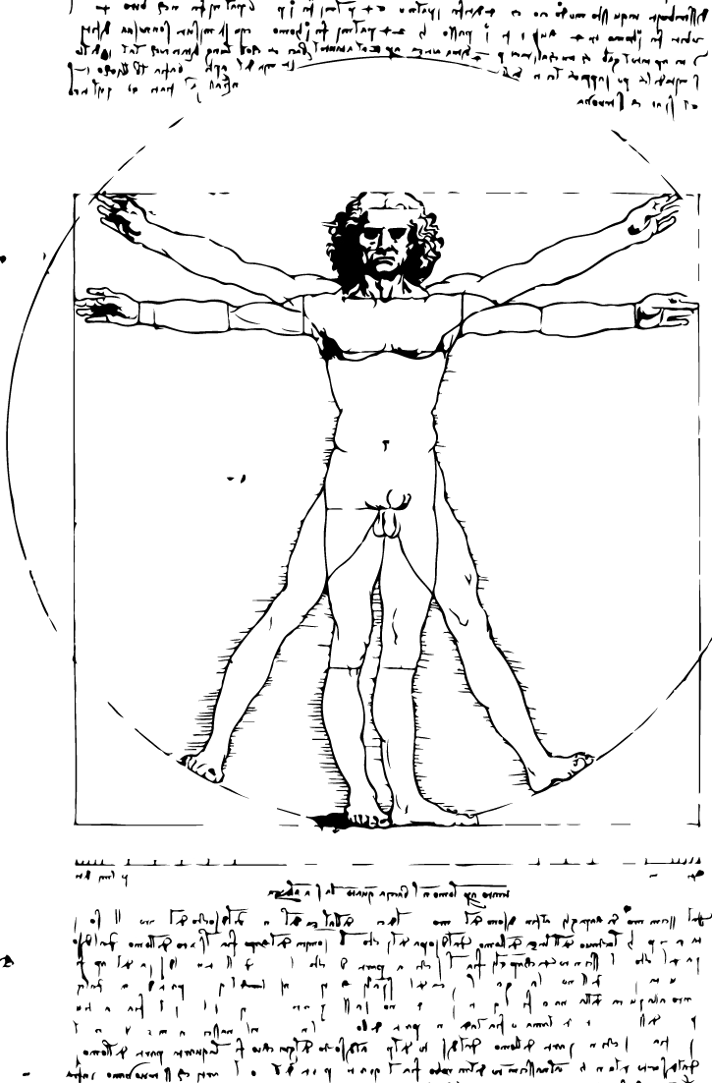
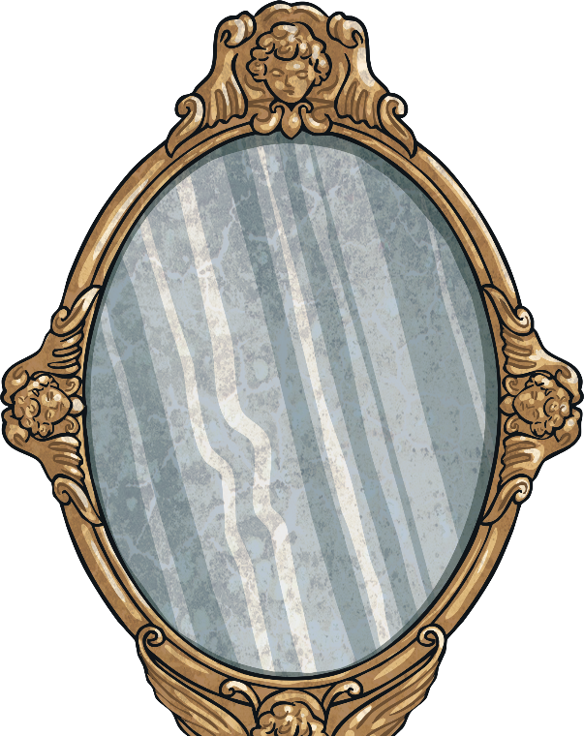
The Vitruvian Man
'The Vitruvian Man' is an ink drawing by Leonardo da Vinci. It shows a man in two superimposed positions.
The drawing is based on da Vinci's ideas about the proportions of the human body, and da Vinci describes these proportions in his notes around the drawing.
Interestingly, da Vinci always wrote his notes in mirror writing!

Slide 11
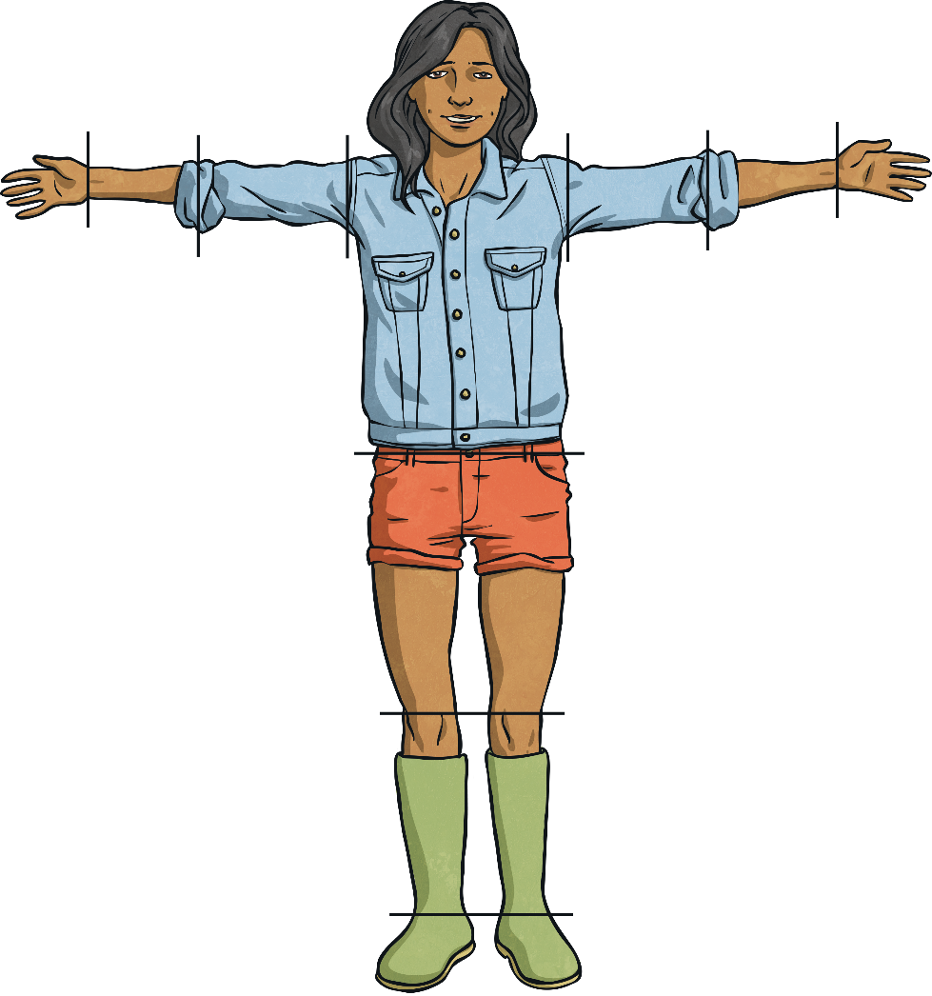
The Vitruvian Man
Da Vinci's notes state that:
The length of the outspread arms is equal to the height of a man.

Slide 12
The Vitruvian Man
Da Vinci's notes state that:
The length of a hand is one tenth of the height of a man.

Slide 13
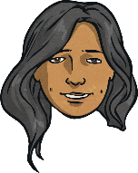
The Vitruvian Man
Da Vinci's notes state that:
The distance from the top of the head to the bottom of the chin is one eighth of the height of a man.

Slide 14
The Vitruvian Man
Da Vinci's notes state that:
The distance from the elbow to the armpit is one eighth of the height of a man.

Slide 15
The Vitruvian Man
Da Vinci's notes state that:
The distance from the elbow to the tip of the hand is one fifth of the height of a man.

Slide 16
Is It Accurate?
Look again at da Vinci's ideas about the proportions of the human body.
The length of the outspread arms is equal to the height of a man.
The length of a hand is one tenth of the height of a man.
The distance from the top of the head to the bottom of the chin is one eighth of the height of a man.
The distance from the elbow to the armpit is one eighth of the height of a man.
The distance from the elbow to the tip of the hand is one fifth of the height of a man.
The maximum width of the shoulders is one quarter of the height of a man.
Do you think they are accurate?
Think about your height, and whether his statements might be true for you. How could you check?

Slide 17
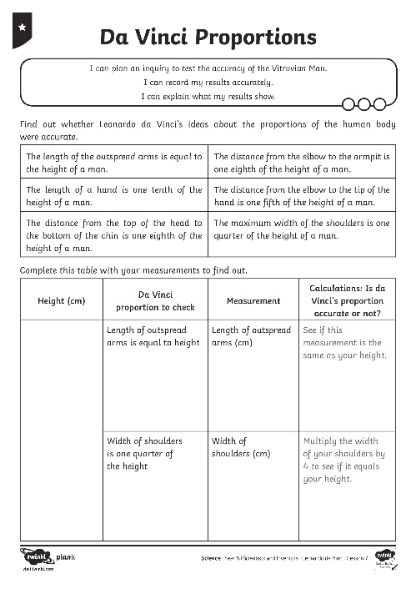
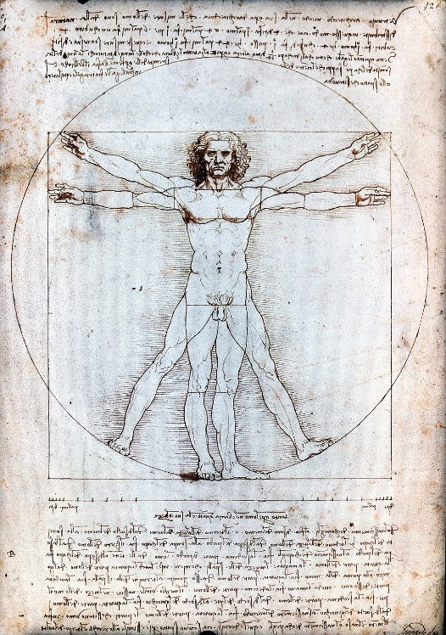
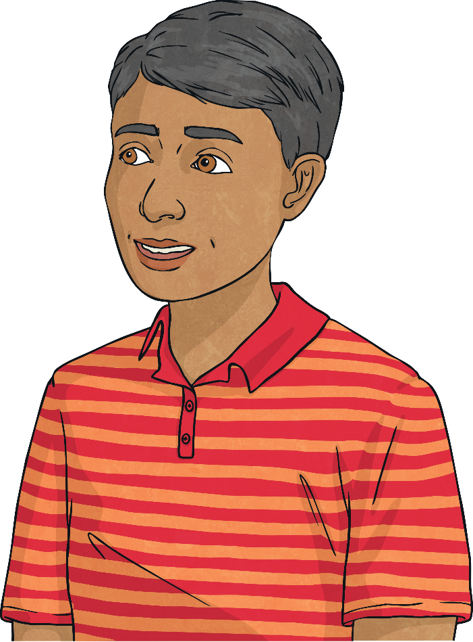
Measure and Check
You are going to find out if the proportions of the human body that da Vinci described in his Vitruvian Man are accurate for you!
Use your Da Vinci Proportions Activity Sheet to record your measurements and follow the instructions to work out whether da Vinci's ideas are accurate for you.

Slide 18
Explain Your Results
Look at your results. What did you discover? Were da Vinci's ideas about proportion accurate for you?
?

Slide 19
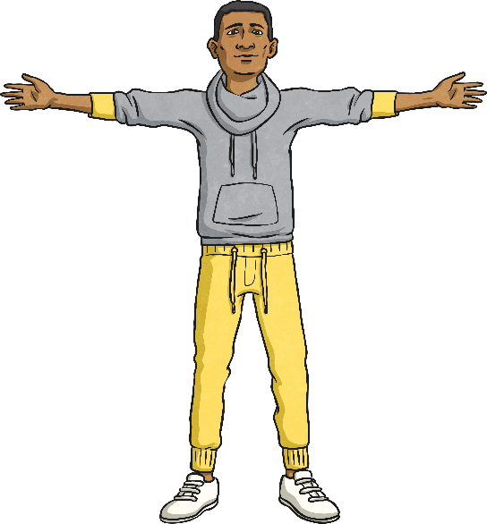
Making New Predictions
Did you find that da Vinci's ideas about the proportions of the human body were almost accurate for you? There will be some differences for everyone, because each person is unique! Da Vinci's proportions are just an approximate guide.
Can you predict the approximate height of these children using the measurement of their body parts and da Vinci's proportions?
Elena
Marcel
Length of hand: 14.1cm
Length of outstretched arms: 138cm

Slide 20
Making New Predictions
What did you predict?
Elena
Marcel
Length of hand: 14.1cm
Length of outstretched arms: 138cm
Height: 141cm
Height: 141cm

Slide 21
Aim
To carry out an inquiry to answer a question.
To use my results to make new predictions.
Success Criteria
I can describe Leonardo da Vinci’s inventions.
I can describe what da Vinci’s Vitruvian Man shows us about the human body.
I can carry out an inquiry to test the accuracy of the Vitruvian Man.
I can record my results accurately.
I can explain what my results show.
I can predict information by looking for patterns in my results.

