Slide 1
At Ellington Primary School …
We support many charities.
Here are the charities our school supports…

Slide 2
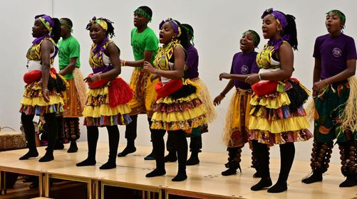
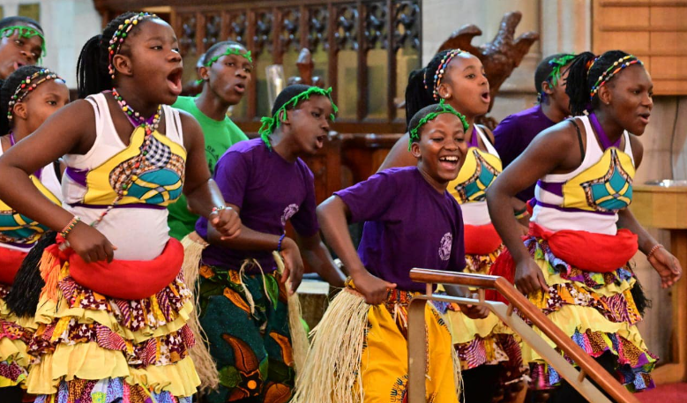
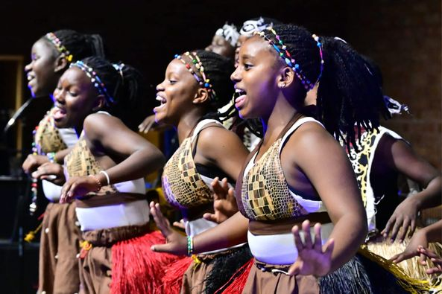
The Pearl of Africa Choir
The Pearl of Africa Choir - The Pearl of Africa Child Care Keeps Over 1,500 Children In School

Slide 3
Beyond Mental Health
Beyond is a youth mental health charity tackling the growing mental health crisis affecting young people in the UK.

Slide 4
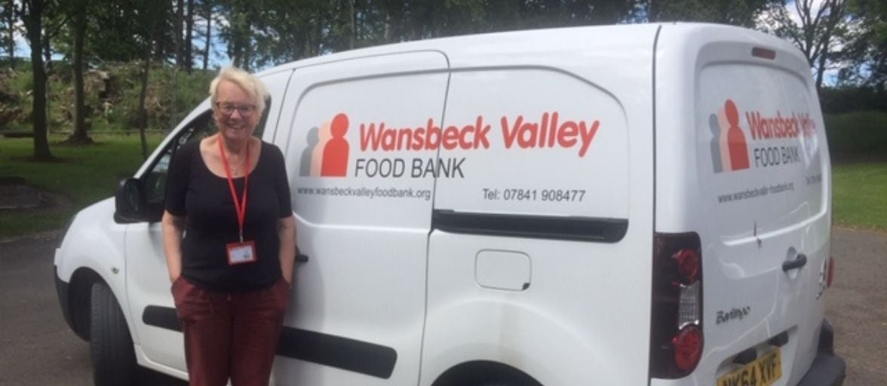
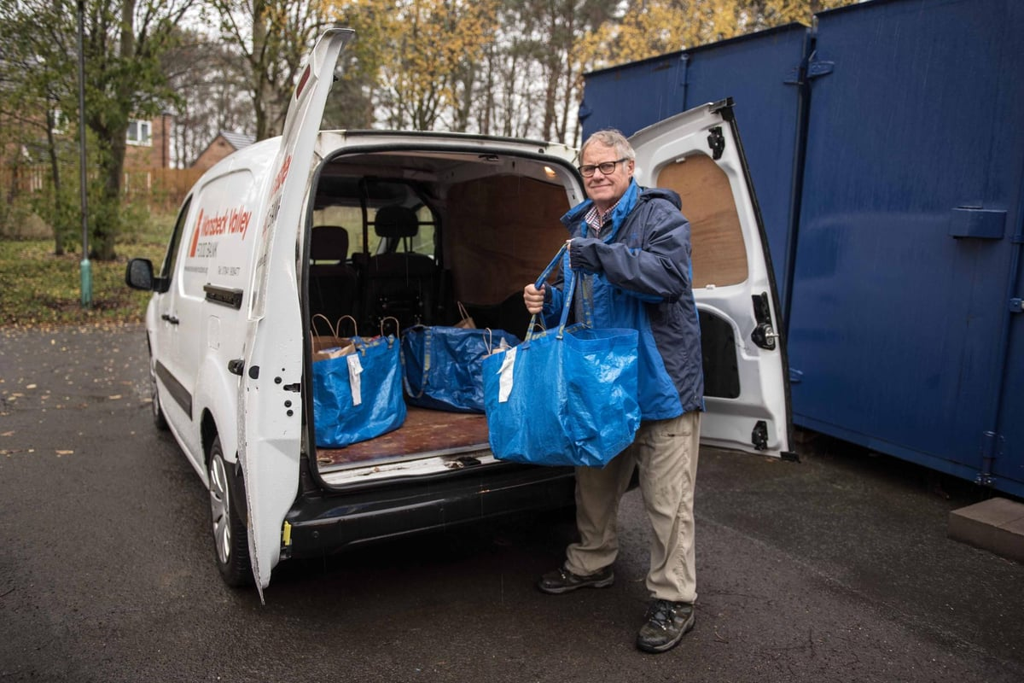
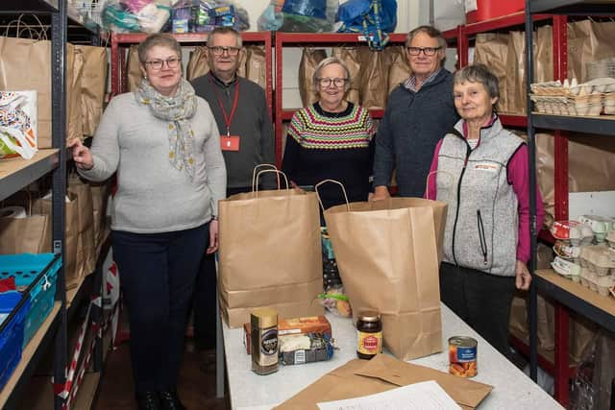
Wansbeck Valley Foodbank
The largest independent foodbank in Northumberland.

Slide 5
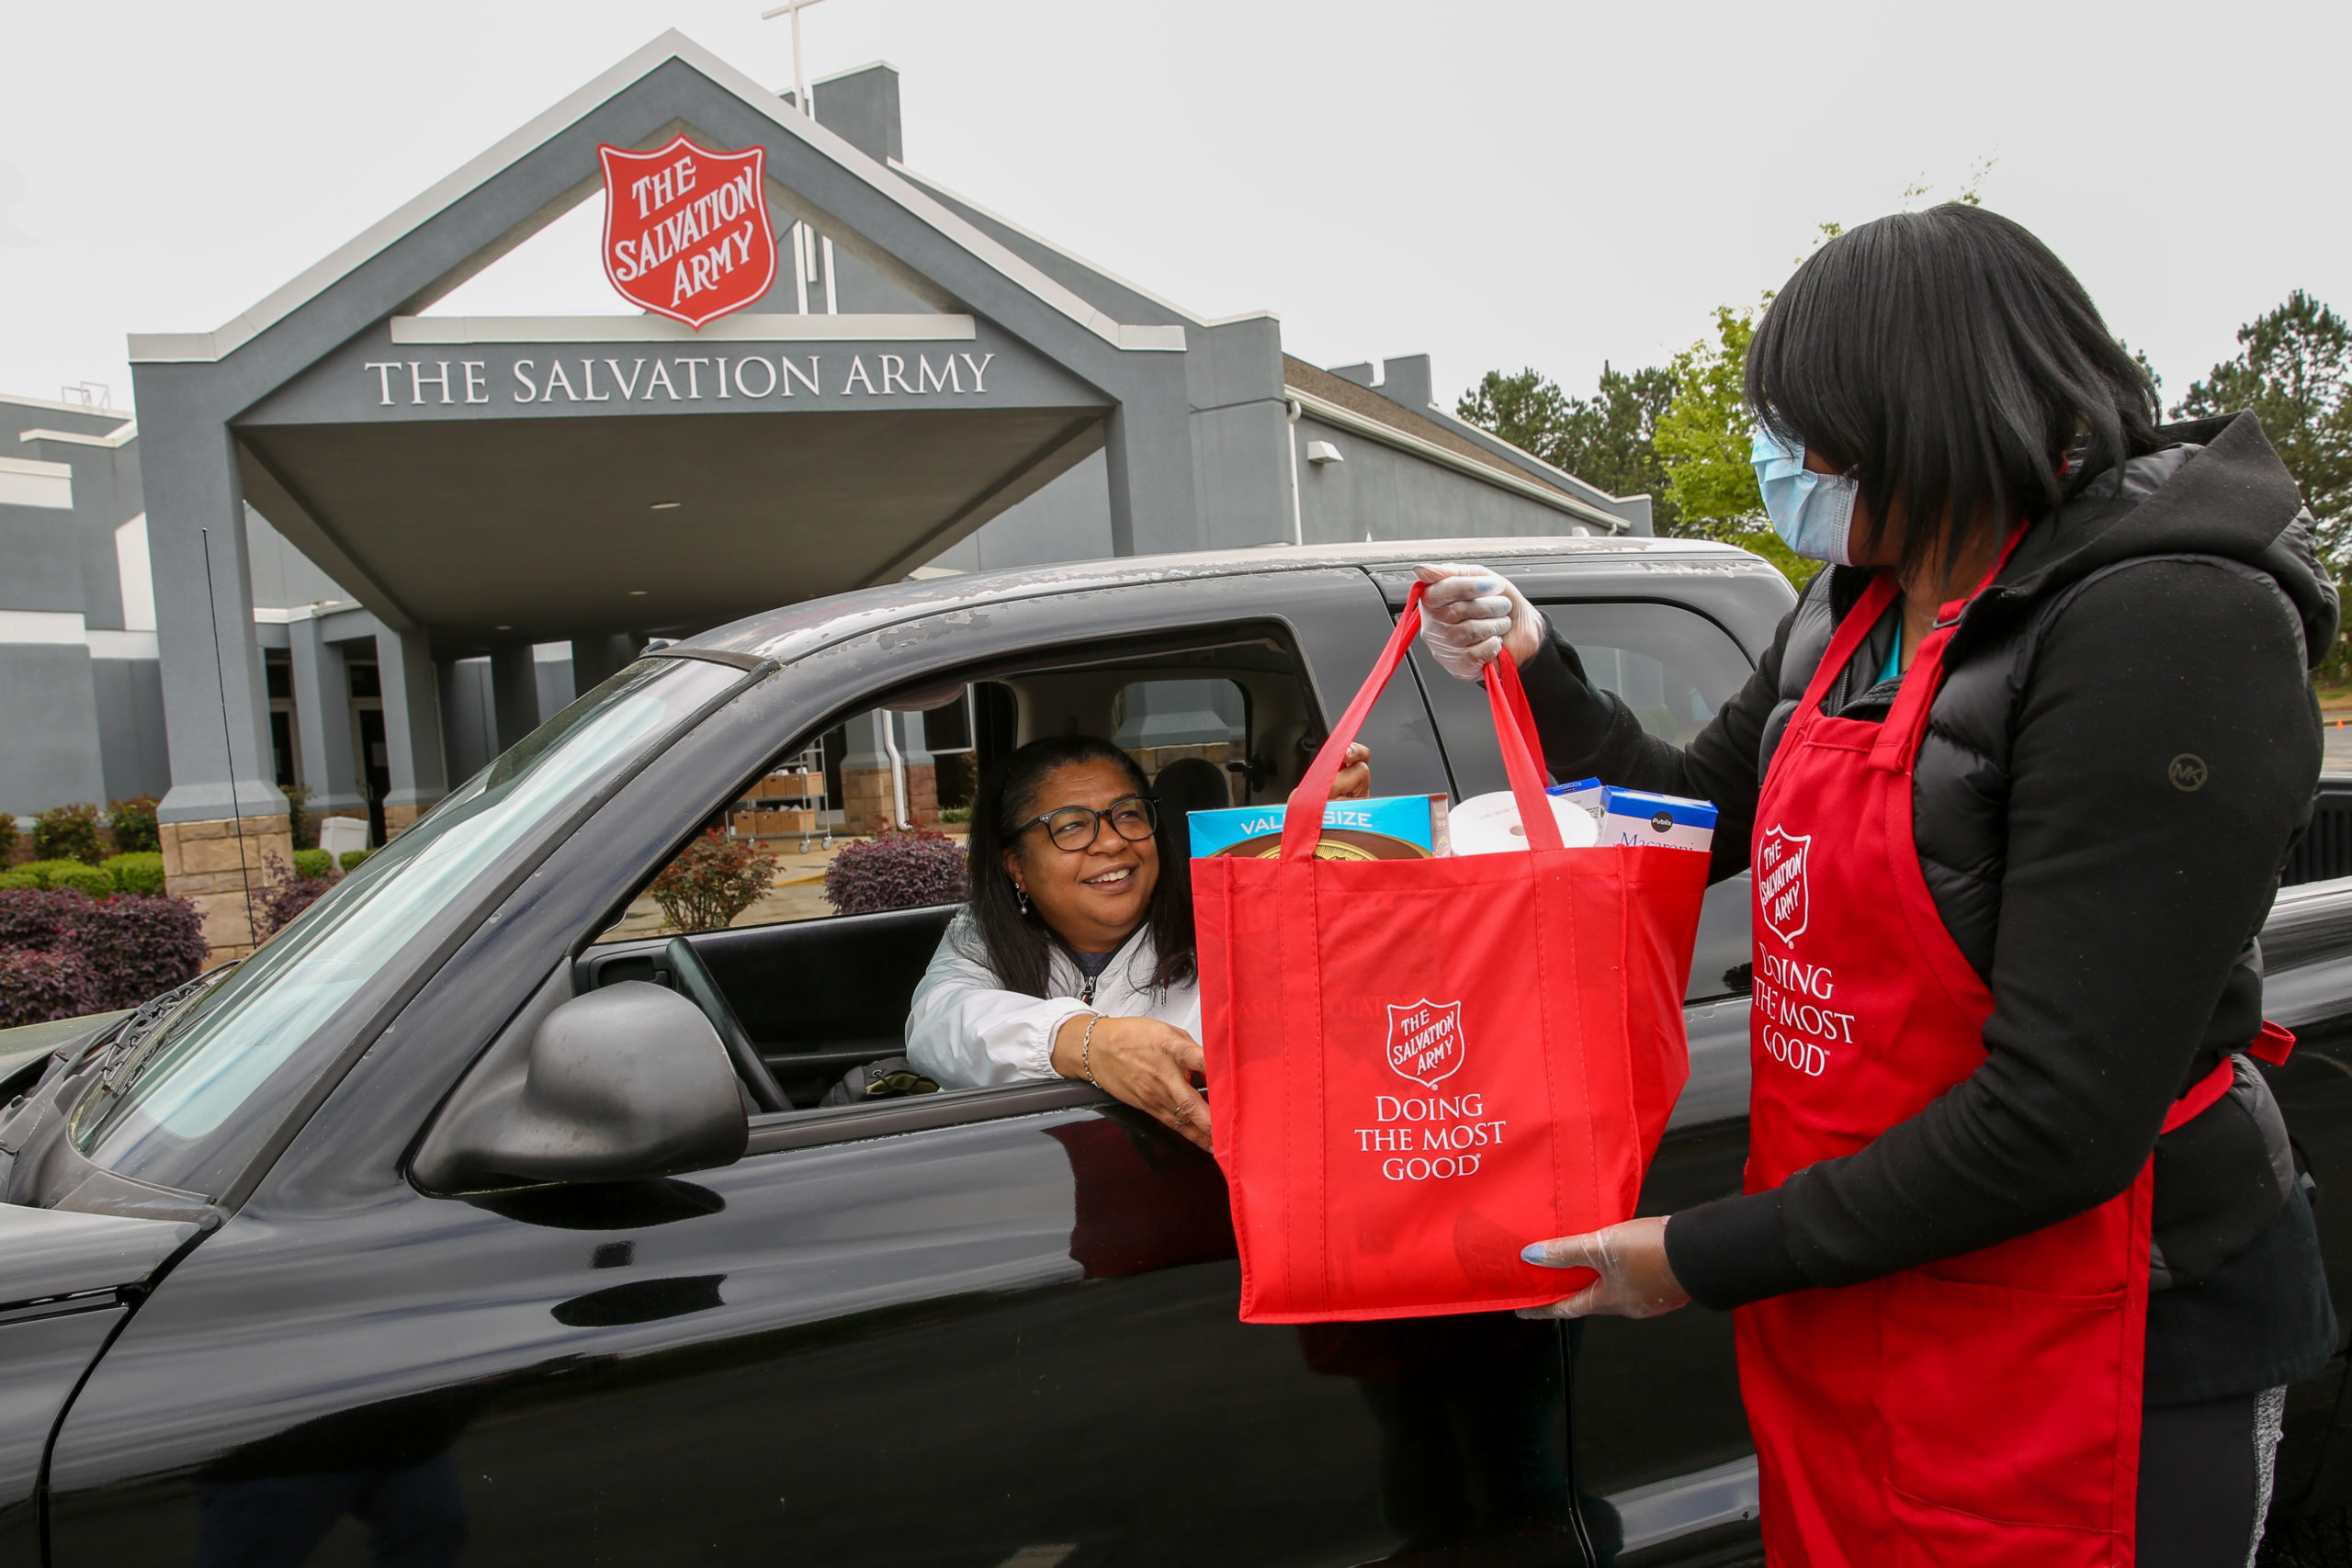
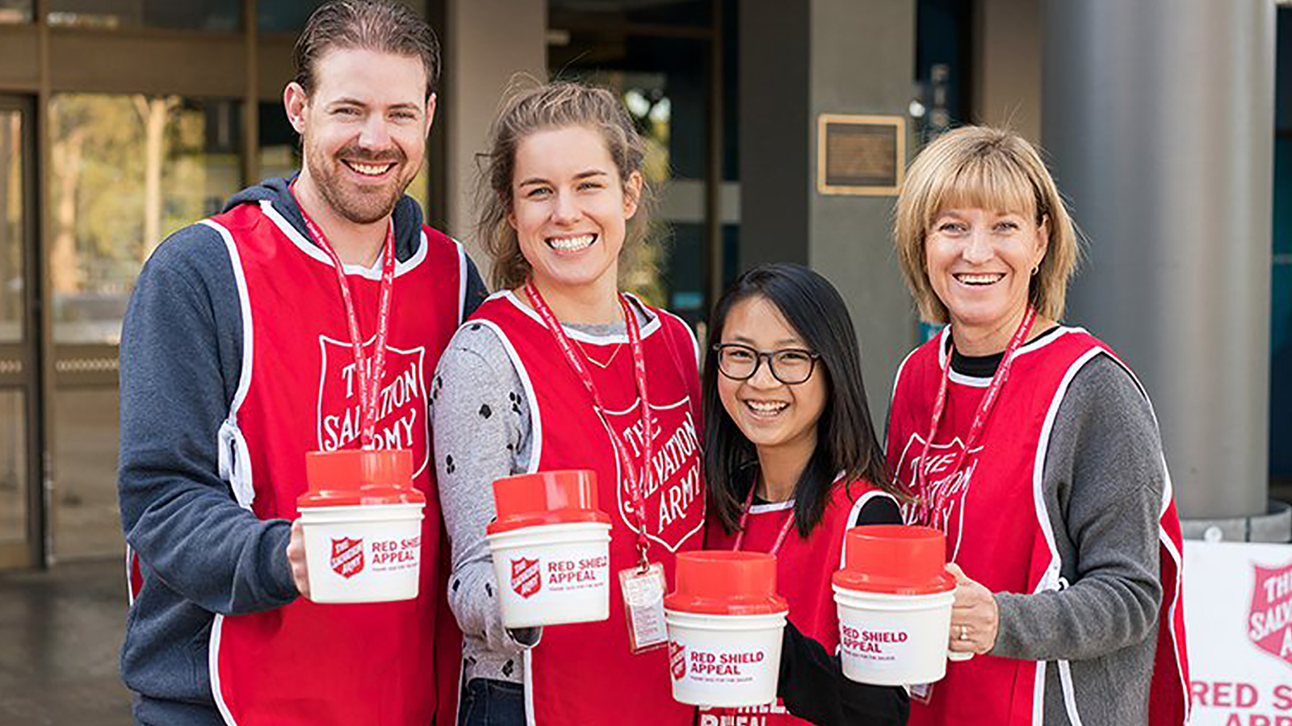
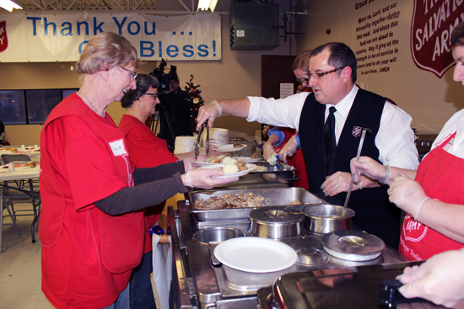
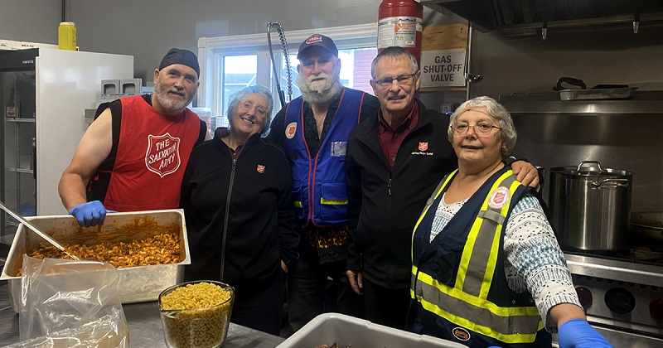
Salvation Army
The Salvation Army is a worldwide Christian church. Our mission is based on our faith in Jesus Christ who wants everyone to experience life in all its fullness.

Slide 6
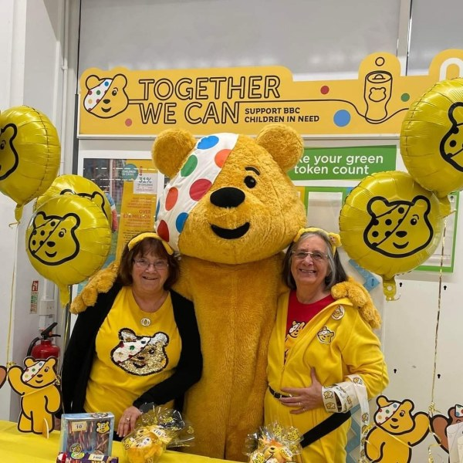
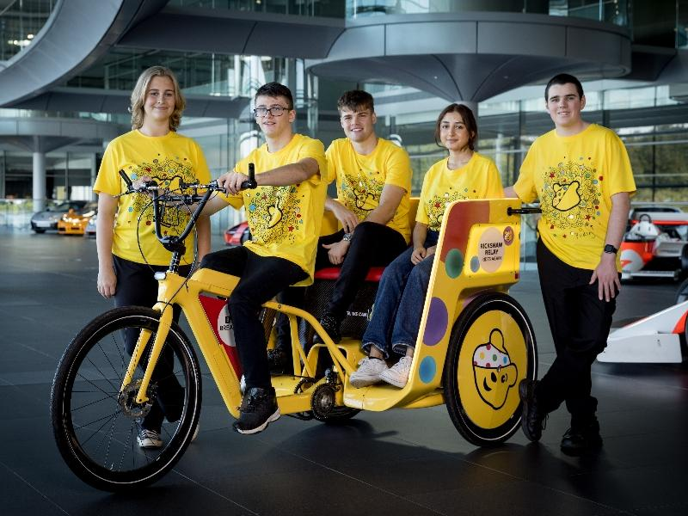
Children in Need
BBC Children in Need is currently supporting over 2400 local charities and projects in communities across the UK

Slide 7
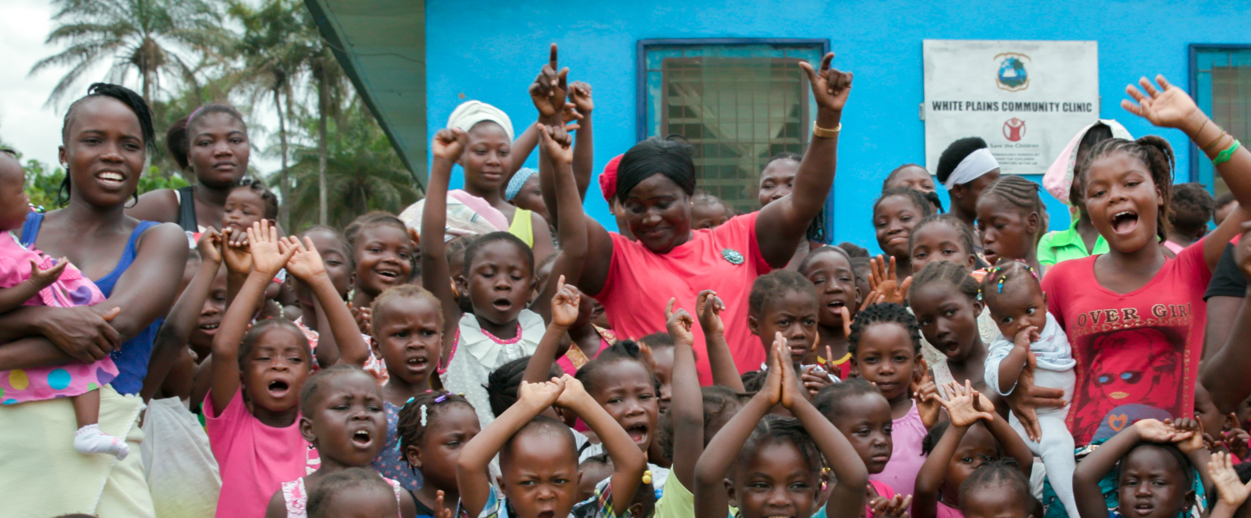
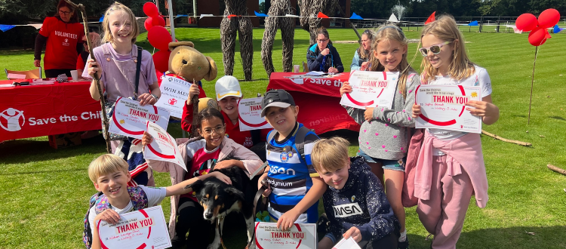
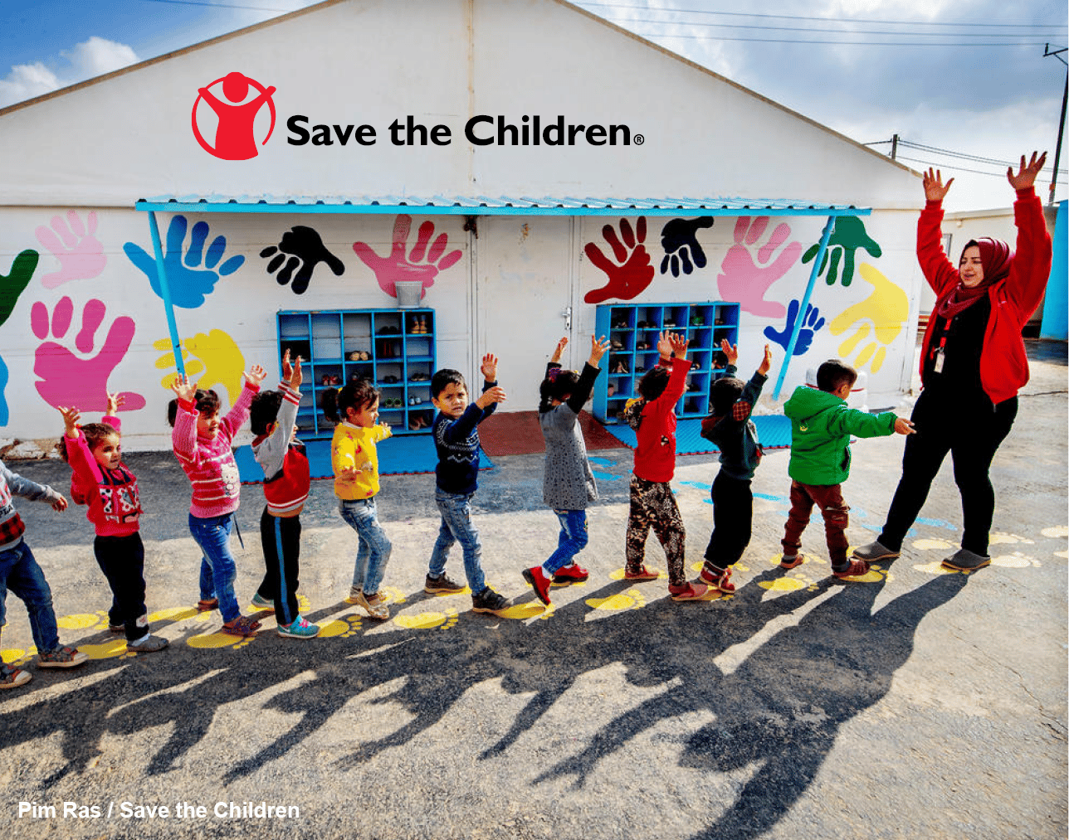
Save the Children
In the UK and around the world, Save the Children make sure children keep safe, healthy and learning.

Slide 8
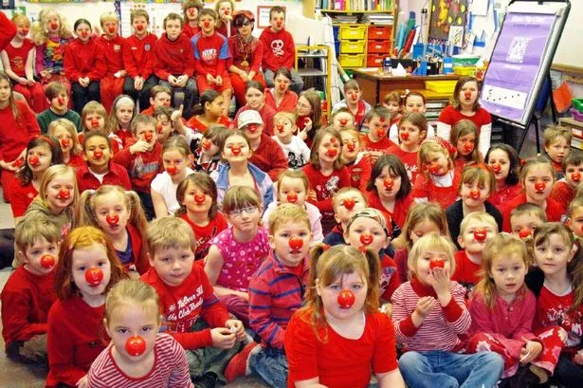
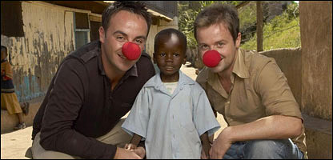
Comic Relief
Comic Relief fund programmes that help people and communities overcome the many challenges they face.

Slide 9
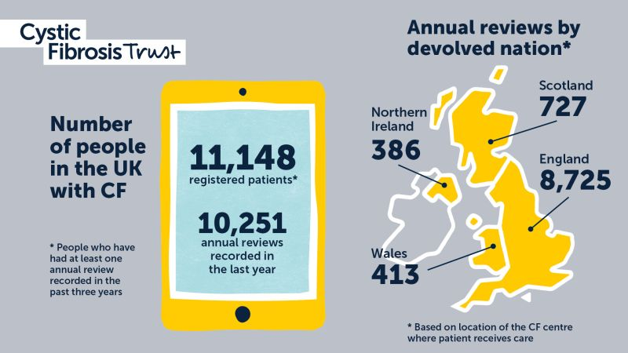
Cystic Fibrosis Trust
The only UK-wide charity uniting people to stop cystic fibrosis (CF).

Slide 10
Red Sky Foundation
Red Sky Foundation raises vital funds to support life saving work for babies, children and adults who are born with or who develop heart conditions across the North East of England.

Slide 11
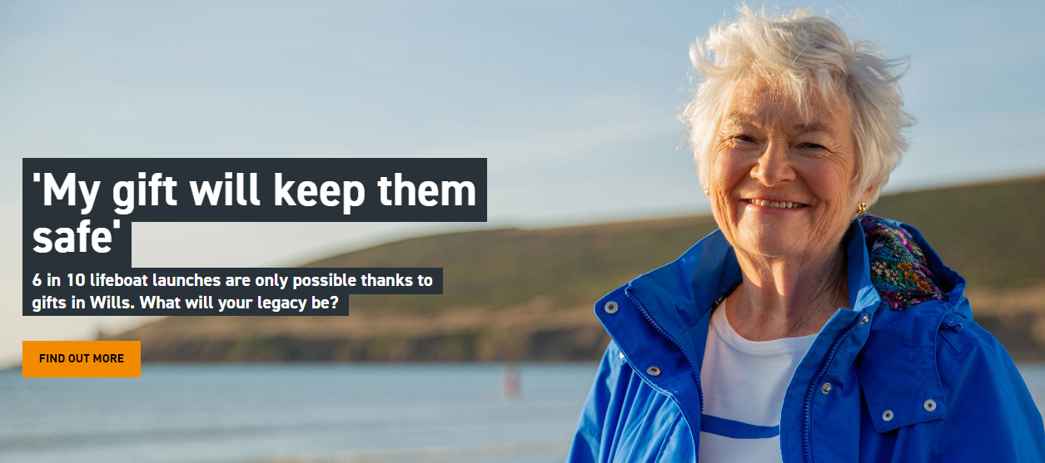
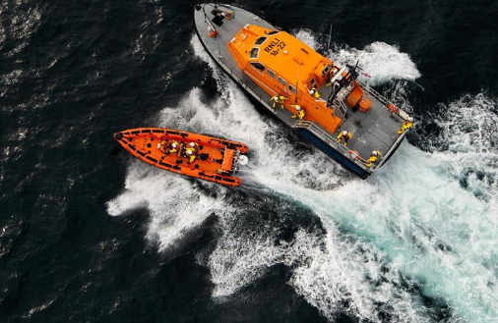
Royal National Lifeboat Institution (RNLI)
The RNLI saves lives at sea.

