Slide 1
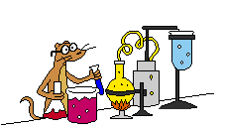
Science
Notes:
1
1

Slide 2
Learning Objective
: to be able to identify and name the body parts required for digestion
Success Criteria
: that you can label some of the body parts
: that you know what digest and digestion
means
WALT
WILF
Notes:
2

Slide 3
Digestive System
Humans digest food. They have a digestive system that allows them to do this.
What do you think digest/digestive system mean?
Digest
Break down food so it can be used by the body.
Digestive System
System of organs that get food in and out of the body and which make use of the food to keep the body healthy.
Click here for a definition of digest
Click here for a definition of digestive system

Slide 4
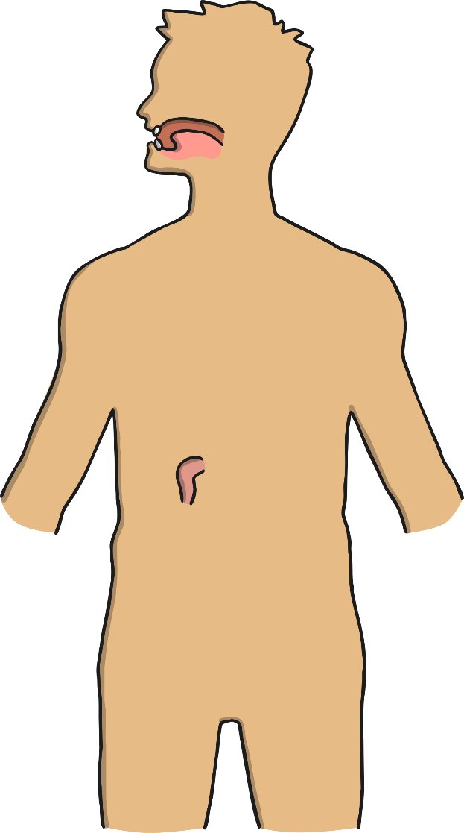
Digestive System Parts
Can you name any parts of the body that are in the digestive system?

Slide 5
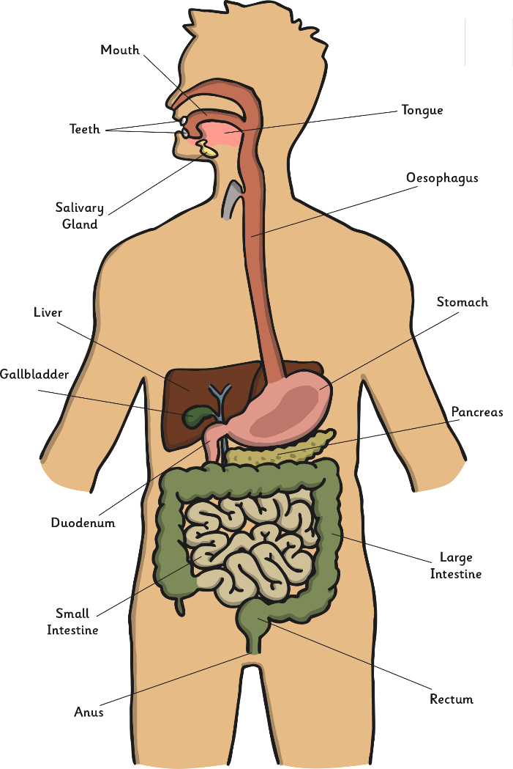
Digestive System Parts

Slide 6
Task:
You will be given a sheet with key words to name and label the different parts of the digestive system.

