Slide 1
Science
Scientists and Inventors
Science | Year 5 | Scientists and Inventors | Stonehenge | Lesson 8

Slide 3
Aim
To identify evidence that supports or refutes scientific theories about Stonehenge.
Success Criteria
I can discuss why Stonehenge is special.
I can identify evidence that supports or refutes the theory that Stonehenge was used as an astronomical calendar.
I can explain my own theories, and describe the evidence that supports my ideas.

Slide 4
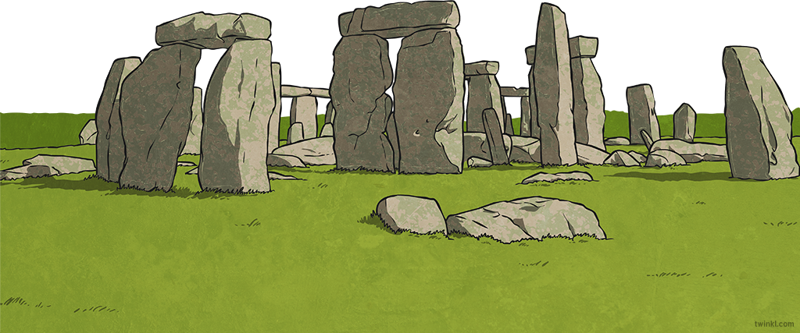
Stonehenge
Stonehenge stands on Salisbury Plain in Wiltshire. It is one of the world's most famous and recognisable monuments, and is estimated to be around 5000 years old!

Slide 5
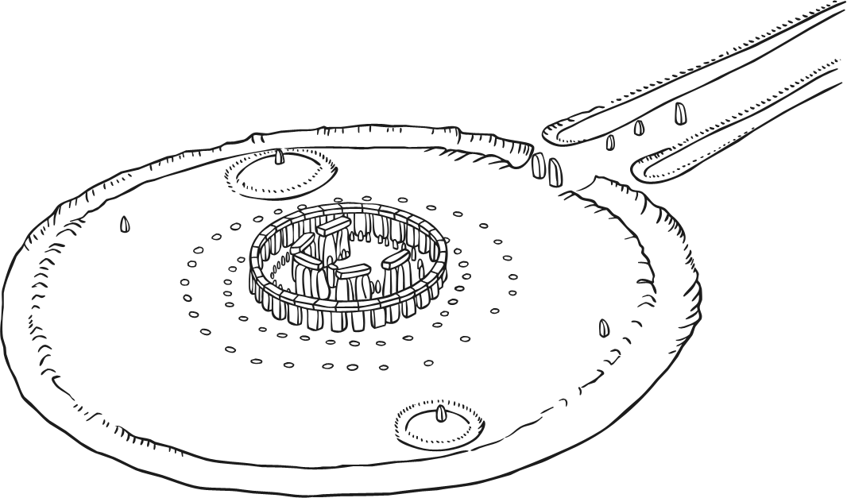
Features of Stonehenge
This is how Stonehenge would have looked around 2000 BC. Think about what each feature might be. Click on the feature to find out more about it.
Outer circle
The outer circle was made from 30 standing stones. A continuous ring of horizontal stones sat on top of them.
Bluestones
These are the oldest stones at Stonehenge. They form one circle inside the outer circle and another inside the horseshoe.
Horseshoe
Five stone arches make up the horseshoe. These stones are around seven metres high.
Heel Stone
The Heel Stone stands at the entrance to Stonehenge. Evidence suggests that there was a second Heel Stone next to it.
Aubrey Holes
A ring of 56 chalk pits has been discovered around the stones.
Avenue
The avenue leads from the River Avon to Stonehenge, and is the entrance to the monument.

Slide 6
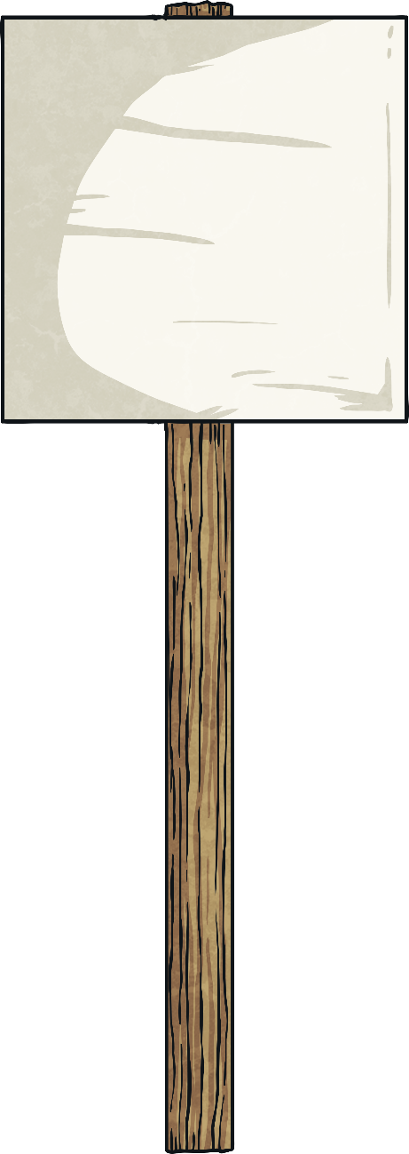
Why Is It Impressive?
Look at these facts about Stonehenge.
Make a note in your workbook about which of these facts you consider to be most impressive, and why.
Some of the stones in the outer circle weigh 20 tonnes. This is equivalent to around 10 average-sized cars.
The stones were cut to shape using tools made from wood and stone.
It is estimated that the construction of Stonehenge would have taken around 30 million hours of work.
The bluestones came from an area in South Wales. Each stone weighs around four tonnes, and was dragged 240 miles over land and water.

Slide 7
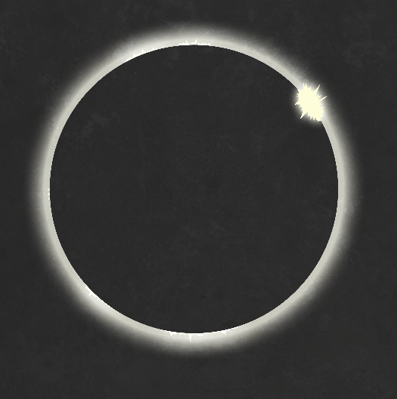
Ideas and Evidence
There are many theories about what Stonehenge was for. Some people believe that it was a place of healing for the ancient Britons, while others think the ancient people may have used it for religious ceremonies.
Many scientists have studied Stonehenge and have developed scientific theories about what it was used for.
By exploring Stonehenge carefully, some scientists believe they have found evidence that it was used as an astronomical clock or calendar. An astronomical calendar tracks the sunrise and sunset over the year, as well as other astronomical occurrences such as eclipses. However, other scientists think that there is not enough evidence to prove this.

Slide 8
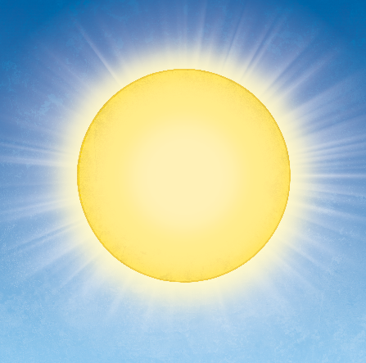
Astronomical Calendar
This alignment is repeated with the midwinter sunrise.
midwinter
Midwinter's Day is also known as the winter solstice. This is the day with the shortest period of daylight and the longest night of the year.
Midsummer's Day is also known as the summer solstice. This is the longest day of the year, marking the end of Spring and the start of Summer.
Some scientists suggest that the site of Stonehenge is arranged so that, on midsummer, the Sun rises near to the Heel Stone, or between the two Heel Stones, and then shines straight into the centre of the horseshoe.
midsummer

Slide 9
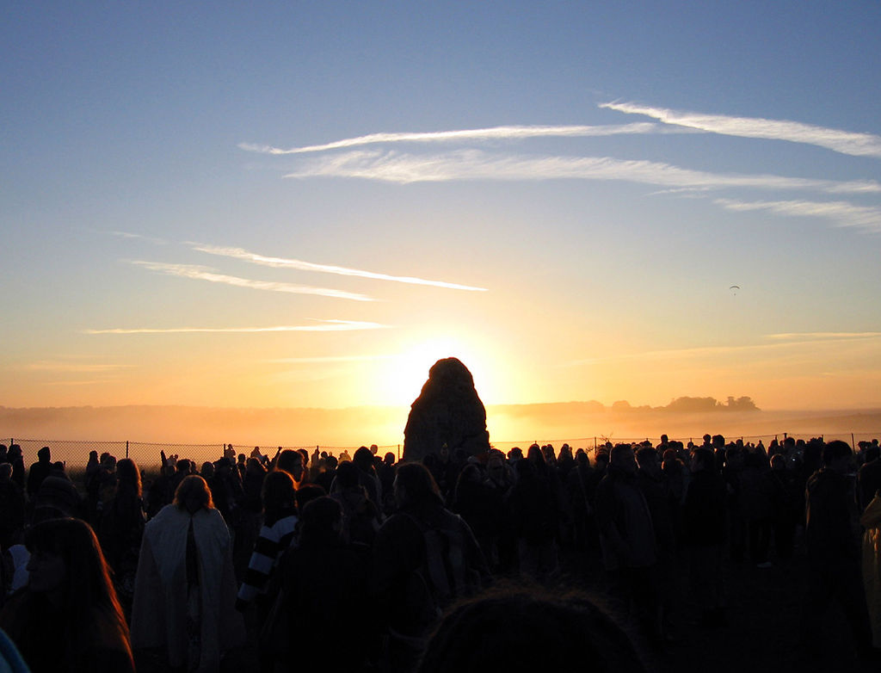
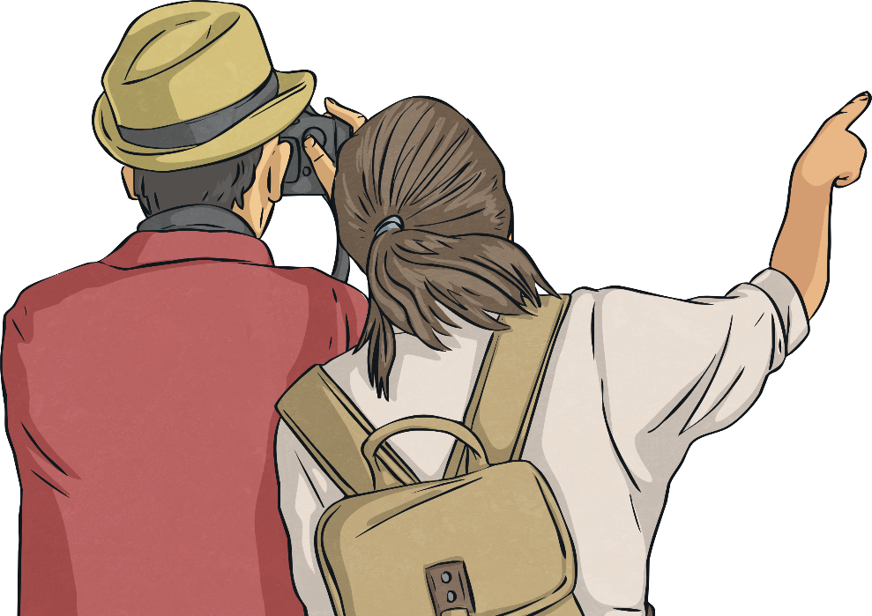
Astronomical Calendar
The midsummer Sun rises over the Heel Stone. If the second Heel Stone still stood, the Sun would rise between them.
“Sun behind the Heel Stone” by Andrew Dunn is licensed under CC BY 2.0

Slide 10
Scientists' Theories
Many scientists have studied Stonehenge to explore the idea that it could have been used as an astronomical calendar. Some scientists have published evidence that supports this idea, whereas other scientists have found evidence that refutes it.
Look at the evidence on your Scientists' Theories Activity Sheet (There are two differing levels of detail that you can choose from). Make a table with two columns in your workbook (label them ‘support’ and ‘refute’). Cut out each box of evidence and stick it into one of the columns in your workbook.

Slide 11
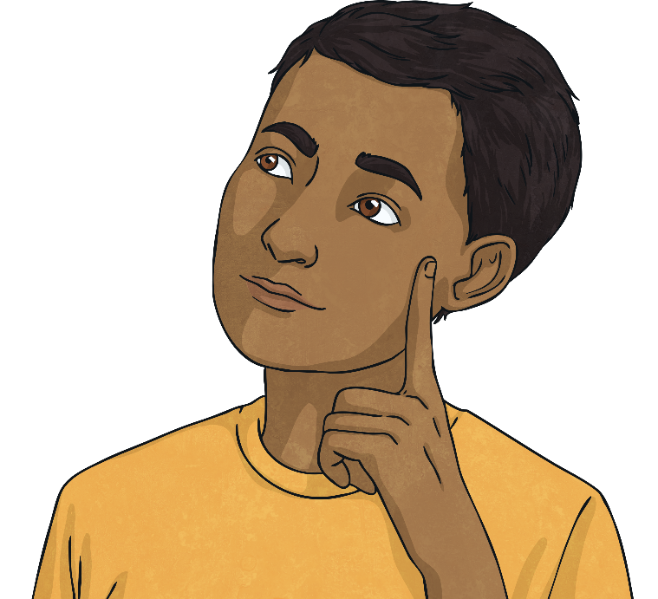
What Do You Think?
You have looked at some of the scientists' theories and their evidence for or against the idea that Stonehenge was used as an astronomical calendar.
Now it's over to you!
What do you think? Could Stonehenge have been used to track astronomical events such as the sunrise and sunset, eclipses or the passing of the year? What evidence makes you think this?
Make a note of your conclusions in your workbook.

Slide 12
Aim
To identify evidence that supports or refutes scientific theories about Stonehenge.
Success Criteria
I can discuss why Stonehenge is special.
I can identify evidence that supports or refutes the theory that Stonehenge was used as an astronomical calendar.
I can explain my own theories, and describe the evidence that supports my ideas.

