Slide 1
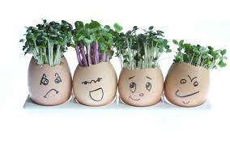
Wednesday 3rd March 2021

Slide 2
Todays tasks:
Follow the instructions in your pack to make your cress heads. There is cress in the little envelope in your pack.
If you haven’t collected your resource pack you can find the cress heads instructions on the next slide.
Once you have made your cress head watch the video in the following slides to find out what plants need to grow and how to look after your cress and plants.
Write your own instructions of how to make a cress head and how to look after it so that a friend could follow to make their own.

Slide 3
Carefully remove the tops from the eggs, leaving the bottom two-thirds of the shells intact.
Secondly, empty the shells (save the eggs for another time), then carefully wash them out.
Next, decorate the shells with pens or paint, then leave them to dry.
Carefully, dip the cotton wool balls in a little water, squeezing off any excess.
Place 1 ball inside each shell, then sprinkle 1 tsp cress seeds onto each one.
Sit the filled shells in eggcups and leave in a dry, well-lit place for a week – a windowsill is perfect.
Your cress will start to grow within a few days, perfect for making egg & cress sandwiches.
Watch the following video of how to look after your cress heads and what plants need to grow.

Slide 4

https://www.youtube.com/watch?v=gIRR-VdIP1M

Slide 5
Watch the following video of how to write instructions.
https://www.bbc.co.uk/teach/class-clips-video/english-ks1-ks2-how-to-write-instructions/zrvtscw

Slide 6
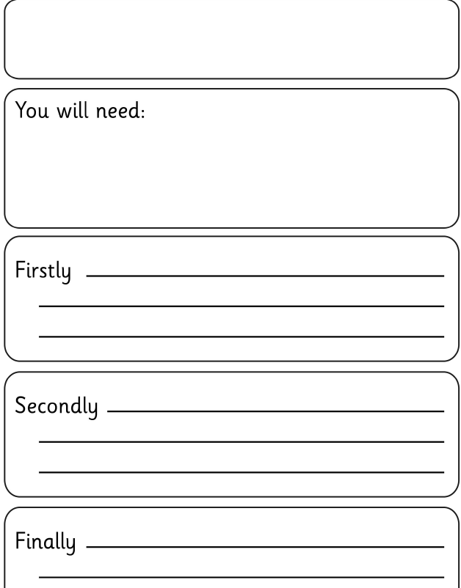
You could use this template or something similar to help you write your instructions in your book or on a piece of bordered paper from your resource pack.

