Slide 1
Welcome
and
Thank You For Coming!

Slide 2
“Believe and Achieve”

Slide 3
School Rules
Be Ready
Be Respectful
Be Kind

Slide 4
School Values
Happiness
Teamwork
Resilience
Pride
Honesty
Respect
Notes:
Link to recognition board

Slide 5
Timetable
Notes:
Children to be in at 8:50 and reading.
Believe they will be swimming
External provider coming in to do some of the music lessons where the children will learn the cornet.

Slide 6
English
“Word of the Day” - Vocabulary Ninja
Spelling - Spelling Shed
Handwriting - Pen Pals
SPAG
Reading lesson -
Three times weekly
Based on a range of rich texts/extracts covering a wide range of genres
Writing
The Ellington Writing Journey (explore, initiate, understand audience and purpose, model, enable, edit, publish)
Based on a class text and write a range of text types focusing on the purpose for writing e.g. to entertain, to persuade

Slide 7
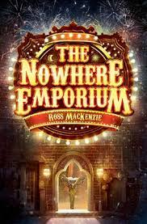
Our Texts

Slide 8
Plan their writing by:
identifying the audience for and purpose of the writing
in writing narratives, considering how authors have developed characters and settings in what pupils have read, listened to or seen performed
Draft and write by:
selecting appropriate grammar and vocabulary, understanding how such choices can change and enhance meaning
in narratives, describing settings, characters and atmosphere and integrating dialogue to convey character and advance the action
using a wide range of devices to build cohesion within and across paragraphs
using further organisational and presentational devices to structure text and to guide the reader [for example, headings, bullet points, underlining]
Evaluate and edit by:
assessing the effectiveness of own and others’ writing
ensuring the consistent and correct use of tense throughout writing
proof-read for spelling and punctuation errors

Slide 9
SPAG
using expanded noun phrases to convey complicated information concisely
using modal verbs or adverbs to indicate degrees of possibility
using relative clauses beginning with relative pronouns such as who, which, where, when, whose, that
using commas to clarify meaning or avoid ambiguity in writing
using hyphens to avoid ambiguity
using brackets, dashes or commas to indicate parenthesis
using semi-colons, colons or dashes to mark boundaries between independent clauses
using a colon to introduce a list
punctuating bullet points consistently

Slide 10
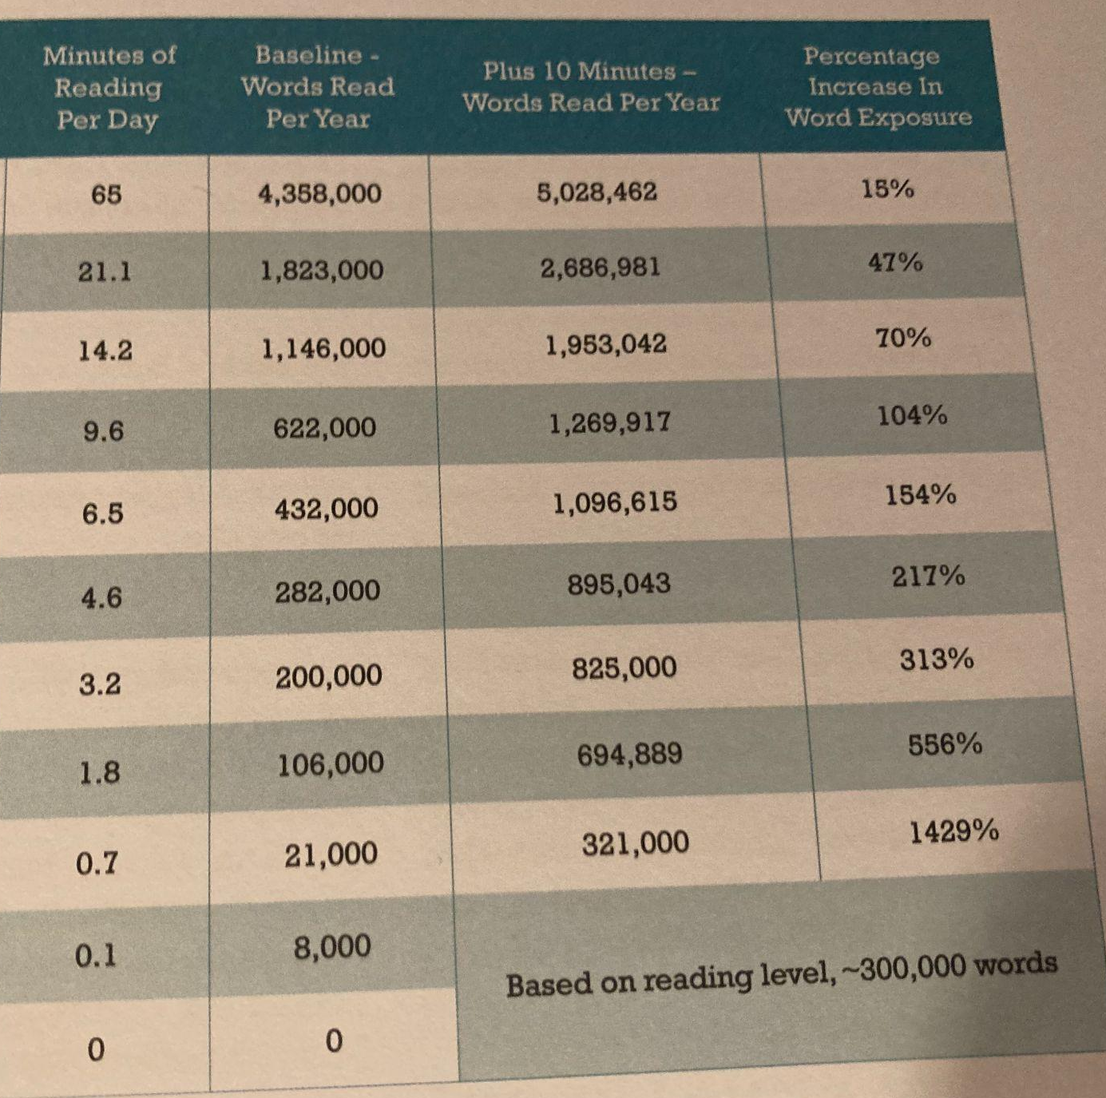
Throughout the school day at Ellington, our children have multiple opportunities to read. We do this through our class text, reading lessons, storytime and independent reading.
Studies have found that an additional 10 minutes of reading a day at home can expose your child to around 700,000 additional words a year!

Slide 11
Maths
Lesson begins with “tough ten”
Lesson is based around a problem that the children should be able to solve by the end
Fridays = arithmetic
What we cover in year 5
Decimal Fractions, Money, Negative Numbers, Multiplication & Division
Area & Scaling, Calculating with Decimal Fractions, Factors, Multiples & Primes.
Fractions, Converting Units, Angles

Slide 12
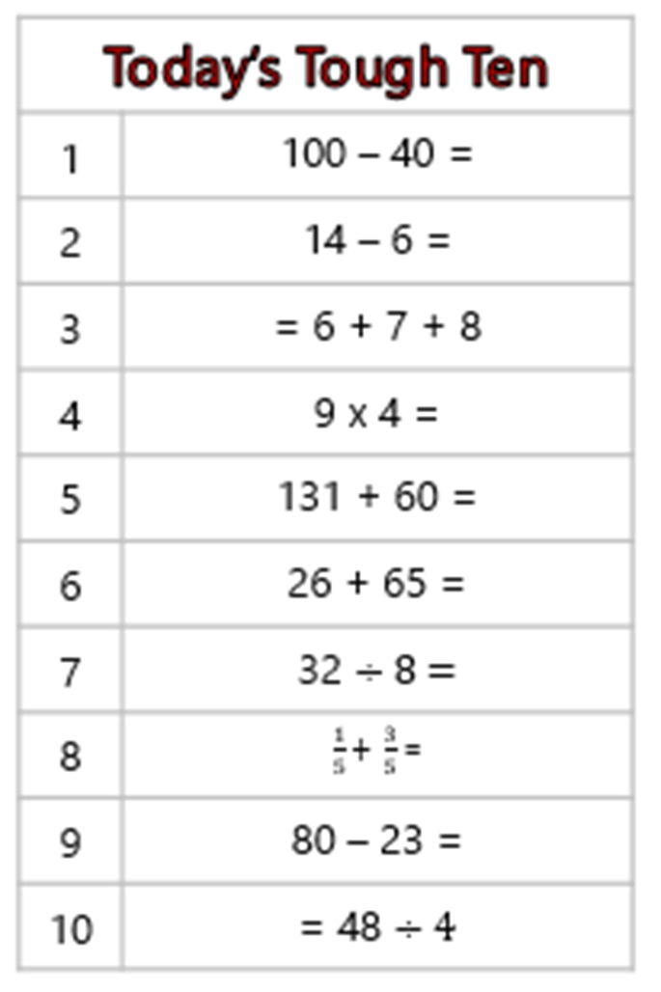
Example of “tough ten”

Slide 13
Topics
 | Science | Geography | History
Autumn 1 | Living things and their habitats | Mountains of the world
Autumn 2 | Forces |  | Early Islamic civilisation
Spring 1 | Earth and space | Climate change and pollution
Spring 2 | Properties of materials |  | Tudors
Summer 1 | Animals including humans | Changes to Newcastle and the UK
Summer 2 | Investigations |  | The kingdom of Benin
Notes:
Mention French, art and computing
Discuss that children are expected to finish work in the time given
Feedback is given to their work either through marking and use of highlighters (green and pink); verbally via teacher or TA; and they should respond in purple pen

Slide 14
Homework
Reading 5 times per week
Homework book will alternate between an English task and a maths task each. They should be able to complete this independently. Set on a Friday and to be returned by the following Wednesday.
Spellings will be sent home on a Friday too, giving the children a full week to practise. Spelling Shed is also available for more practise.
Notes:
Mention reading rewards.
Homework book will be based on things we have covered in lessons.

Slide 15
Other ways to help at home
Ask your children to tell the time and use different clocks
Let them handle money
Times tables
Discuss fractions e.g. half a pizza, six equal pieces means sixths
Encourage your children to write - diaries, thank you notes, cards
TTRS
Spelling Shed
Taking an interest in current events and encouraging children to form an opinion, verbalise this and have debates and discussions

Slide 16
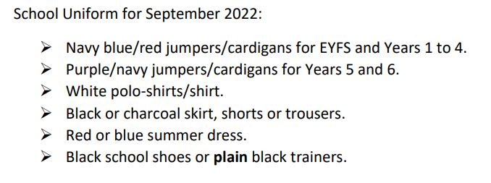
Uniform

Slide 17
Attendance

Slide 19
Any Questions?

