Slide 1
New Nursery Parents Meeting
2022

Slide 2
Purpose of tonight
Chance to meet staff
Go through welcome and induction arrangements
Explain Nursery routines
Outline the Nursery curriculum
Opportunity to look around Nursery
Ask any questions

Slide 3
Meet the staff.
Mr. K. Hodgson
Headteacher
Mrs. F. Pirie Mrs. T. Goodall
Nursery Teacher Nursery Teaching Assistant

Slide 4
Staff
Mrs. J. Cook Mrs. R. Hays
Reception Teacher Teaching Assistant
Mr. G. Liddle
Teaching Assistant

Slide 5
Welcome
Welcome Pack to hand out
Starting dates
Gradual beginning for the first week
Contact numbers
Any changes before the Summer Term

Slide 6
Nursery Routines
Door opens at 8.45 - Sessions start promptly
To ensure the safety of the children the gate will be closed 5 mins after the start of the session. Please ensure you arrive and collect your children on time.
Self registration
Circle time
Small group phonics/ maths / dough disco
Child initiated Play and Learning/ Adult led activities indoor or outdoor /Thrive activities
Free Flow – activities indoors or outdoors
Snack bar open/snack time
15 hour a week children go home at 11.45
Lunchtime for 30 hour a week children
Small group phonics /maths/ dough disco
Outdoor play
Circle time
Child initiated Play and Learning/ Adult led activities / Thrive activities
Free Flow – activities indoors or outdoors
Story
Finish 3.15pm

Slide 7
Nursery Equipment
Uniform- Navy blue embroidered jumper/cardigan available from Cloud Nine
Velcro black school shoes
School draw string bag with spare clothes to leave on peg
Book Bag
Named water bottle
Lunch box for children staying all day
Fruit snack is provided for everyday for all of the children
Healthy lunch boxes and drink –
NO NUTS please.

Slide 8
Curriculum
Follow Early Years Curriculum
Activities in the Nursery are planned to help the children to work towards the Age Related Expectations
Focus on 3 Prime areas – Communication and Language, Physical Development and Personal, Social and Emotional Development;
Then focus on the four Specific Areas being: As children grow, the prime areas will help them to develop skills in 4 specific areas – Literacy, Maths, Understanding the World, and Expressive Arts and Design.
RWI phonics
Big Ideas/ Learning Trajectories/Number blocks/ Numicon

Slide 9
Early Years Foundation Stage

Slide 10
Characteristics of Effective Learning

Slide 11
How to help

Slide 12
How to help

Slide 13
Indoor and Outdoor Areas
Children have access to both the indoors and outdoor areas throughout the day
Inside we offer –water, small world & construction, playdough, finger gym, mark making area, maths area, IWB, creative & painting, junk modelling DT area, science investigation area, reading corner, role play area
Focussed adult led area, communication area for Talk Boost
Outsider we offer – large construction, mud kitchen, science investigation area, water play, bikes, climbing frame, bats and ball, role playhouse, large painting, sand play and gardening

Slide 14
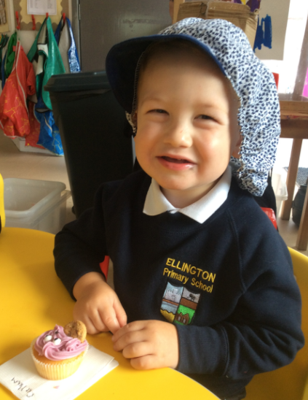
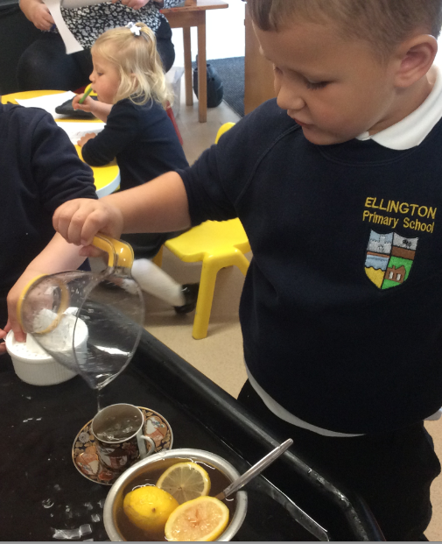
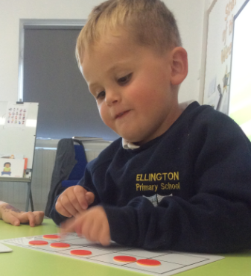
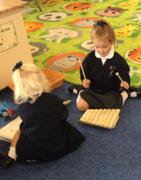
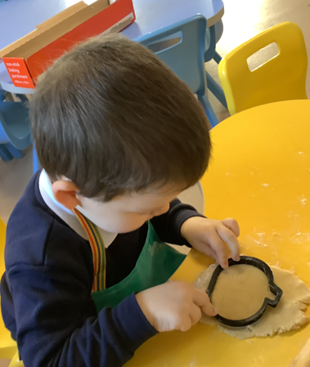
Indoors

Slide 15
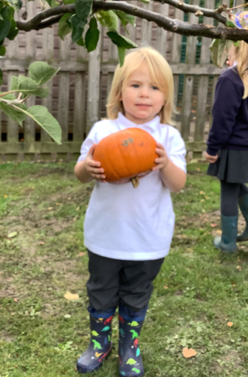
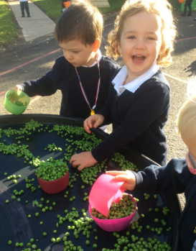
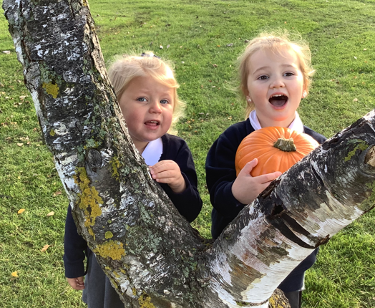
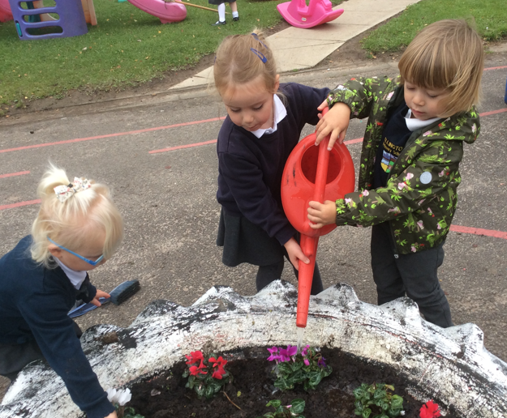
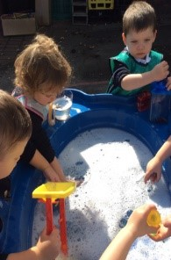
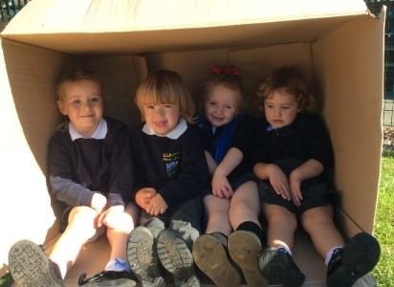
Outdoors

Slide 16
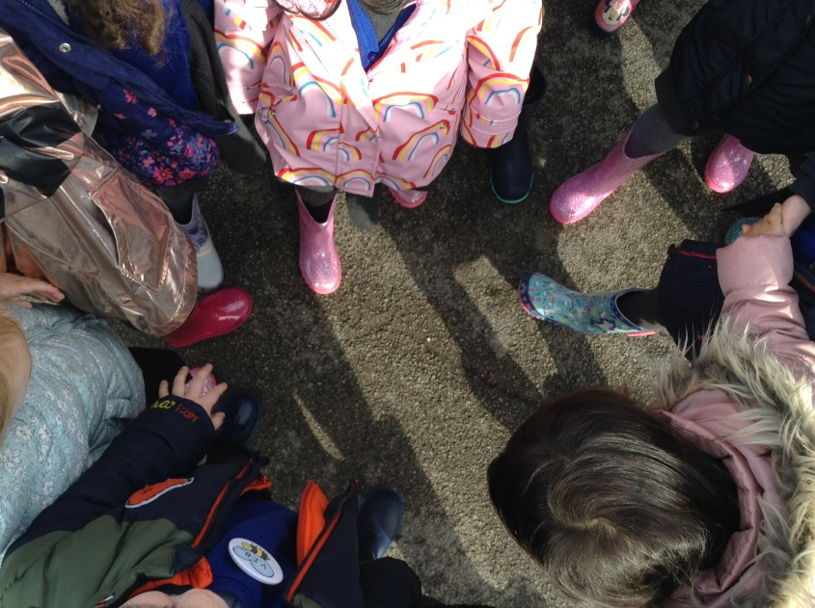
Welly Walks to the Wildlife Garden

Slide 17
Medicines and Allergies
Please inform us of any allergies as soon as possible - depending on the medical condition we may need to contact the school nurse for staff training.
If your child has any specific needs please inform us as soon as possible so that we can have as much information and training available
Inhalers are kept in the classroom medical area any other medication needs to be signed in to office staff and forms completed
Medicines are administered by a first aider but only when permission has been given.

Slide 18
Keeping you up to date
Our school website has lots of general information, holiday dates and upcoming events.
Class dojo
Nursery class page
Twitter/instagram
Newsletters
Mid term report / End of year report
Parents Evenings/ Mid term reviews
Teachers are readily available at the start of the day if you need a chat

Slide 19
School Readiness
Putting own coats on
Manage own footwear
Toileting
Self Help skills and independence

Slide 20
We are here to help!
Please keep us informed of any achievements outside of Nursery – we love to celebrate swimming badges, places you have visited and any milestones
School 360
Class Dojo
Let us know about any issues straight away
Thrive activities can be adapted to support Parents at home
We operate an open door policy

Slide 21
School 360

Slide 22
Class Dojo Communication with parents.

Slide 23
EYFS setting improvements
New carpets
New flooring
New furniture
New painting throughout
Toilet refurbishment
New resources for both indoors and outdoors
New sporting equipment for out doors

Slide 24
Volunteers
Any parent or grandparent who would like to volunteer is greatly appreciated. (see office for relevant checks)
Help with sharing library books, craft work or gardening.
PTA are always looking for new support.
They are busy fund raising for the EYFS as we speak and provide a huge boost to school funding.

Slide 25
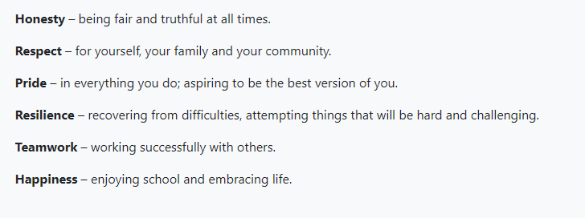
School Values

Slide 26
Thank you for joining us. Any questions please ask. Please join us in a tour of the EYFS setting.

