Slide 1
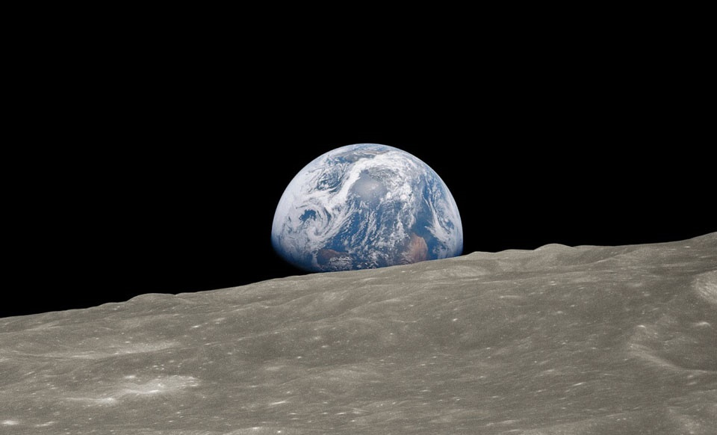
Our Planet
The story of the one place we all call home
Notes:
Our Planet is a Netflix Original documentary series that tells the story of the one place we all call home. The series, and the accompanying website filled with free videos and resources, aims to help people all over the world to understand what we all need to do in order to ensure a future for our planet in which people and nature thrive.
WWF is the world’s leading independent conservation organisation. Our mission is to create a world where people and wildlife can thrive together.
This photograph is called ‘Earthrise’ and was taken by astronaut William Anders on December 24, 1968, during the Apollo 8 mission. Seeing Earth from space was an important moment for humans. We can see not only how beautiful it is, but how connected it is. It sustains all the life that we have ever discovered, but can only do that if it is allowed to work properly by humans.
Earthrise photo by Bill Anders / NASA
Processing by Jim Weigang

Slide 2
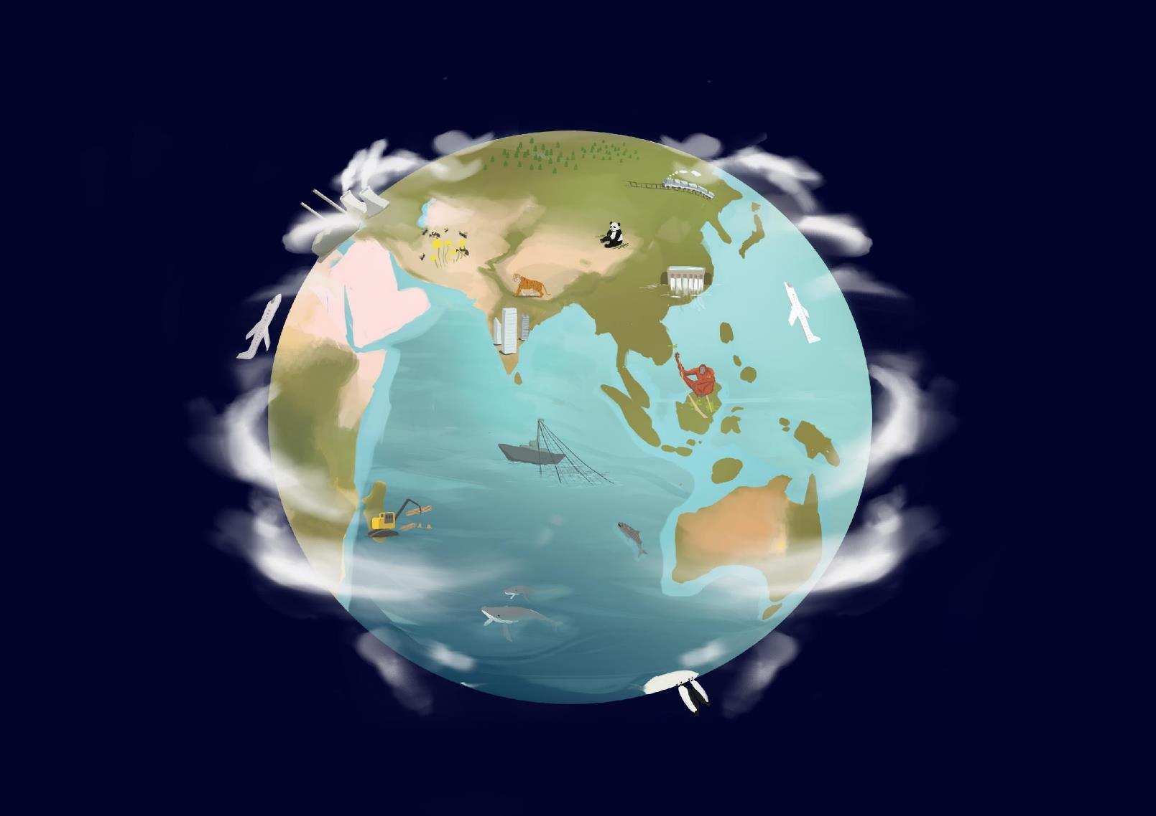
What does nature give us?
Food
Medicine
Clean water
Wood & paper
Energy
Weather
Beauty
Fun
A home!
Notes:
What does nature give us?
Nature is the basis for our survival. We depend on the natural world for our food, water and clean air, as well as many things that make our lives more comfortable and enjoyable.

Slide 3
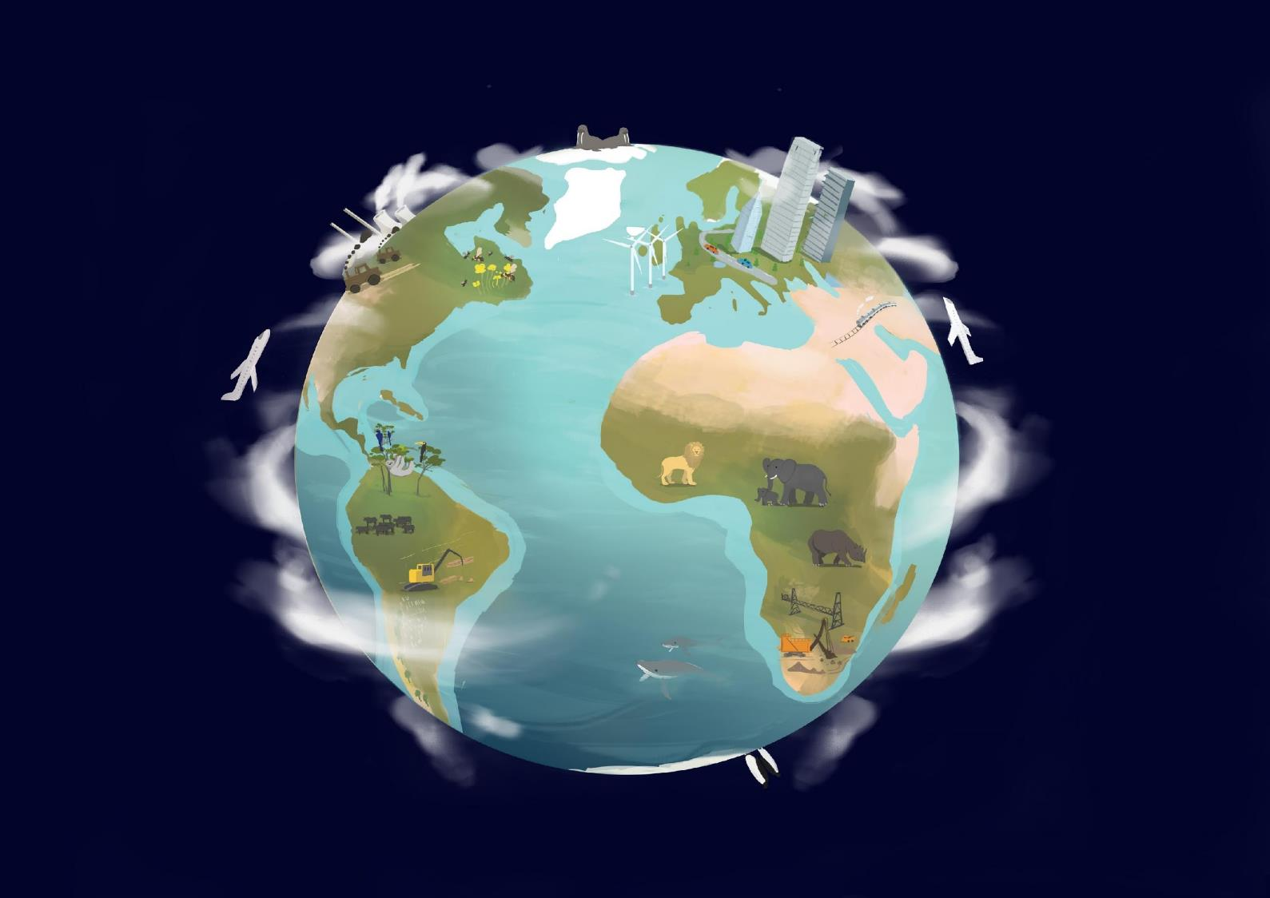
What human activities affect nature?
Farming
Transport
Logging
Fishing
Hunting
Pollution
Buildings/ Roads
Dams
Climate Change (carbon emissions)
Notes:
What do we do that could have an impact on wildlife or on the things they need to survive?
A lot!

Slide 4
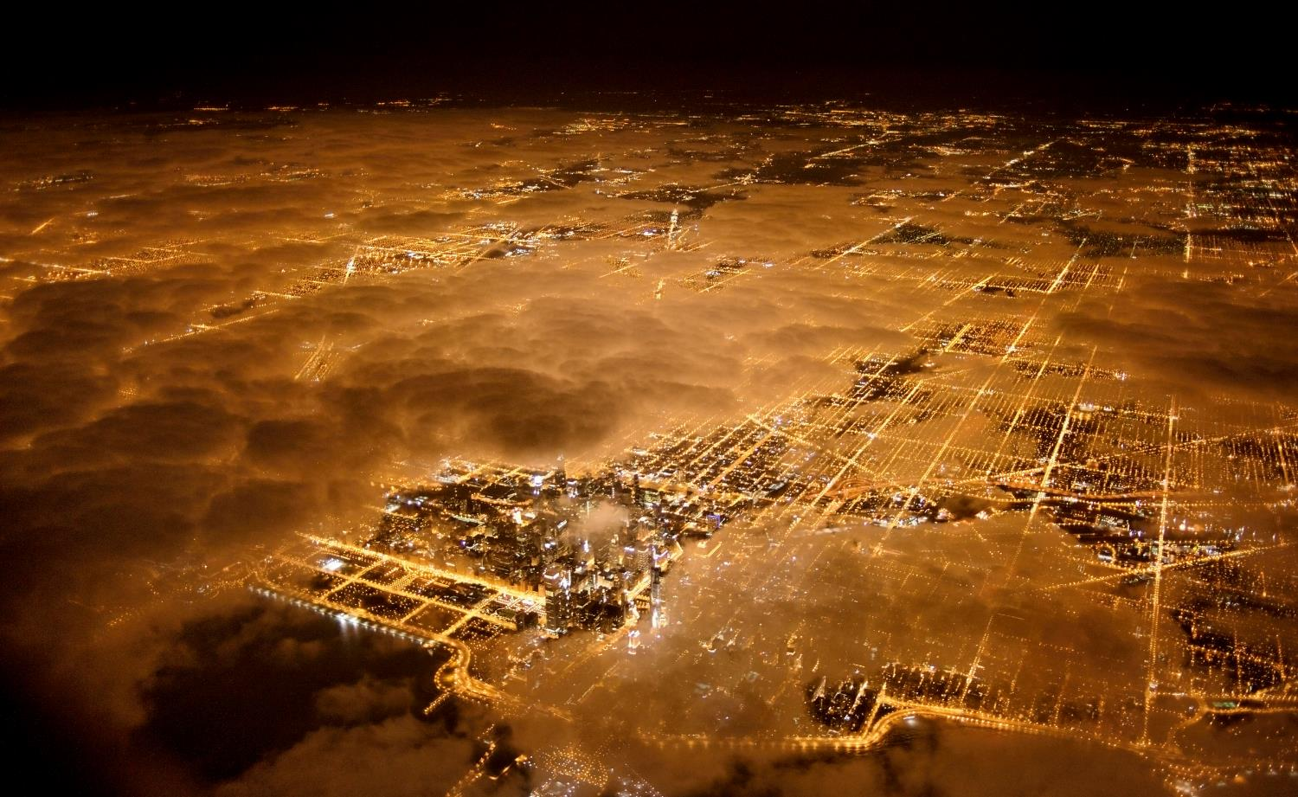
© National Geographic Stock / Jim Richardson / WWF
Anthropocene
‘The Age of Humans’
Notes:
Human activity is changing every part of our planet. These changes are so great that scientists are saying that we have entered a new age – the Anthropocene epoch, meaning ‘the age of humans’.
Humans have only been around for 200,000 years, a tiny sliver of time in comparison to the 4.6 billion years of our planet’s history. Yet in that time we have had a greater impact on our planet than any other species - and our impact is increasing. We have spread into almost every part of the planet, cutting down forests to create farm land and, over time, settling into huge cities. Technological changes have led to the growth of industries and we now consume more of the earth’s resources than ever before.

Slide 5
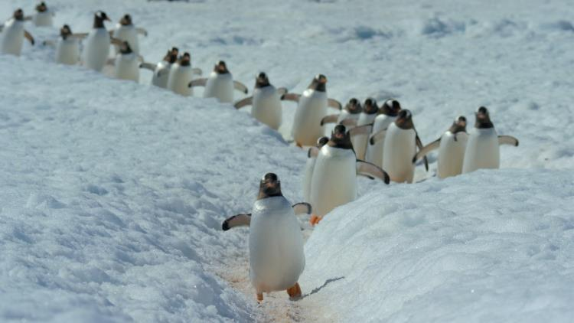
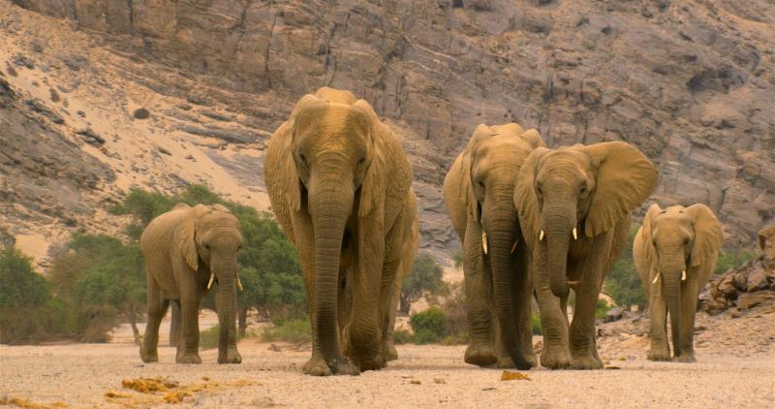
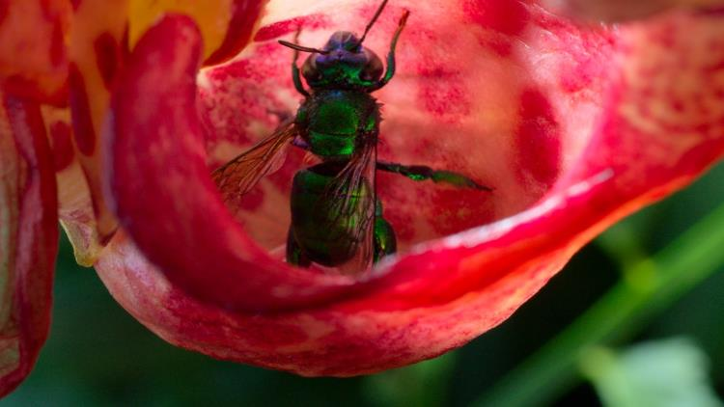
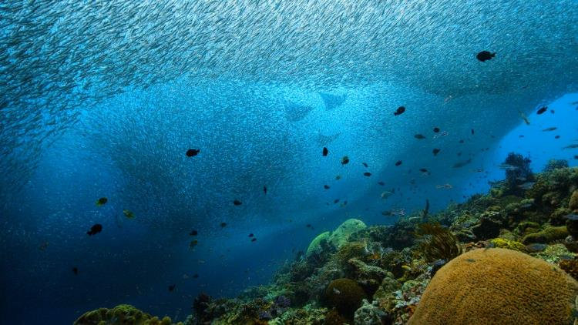
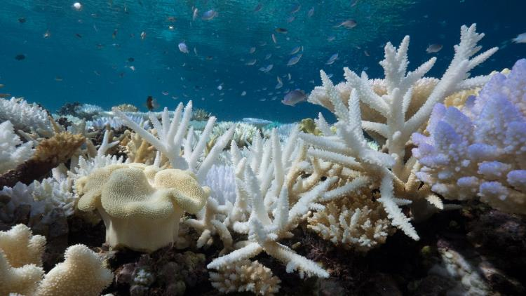
© Silverback Films / Netflix
© Silverback Films / Netflix
BIODIVERSITY
The heartbeat of our planet
Notes:
Biodiversity is the term for the total variety of all life on earth – thousands of different habitats, millions of different species and billions of individual animals. The more biodiversity, the more secure all life on earth is – including us. All the different pieces in the big jigsaw of life on our planet play a part in keeping it healthy and strong.
Video (3mins): ourplanet.com/biodiversityvideo

Slide 6
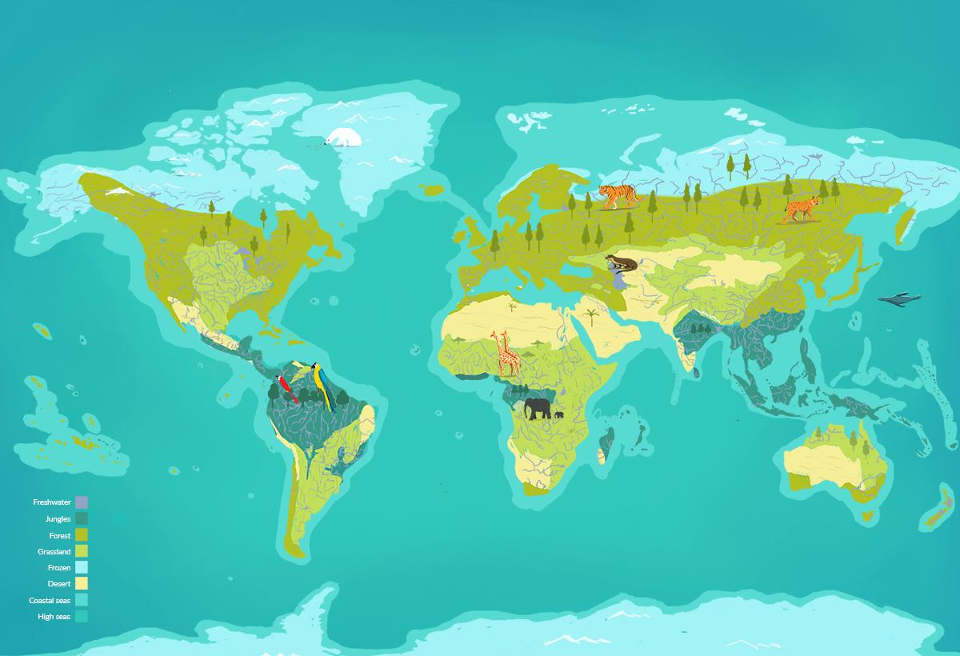
© Silverback Films / Netflix
THE BIOMES
The organs of our planet
Notes:
Our planet is one giant living system, like a human body, and the ‘biomes’ are like its organs. Each biome is nature’s response to a particular environment on earth with a certain geography and climate. They all contribute to the whole planet working well as a system that sustains life. Damage to one biome can lead to the whole system becoming weaker.
Each biome has a particular quality that is important for it to work well, and to contribute to the survival of all life on our planet.
Video (3mins 42s): ourplanet.com/biomes

Slide 7
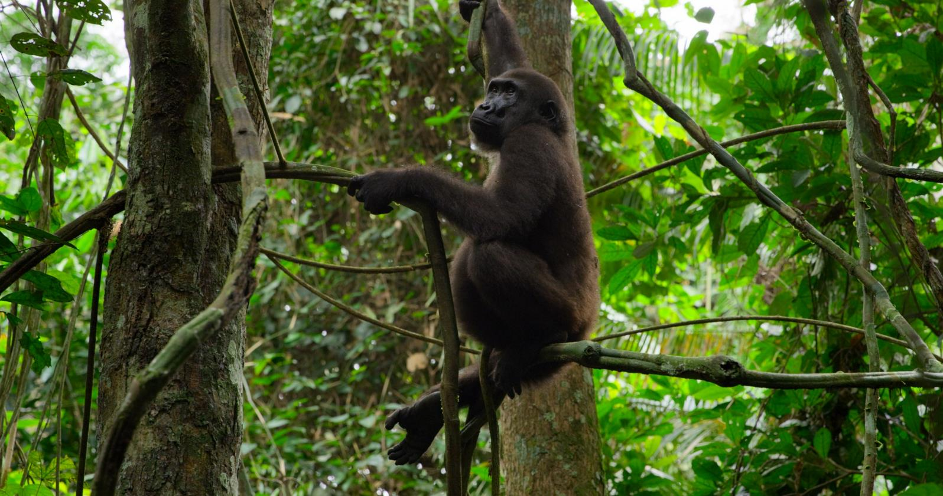
© Silverback Films / Netflix
Jungles
Diversity
Notes:
Jungles – Diversity
More than half the species on land live in the jungles. The complex variety of life is what allows it to work so efficiently.
Jungles absorb huge amounts of carbon from the atmosphere, drive weather systems, and provide us with medicines.
At the moment we are destroying jungle habitat to make space for crops, and each time we destroy even a small area we risk losing species from our planet.
Another thing that makes jungles important is their role in cleaning, storing and disseminating freshwater around the planet. A quarter of our usable freshwater comes from jungles.
Screen the biome tour video at http://ourplanet.com/schools-and-youth

Slide 8
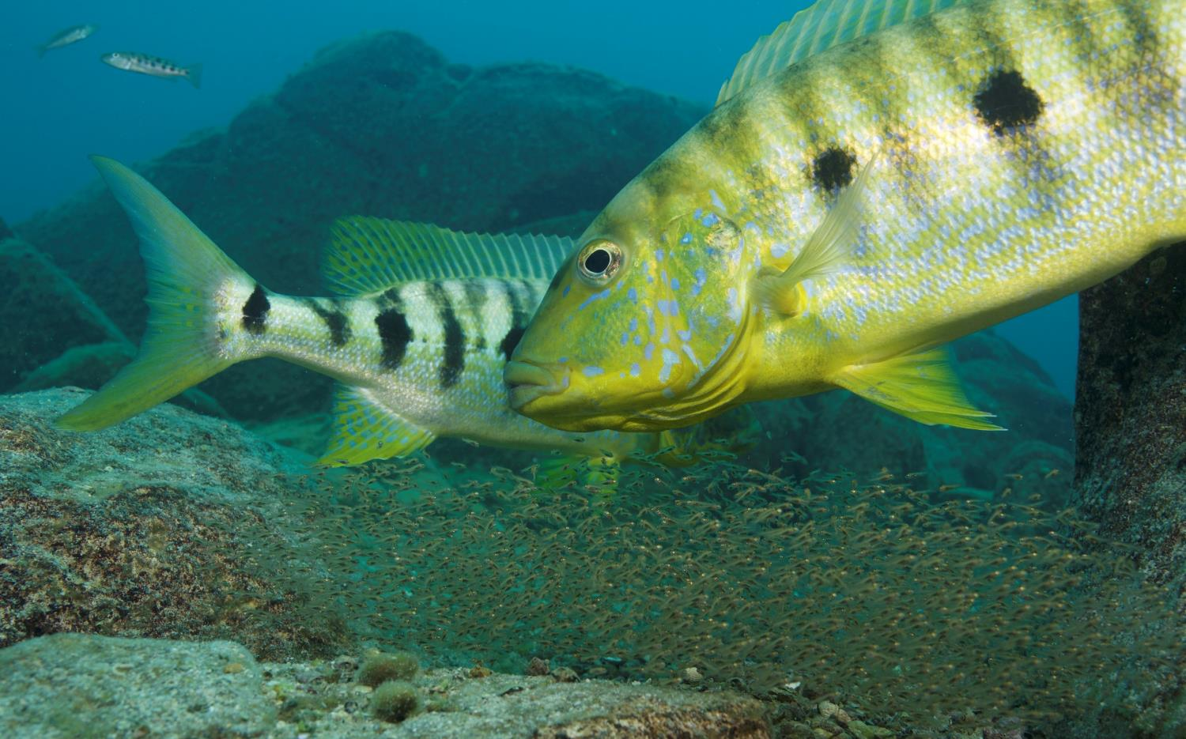
© Angel Fitor / Silverback Films / Netflix
FRESHWATER
Flow
Notes:
Freshwater – Flow
Freshwater systems need reliable flow to allow freshwater species to complete their life cycles, and to ensure nutrients and sediments are carried across the landscape.
We are stopping freshwater from flowing as it should by building dams and extracting too much water for our own use.
Some species travel down river systems and spend some of their life in the sea, but return upstream in the winter for warmth, or to return to their place of birth to spawn and begin a new cycle of life.
Screen the biome tour video at http://ourplanet.com/schools-and-youth

Slide 9
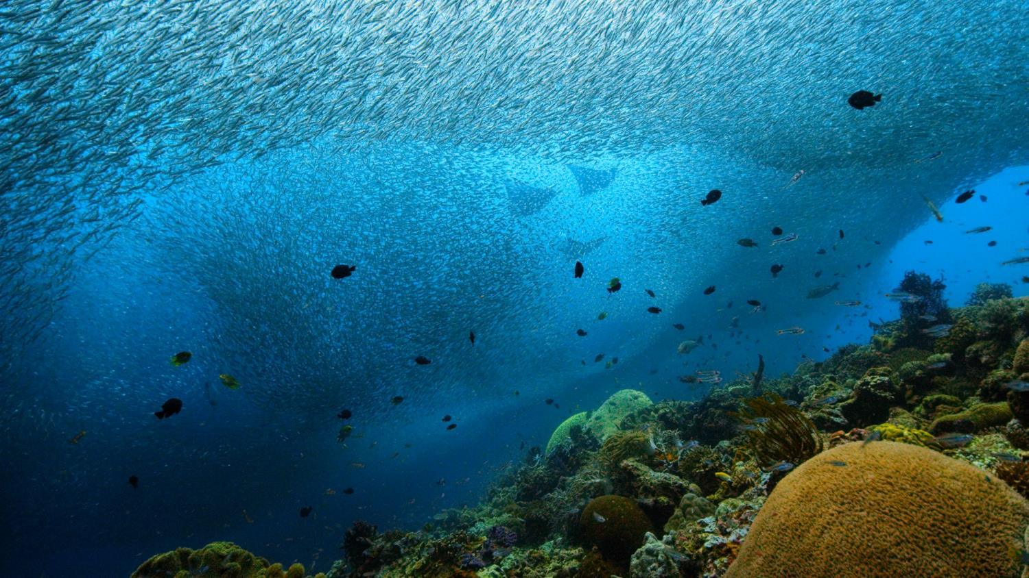
© Silverback Films / Netflix
COASTAL SEAS
Abundance
Notes:
Coastal seas – Abundance
Warmer shallower waters near land teem with life which spreads to populate the deeper high seas and which provides nourishment for many land-based species – including ourselves.
Abundance in the shallows is only possible if every member of the complex community is allowed to thrive.
Screen the biome tour video at http://ourplanet.com/schools-and-youth

Slide 10
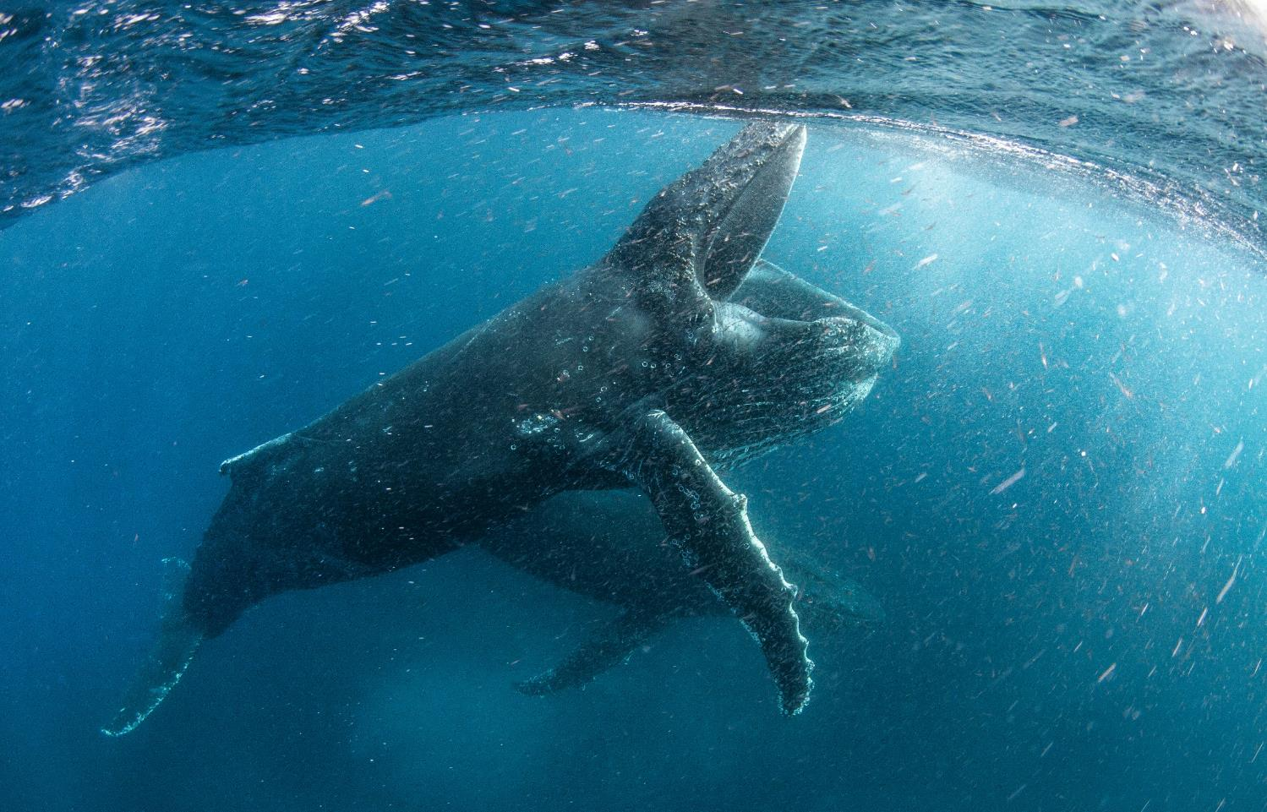
© Steve Benjamin / Silverback Films / Netflix
HIGH SEAS
Predators
Notes:
High Seas: Big Predators
Big animals like whales, sharks and dolphins are important because they fertilise the surface waters with their poo, and mix air into the water when they breach the surface, allowing phytoplankton to thrive. These tiny floating plants are the basis of life in the seas, but also produce half of the oxygen in the air that we breathe.
The high seas are not policed because they fall outside the borders of any country, and as a result they are being unsustainably fished in a way that endangers these large creatures – and all life in the ocean.
Even the biggest animals in the high seas depend on the small life forms such as krill – tiny crustaceans that eat the phytoplankton that the large animals help to sustain. Antarctic krill – one of the most common types – survive their first year thanks to sea ice in the frozen world of Antarctica.
Screen the biome tour video at http://ourplanet.com/schools-and-youth

Slide 11
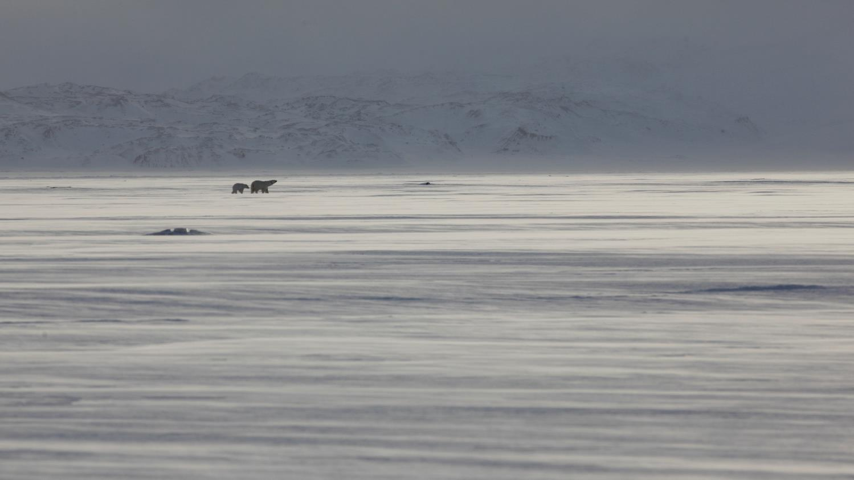
© Sophie Lanfear / Silverback Films / Netflix
FROZEN WORLDS
Ice
Notes:
Frozen Worlds – Ice
Ice is not just something for polar bears and penguins to walk on. Ice is the soil of the poles, supporting the entire food chain, and acts as an air conditioning system for our planet by reflecting sunlight into space.
Sea ice in the Antarctic is especially important for large predators that hunt in the sea and need places to rest, and also provides a safe place with shelter and food for krill to survive their first year of life. Krill then populates the seas and provides food for many larger ocean species, even whales.
Climate change caused by carbon from burning fossil fuels is causing the ice to melt. The loss of forests has an impact too – because trees draw in and capture carbon form the atmosphere in themselves, and the soil.
Screen the biome tour video at http://ourplanet.com/schools-and-youth

Slide 12
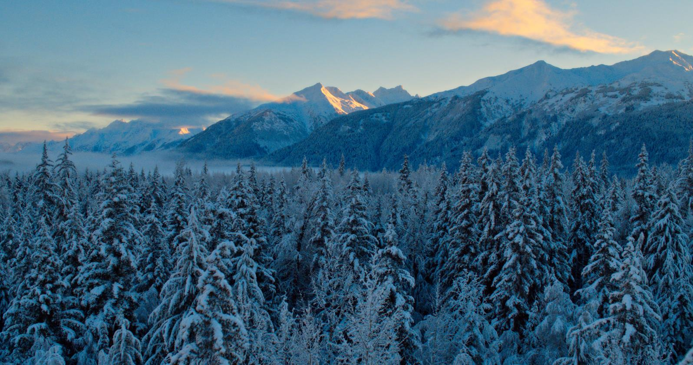
© Silverback Films / Netflix
Forests
Resilience
Notes:
Forests – Resilience
Trees in seasonal forests are adapted to deal with changing temperatures and forest fires. Forests with a mix of trees of different species and ages are the most able to bounce back. Many animals also have a role to play in helping forests thrive – distributing nutrients and seeds, and in the case of predators, ensuring that there are not so many grazing animals that new trees are unable to establish themselves.
Trees play an important role in supporting wildlife, but also in making our planet more resilient by capturing carbon from the atmosphere. Unfortunately, human activity can cause damage to forests from which they are less able to recover, when they clear areas for farms, roads and buildings and break forests into smaller pieces. This is called ‘fragmentation’.
Less than a quarter of the world’s forests are now part of large unbroken expanses of trees where large animals such as tigers and bears have enough space to hunt or forage for the food they need to survive. A single grizzly bear may need 1,000 square kilometres (385,000 square miles) to itself. These animals also spread seeds in their droppings, so they are an essential part of the forest ecology. Predators like the Siberian Tiger keep deer populations under control, which stops overgrazing from damaging the forest ecosystem. Fragmented forest is less resilient.
Screen the biome tour video at http://ourplanet.com/schools-and-youth

Slide 13
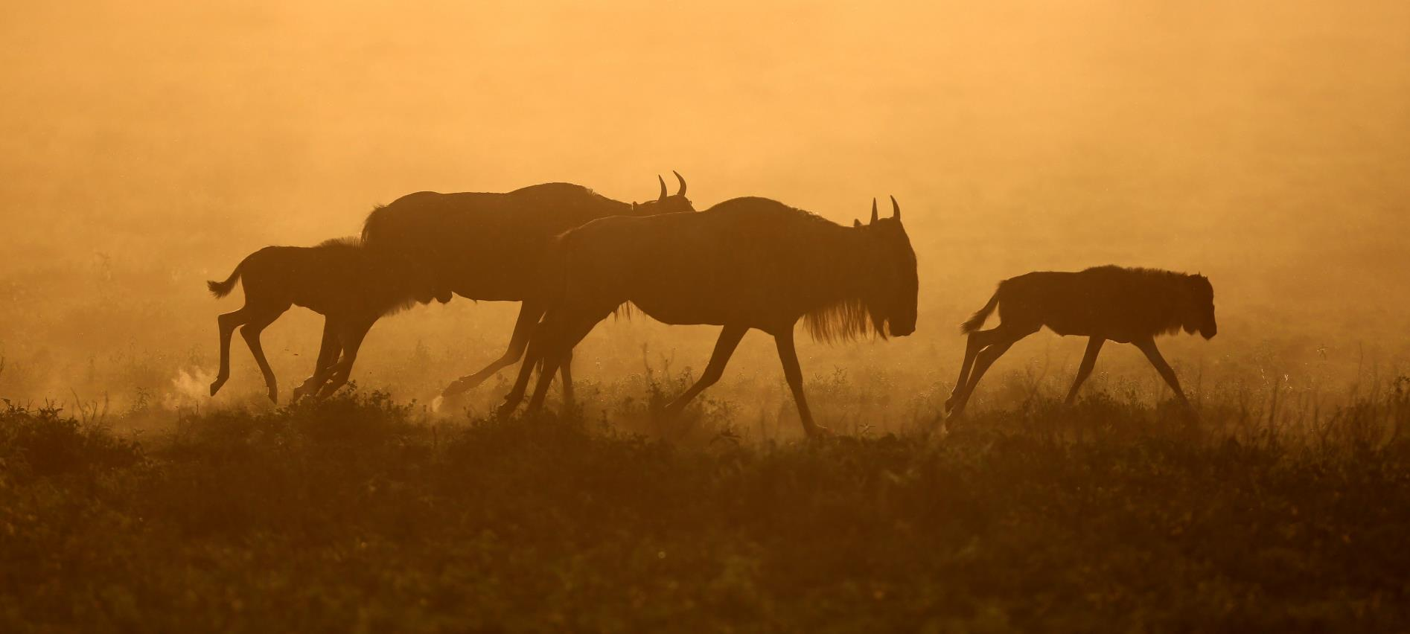
© Sophie Lanfear / Silverback Films / Netflix
GRASSLANDS
Space
Notes:
Grasslands - Space
Fragmentation also affects grassland ecosystems. Big animals like wildebeest (pictured) live in big herds, and need space to move large distances to follow rainfall, otherwise the grass is overgrazed and the whole system collapses.
We are using up space in grasslands to farm food, leaving less space and blocking migration routes for the wildlife that keeps the grasslands ecosystem working.
Screen the biome tour video at http://ourplanet.com/schools-and-youth

Slide 14
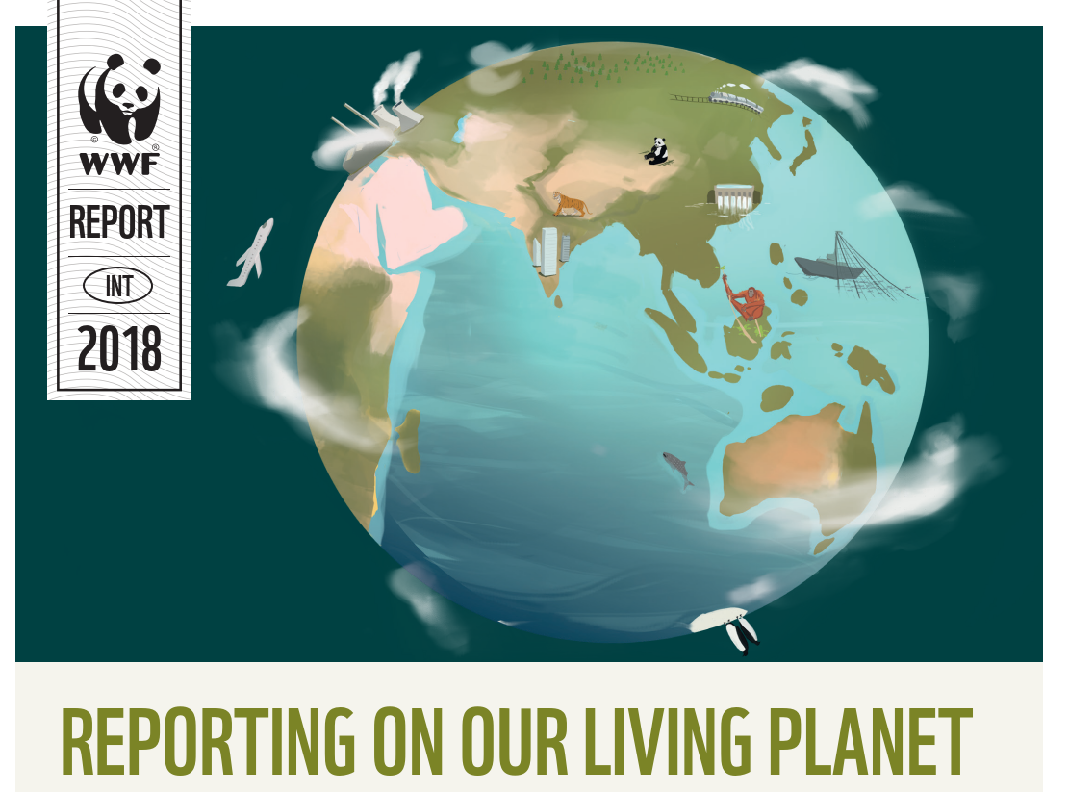
Notes:
WWF’s Living Planet Report in 2018 revealed that biodiversity on our planet is in serious decline.
Wildlife populations globally have declined by 60% in less than 50 years.
Full report: http://wwf.panda.org/knowledge_hub/teacher_resources/

Slide 15
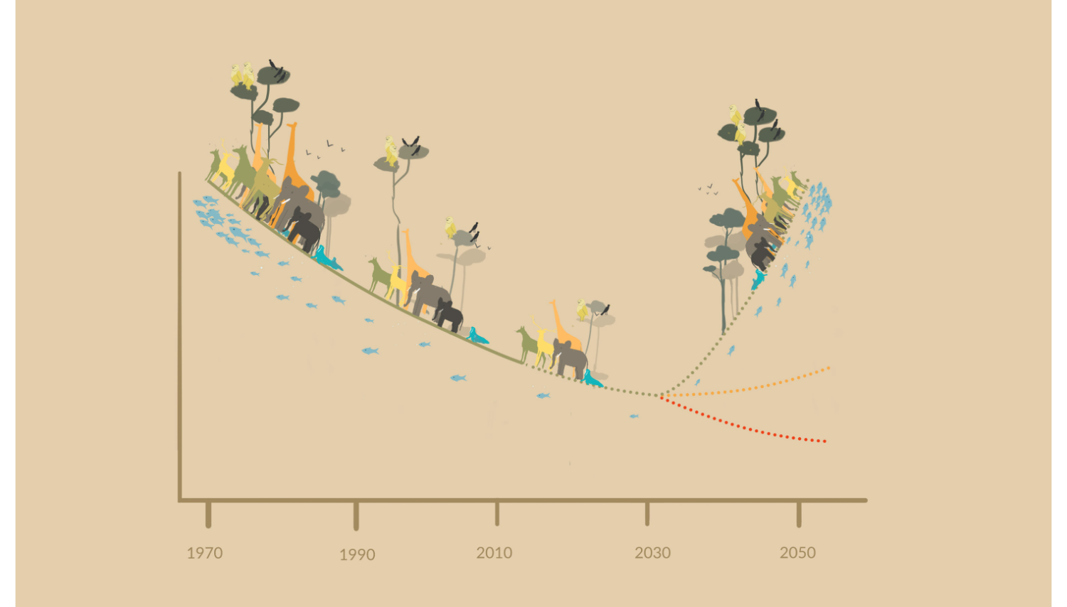
What can we do to bend the curve?
Recovering
Wildlife
Populations
Stabilising
Declining
Notes:
Bending the curve of biodiversity loss
The data compiled by scientists to create the Living Planet Report shows that our planet’s biodiversity (the term for all wildlife and ecosystems in a set area) has been declining rapidly since the 1970s, and we know that it was already much lower at that point than it has been in the distant past.
This graph shows how the size of wildlife populations around the world has fallen and is set to continue falling for the next decade. What happens after that will depend on what we do in the next few years.
If humans carry on doing all the things we have been doing over the past years that damage the environment, and our population continues to grow, we can expect that the red line will be our future. This would mean that wildlife populations around the world become very small and some species would be lost completely.
If we work together to limit our destructive impact on the environment we could slow the loss of wildlife populations until it stabilises (yellow line). This means we could keep the amount of nature that we currently have on our planet.
If we change lots of things about the way we live – the things we eat and the way we produce it, the way we generate the energy that we use each day – then we could allow nature to recover (the green line).

Slide 16
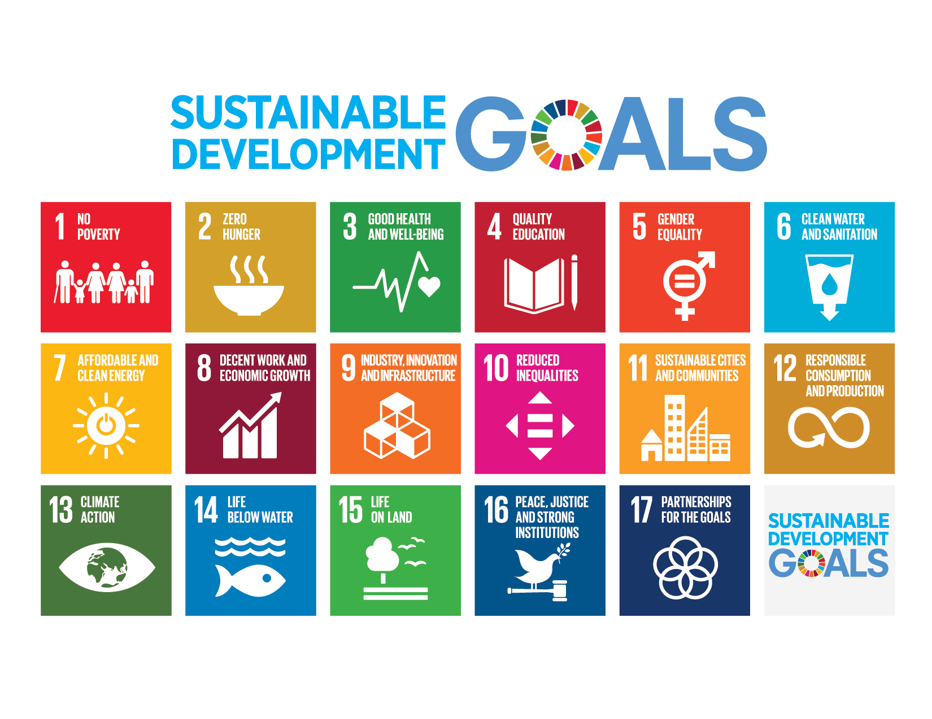
Notes:
In September 2015, 193 Global Leaders agreed on 17 Sustainable Development Goals. These Global Goals are focused on ending extreme poverty, fighting inequality and tackling climate change - all by 2030.
The goals that are specifically to do with the living planet – 6, 13, 14 and 15, are all essential to realise if we want any of the others. Food, fairness and prosperity are only possible on a planet that is able to support us properly.
It will take extreme changes to the way we live to achieve the SDGs.

Slide 17
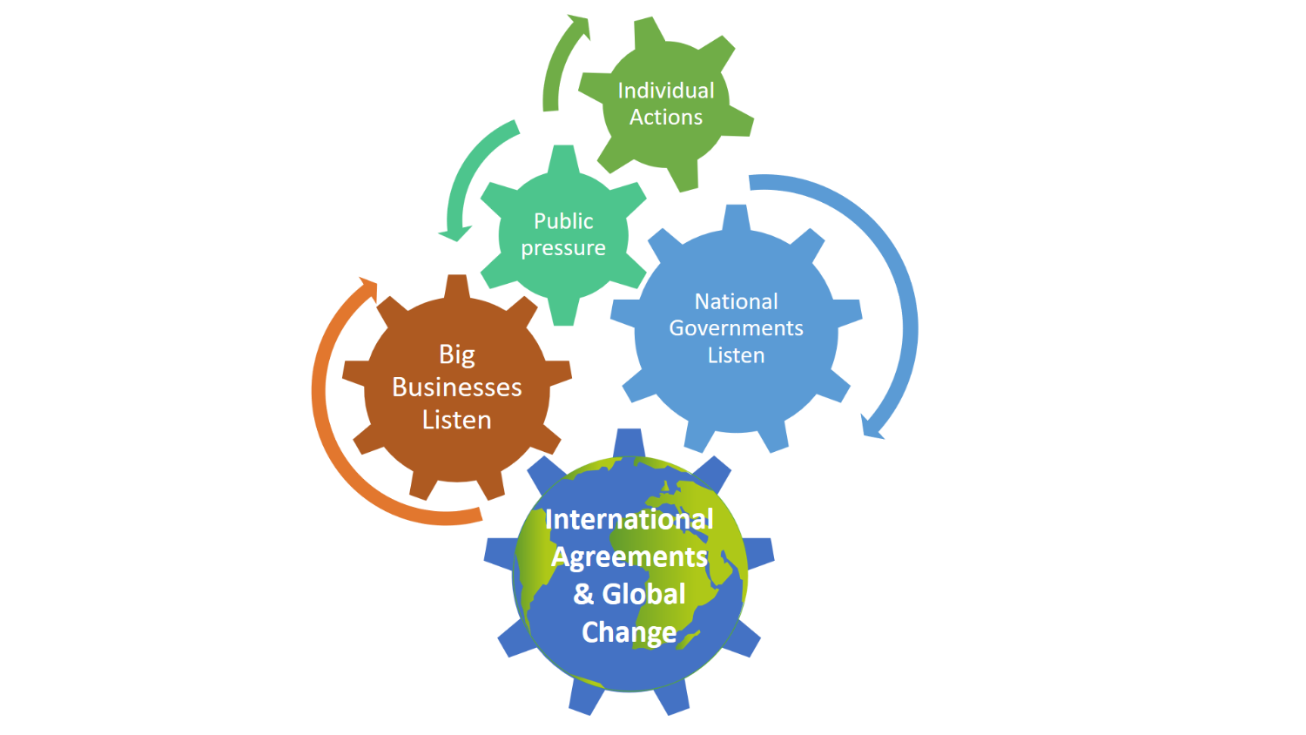
Notes:
We can all play a role in creating a more sustainable future through our own actions, but it needs to be big businesses and governments acting together to make the big changes needed to save the planet. That doesn’t mean we should give up – if we show through our actions and voices that we want change then big businesses and governments will listen. After all, businesses need customers and governments need support from their citizens!

Slide 18
#OurPlanet
www.ourplanet.com
Notes:
Visit www.ourplanet.com for more information, classroom resources and a wealth of free videos.

