Slide 1
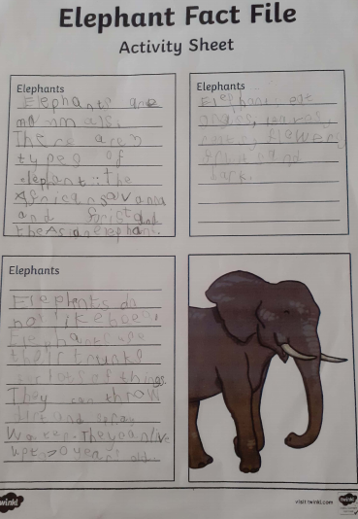
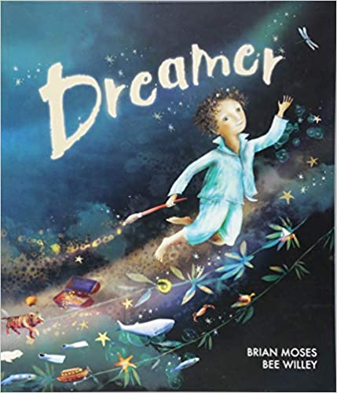
Task 1 Dreamer by Brian Moses and Bee Willey. Watch the story being told on Milk Shake with the link on the weekly plan. See the part about elephants. See if you can use the information in your pack about elephants and make a fact file about them. Remember to add the special message from the story Dreamer that no elephants should be hunted for their ivory.

Slide 2
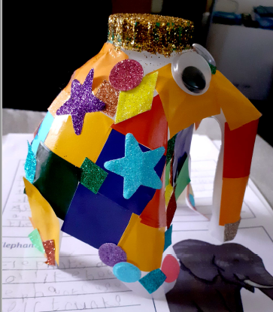
Task 2 After listening to the video for Wednesday see if you can think about making an elephant from a plastic milk bottle. Look at the one that George has kindly made already. You have the instructions in your pack and some bits to stick onto your recycled elephant. You can use your own materials if you would want.

