Slide 1
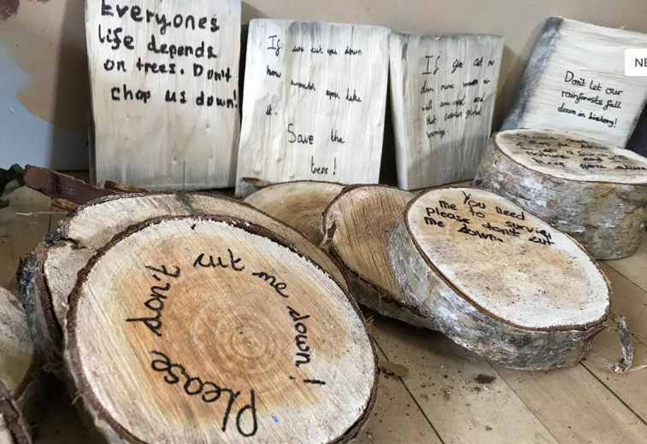
Task 1 Watch the video for Tuesday. Think about the pictures from Dreamer about the rainforests. Remember the story of The Last Wolf and how we wrote letters to tell everyone to plant trees. Use the log template in your pack to write messages about saving our trees. Remember to save them to bring into school or send photographs of your work

