Slide 1

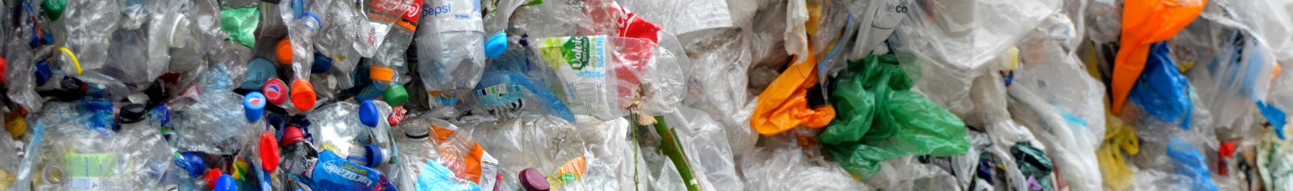

Together, we can make plastic pollution a thing of the past.

Slide 2
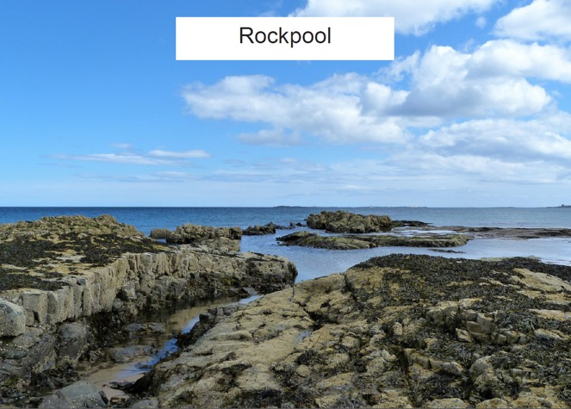
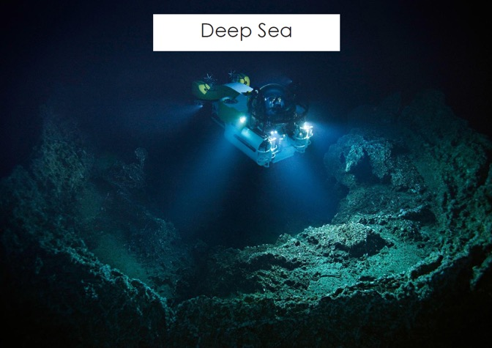
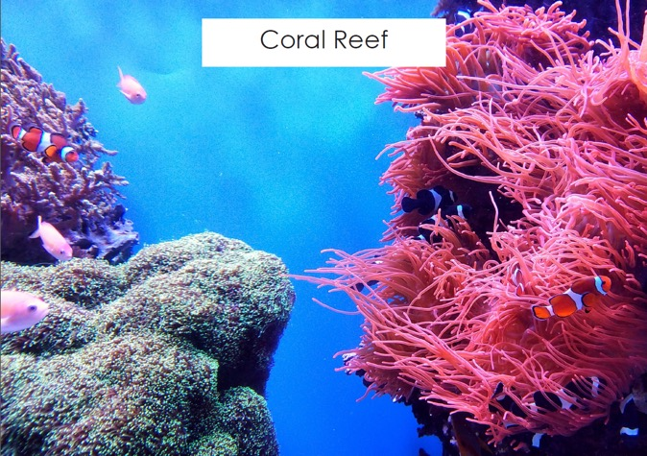
Ocean Habitats
Notes:
This activity will use the sea creatures and the habitats if you wish. The following slides can be used, projected and the sea creatures stuck on top (this may not be suitable for an interactive white board) or the habitats printed out and used that way. Ask the children to come up one at a time or in pairs, pick an animal and explain why they think it belongs in that particular habitat. There are some plastic items in with the sea creatures, if a child picks one of these tell them that they are correct, it is found in the ocean but it shouldn’t be there. If any of the class ask what the animals are the names can be found in the teacher pack.

Slide 3

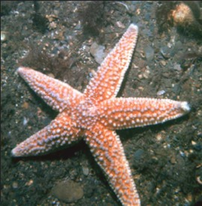
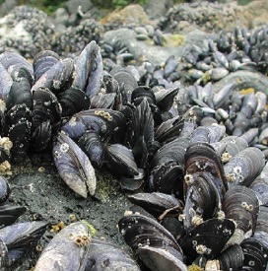
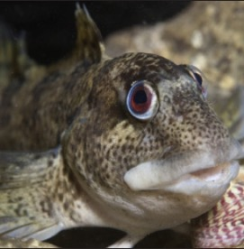
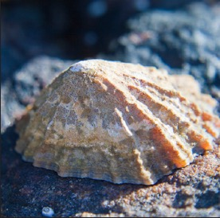
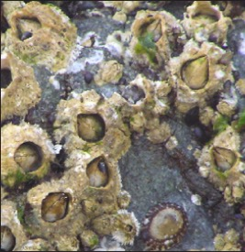
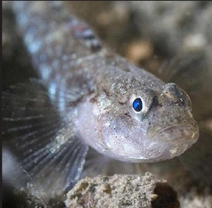
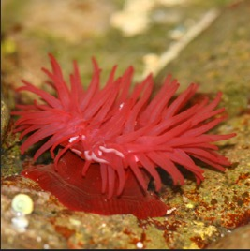
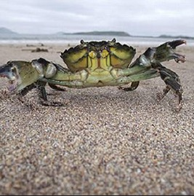
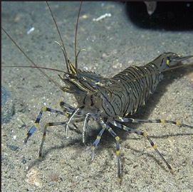
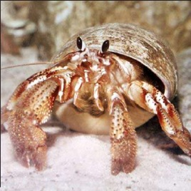
© MarLIN
©sciencenationalhonorsociety
© wildlifetrust
© newatlas
© tes
© Pooleparklife
© coralreefsofourworlds
© Sjon Heijenga
© Ilfracombe Aquarium
© Britannica
Notes:
Rockpool: this habitat may be familiar to some children depending on where they live/go on holiday. During the slide show the slide will initially just show the rock pool image, a click will make the correct animals appear. Once you have been through the animals that live in the rock pool ask the class what they think the habitat might be like.
Some characteristics of a rock pool: shallow water, salty, lots of light, can dry out.

Slide 4

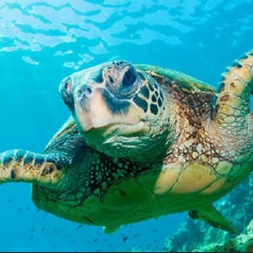
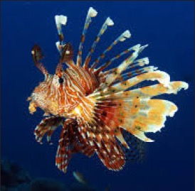
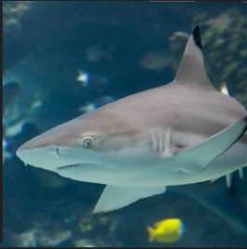
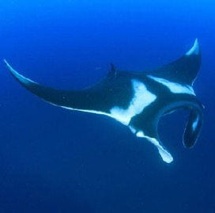
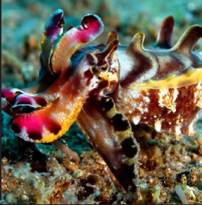
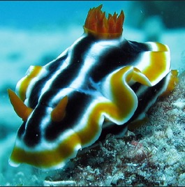
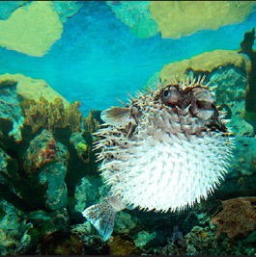
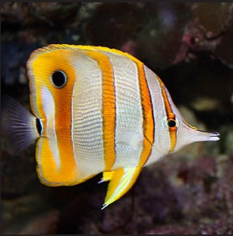
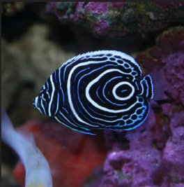
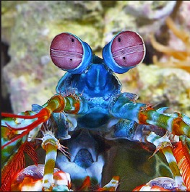
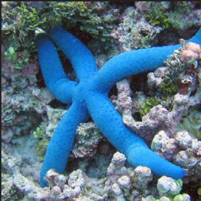
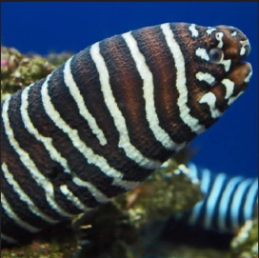
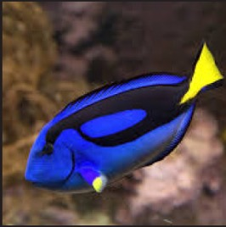
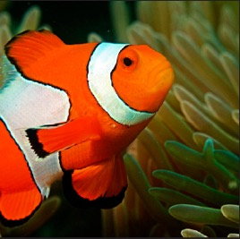
© Omaha zoo aquarium
© Laura Dinraths
© Maui ocean center
© divetheworld
© Q Phia
© National Geographic
© National Geographic
© fishkeepingadvice
© Malta National Aquarium
©George Grall
© NPS
© Monterey Bay Aquarium
© Podolnaya Elena
© Ritiks
Notes:
Coral reef: this habitat may be familiar to some children from films such as Finding Nemo. If the class are struggling you can give them the hint that many of the creatures on coral reefs are brightly coloured. During the slide show the slide will initially just show the coral reef image, a click will make the correct animals appear.
Once you have been through the animals that live in a coral reef ask the class what they think the habitat might be like.
Some characteristics of a coral reef: lots of light, bright colours, salty, warm water

Slide 5

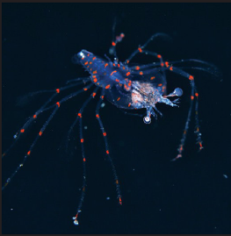
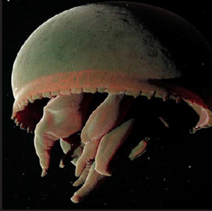
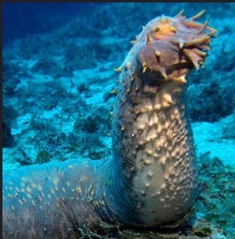
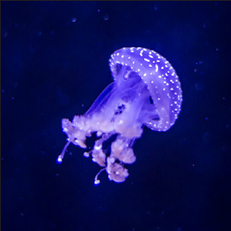
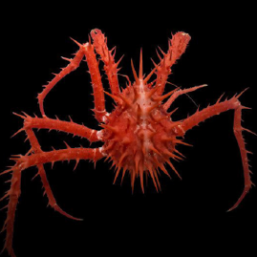
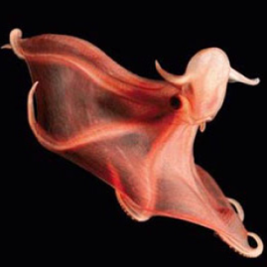
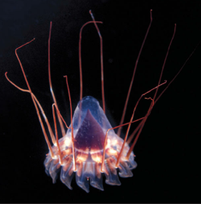
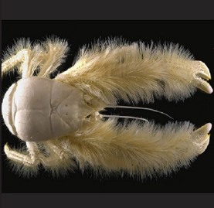
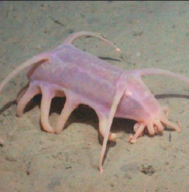
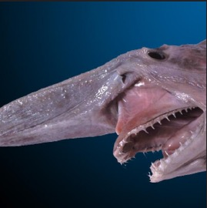
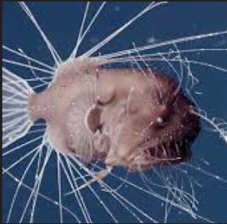
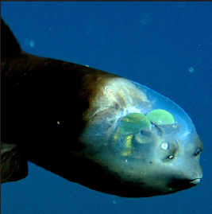
© Kei Nomiyama
© MBARI
© Gary Hughes
© Lennart Tange
© natuerismetal
© David Shale
© the times
© A. Fifis
© MBARI
© Dianne Bray
© Rebbikorf Foundation
© MBARI
Notes:
Deepsea: this habitat will likely be unfamiliar to most of the class. The animals can be identified generally by their strange appearance and the dark colour of the picture background (only tell the class this if they are really struggling) . During the slide show the slide will initially just show the deep sea image, a click will make the correct animals appear.
Once you have been through the animals that live in the deep sea ask the class what they think the habitat might be like.
Some characteristics of the deep sea: dark, cold, no plants, high pressure

Slide 6
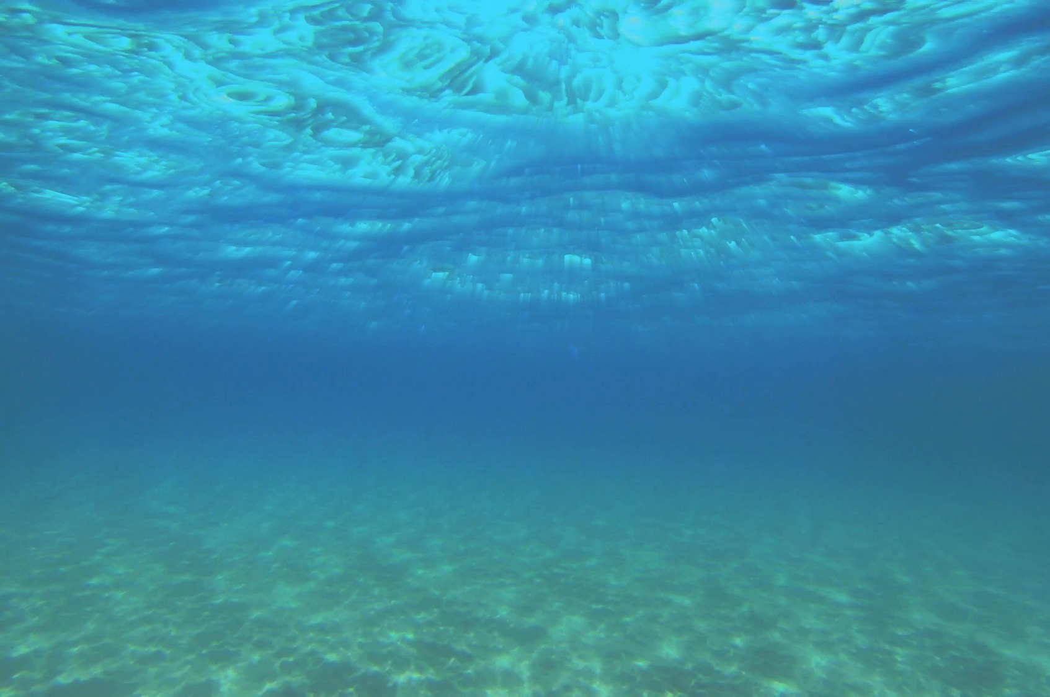
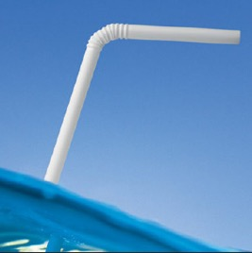
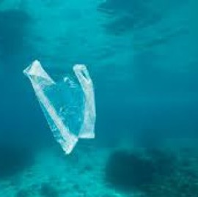
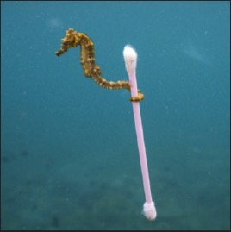
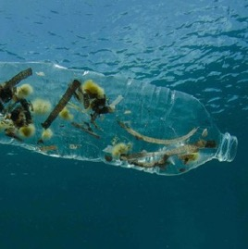
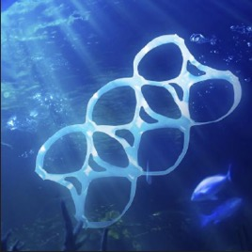
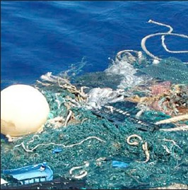
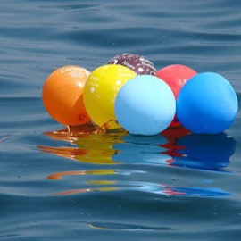
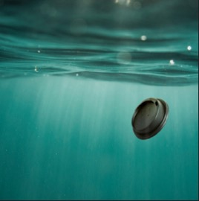
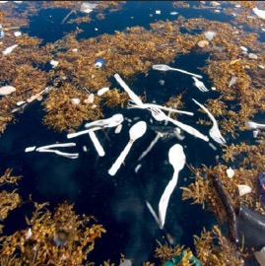



What doesn’t belong in the ocean?
© Webtech
© Coastal Living
© Justin Hofman
© Gillian Butler
© Fergregory
© Stephen Leahy
© Michael Bear
© plasticfreemanly
© Caroline Powers
© Peter Oxford
© Peter Barritt
© Emiliano Noelia
Notes:
This shows many every day items that do not belong in the ocean but end up there. A question to the class: How do they get there?

Slide 7

Notes:
All the way to the ocean is a 12 minute video showing what happens to litter that gets dropped on the street.
Follow-up questions for the class:
Hands up if they have ever (accidentally or on purpose)?
How do they feel about littering now?
What problems do they think litter could cause in the environment?

Slide 8

Notes:
Short animation showing some of the problems that plastic can cause animals.
Ask the class to discuss the videos with each other for 1 minute after watching them and then ask them to feedback to the group

Slide 9


Design a poster
Notes:
After watching All the way to the ocean and the animal hospital film ask the class to make a poster each to tell people either: what happens when they drop litter or when happens to animals when there is plastic in the ocean. 15 minutes for this activity (can be shorter if needed).

Slide 10





Plastic
Plastic is useful for lots of things
Notes:
Plastic is a really useful material which we use for many things every day. Question for the class: What are some of the properties of plastic that make it so useful?
Go on to explain that most of the plastic that causes problems in the ocean is single-use plastic. Things made of plastic that we only use once and then throw away. Question: Can anybody think of something that is single-use plastic? We are going to look at what materials can be used instead to single-use plastic so that we can use it over and over again.

Slide 11



What could be used instead?
Notes:
What could be used instead of single-use plastic to make a bottle? Answer: Metal or glass.

Slide 12




What could be used instead?
Notes:
. What could be used instead of single-use plastic to make a straw? Answer: Metal, bamboo or paper.

Slide 13



What could be used instead?
Notes:
What could be used instead of single-use plastic to make a bag? Answer: Cotton or hemp.

Slide 14


What can you do?
Notes:
Ask all the children to think of something that they could do at home, school or in a club. Here are some examples of pledges we have received (you can change these for some of your own) read these out to the class to give them ideas. They can then write this on a pledge card, tell them to keep hold of it as they will need it in a minute.

Slide 15
What can you do?
I will stop using
I will tell about what I have learnt today
Notes:
These are some prompts to help the class with their writing. This is also on the back of the Word Bank handout which the children will already have on the table. Read out the prompts and make some suggestions for what they could write in the blanks.

Slide 16

Thank you for helping to make plastic pollution a thing of the past!
Notes:
Thank all the children for listening and doing so well. Ask if there are any more questions.
Then get the children to come up to the front to post their pledge and receive a sticker.

