Slide 1
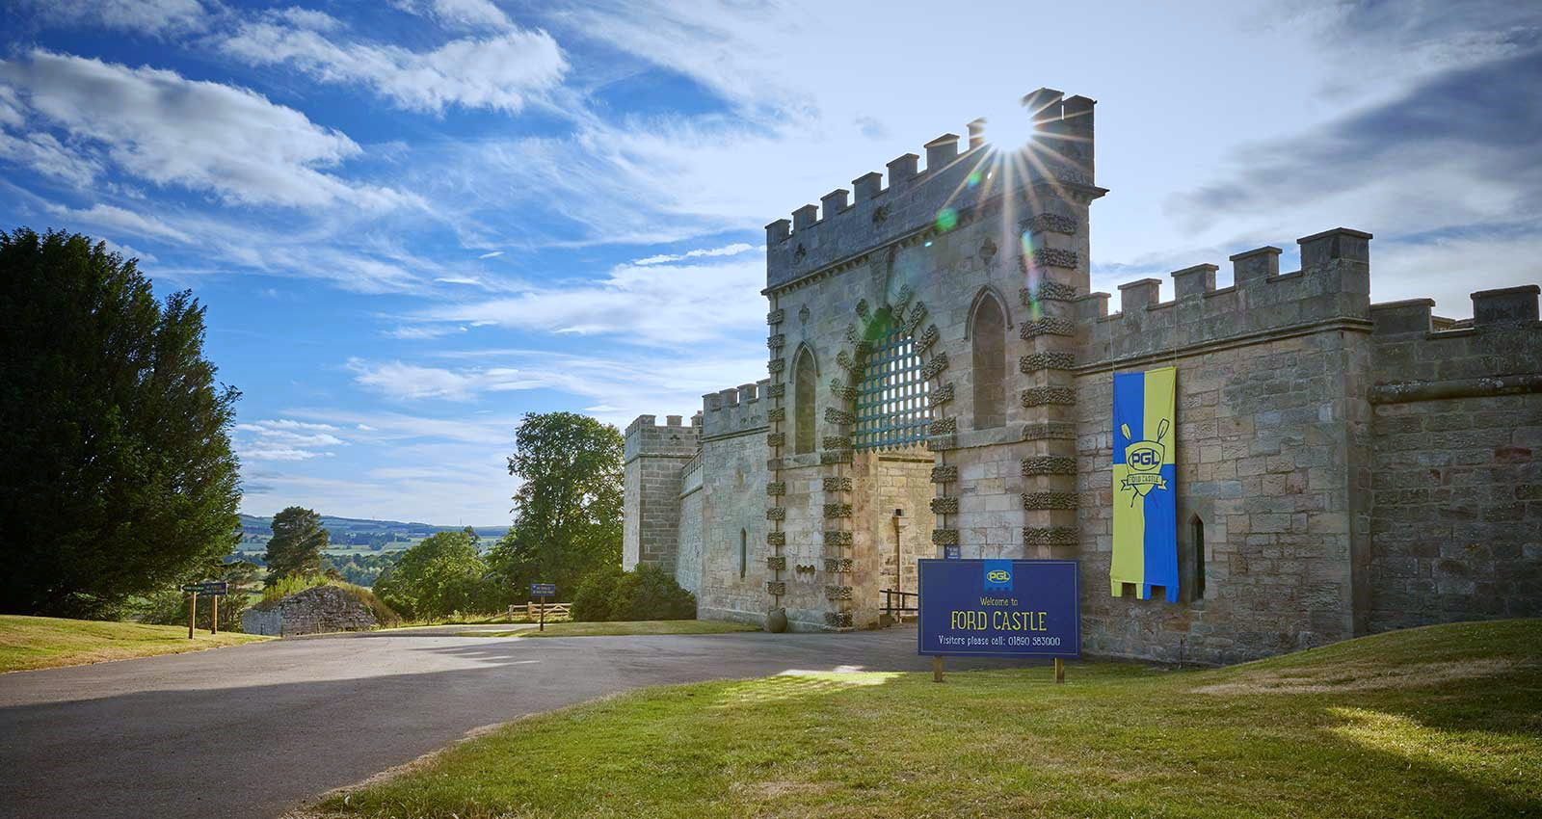
Ford Castle
Year 6 Residential 2023
07.06.23 – 09.06.23

Slide 2
Ford Castle are part of the PGL organisation who run several leading residential activity centres throughout the country and offer rewarding educational programmes combined with excellent outdoor and indoor activities.
Pupils benefit enormously from the experience. It boosts their confidence, develops their team building skills and the children always have a fantastic time!

Slide 3
Aims
To promote independence and team bonding.
To create memories.
To challenge ourselves.
To build friendships.
To learn new skills.
To learn outside of the classroom.

Slide 4
Staff → Mr Todd, Mr McConville and Mrs Strachan
Bus leaves school at 10.30am on 7th June. You are welcome to wave off the children when they leave.
A packed lunch is required on the first day but all other food is catered for.
Arrive back to school at 3pm on 9th June and children can be collected at normal time.

Slide 5
Our Rules
No phones, iPads , etc.
£10 maximum spending money.
Reasonable snacks in moderation.
Be prepared for weather changes.
Staff will decide room and group allocations.
Give all the activities a try!
Most of all… HAVE FUN!

Slide 6
Food

Slide 7
Sample Day

Slide 8
Itinerary

