Slide 1
Thursday 4th March 2021 Book Week

Slide 2
Today is World Book Day

Slide 3
Share as many books with as many people as possible today
You could share a book with your:
Parents, / Careers
Siblings
Grandparents – Perhaps you could ring or video call them and read a book to them
Friend – you could ring a friend from Year 3 and talk about the book ‘Dreamer’.

Slide 4
Thursday 4th March 2021 Book Week Task 1

Slide 5
Comprehension on Endangered Animals
I would love for you to read one of my comprehension paragraphs about an endangered animal
You will find these under todays video on the website
Have a look through the pages and choose 1 or 2 to print of and complete
The next slide is an example.

Slide 6
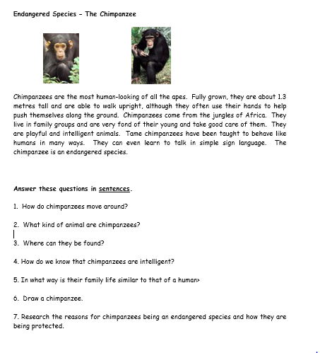

Slide 7
Challenge:
Can you create your own paragraph about an animal and some questions to go with it.
Next week bring these in and we will complete them as a whole class

Slide 8
Thursday 4th March 2021 Book Week Task 2

Slide 9
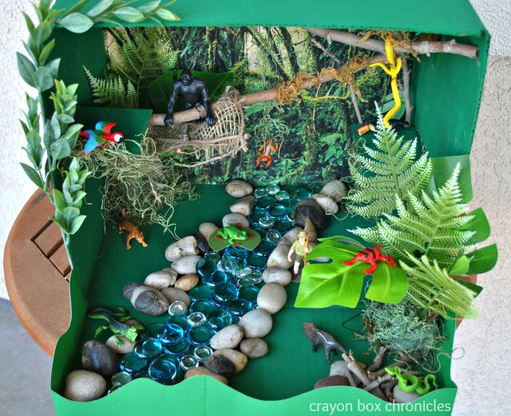
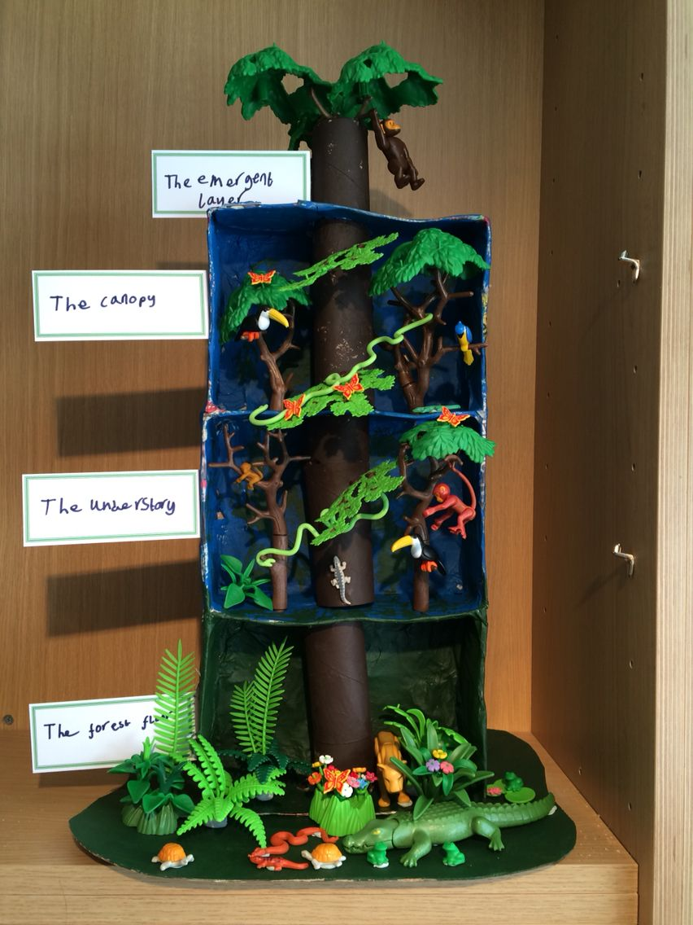
Create a Rainforest in a box

Slide 10
Last Year you did a lot of work on Rainforests and what animals live in each layer.
Can you create your box with all 4 layers or you could focus on one particular layer and add the animals and insects you would find there.

