Slide 1
Year 6
Miss Gray and Mrs Sayer

Slide 2
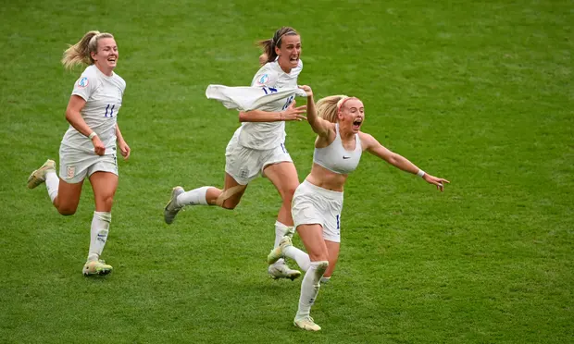
Goals scored and conceded…the season so far
Super enthusiastic
Have shown resilience
Great ideas and knowledge
Enthusiasm bubbles over and they forget to listen
Remembering our school rules and expectations
Taking responsibility for our own actions - important year

Slide 3
What will we be learning this year?
English

Slide 4
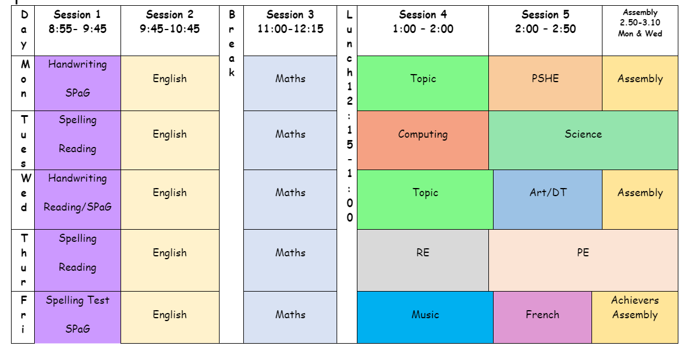
Year 6 Timetable

Slide 5
What will we be learning this year?
Maths
Currently Place Value
Will cover all 4 operations and include fractions and decimals
Long multiplication
Long division
At home - practise times tables, play dice games, ask about the methods they use in school - can they teach you!

Slide 6
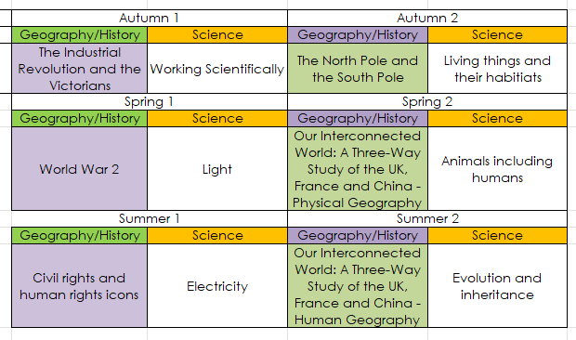
What will we be learning this year?
Foundation subjects
Broad and balanced
Weekly: art, music, PE, computing

Slide 7
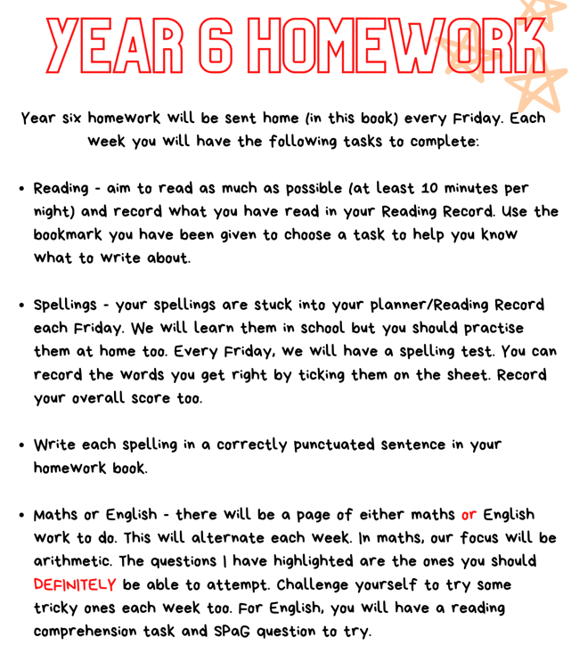
Homework

Slide 8
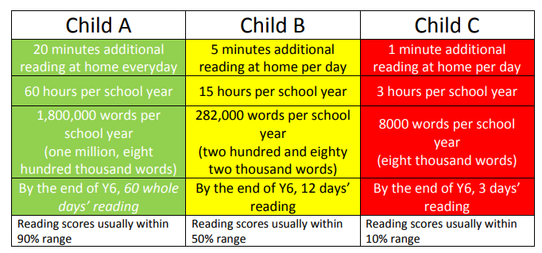
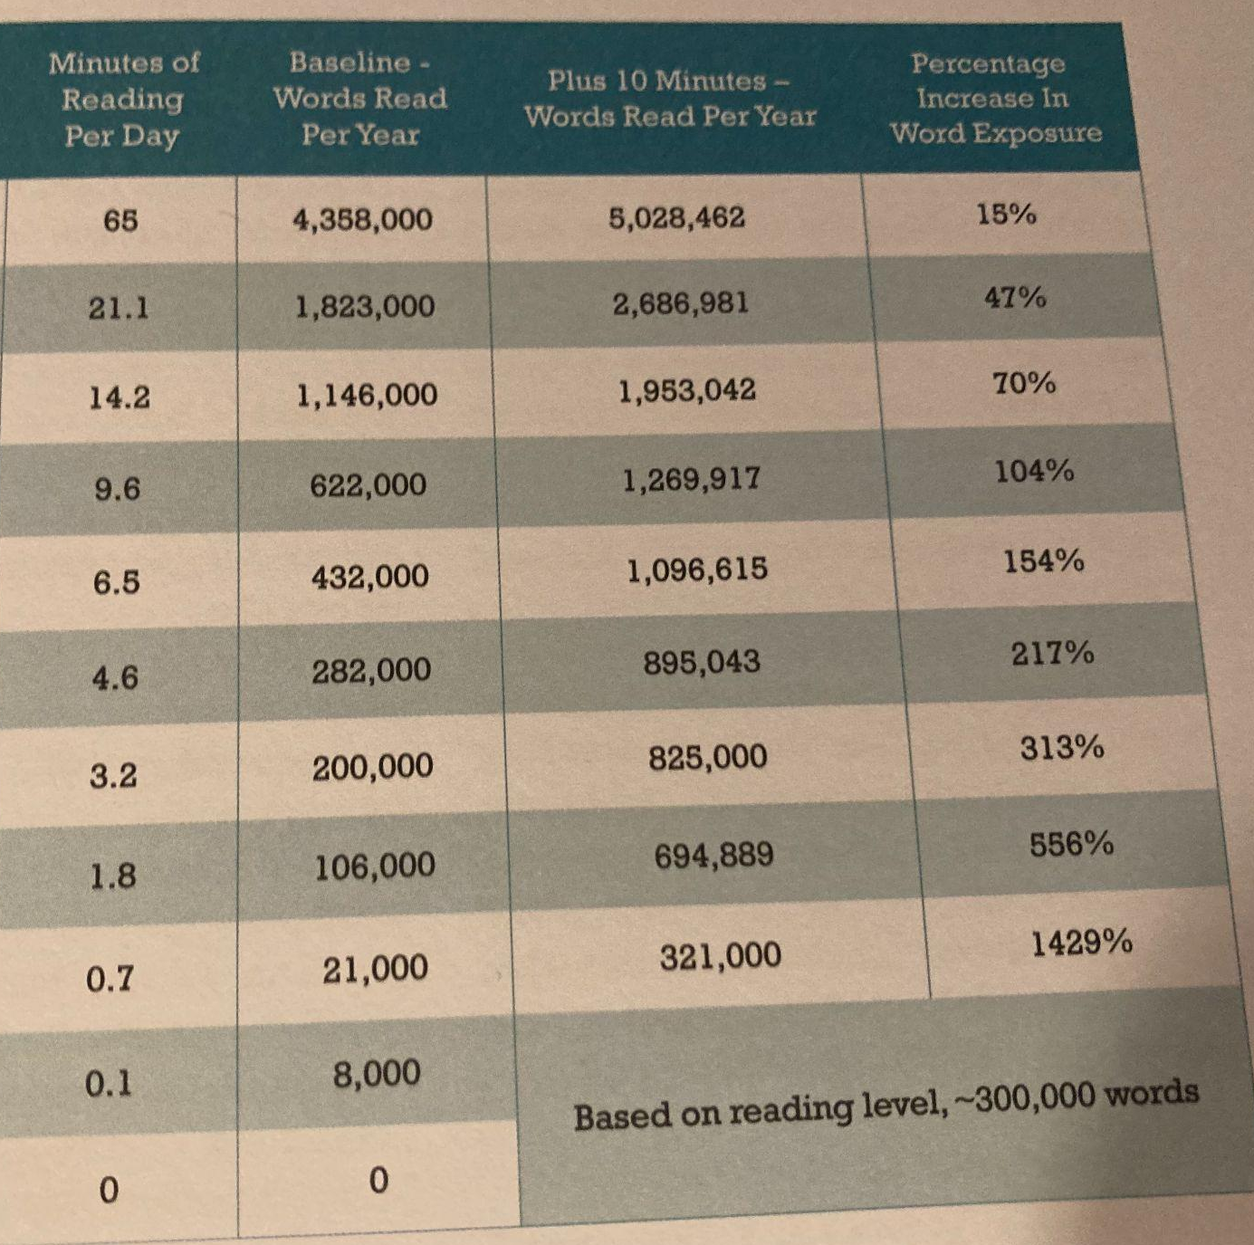
Reading
Throughout the school day at Ellington, our children have multiple opportunities to read. We do this through our class text, reading lessons, storytime and independent reading.
Studies have found that an additional 10 minutes of reading a day at home can expose your child to around 700,000 additional words a year!

Slide 9
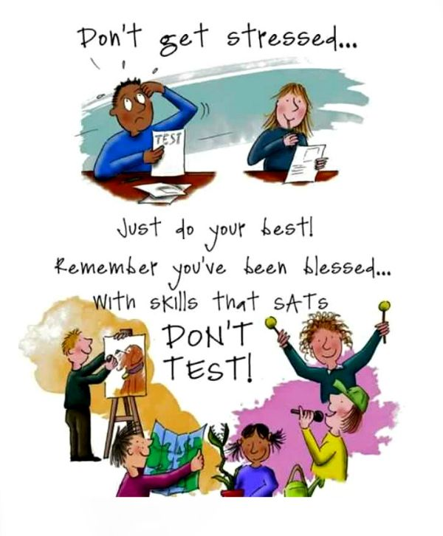
SATs
May 2023
Assessment of learning over KS2 not just Year 6
More information will follow over the year
Main point to note is when and to avoid booking holidays

