Slide 1
Welcome to Year 1’s Parents Meeting
Ellington Primary School
Mrs Horsley

Slide 2
How to be prepared for school
Uniform
Coats – please bring these daily
Bags – please only bring a reading bag Drinking Bottles
Come to school dressed in PE kit on a Tuesday
Daily Reading – signed by a grown up in their reading record

Slide 3
What happens in Year 1?
Day | Session 1 8:55- 9:45 | Session 2 9:45-10:45 | Break | Session 3 11:00-12:00 | Lunch 12:00-12:50 | Fluent Five / Tough Ten 12:50-1:00 | Session 4 1:00 – 2:00 | Session 5 2:00 – 2:50 | Assembly 2.50-3.10 Mon & Wed
Mon | Phonics | English |  | Maths |  |  | Science | RE | Assembly
Tues | Phonics | English |  | Maths |  |  | PE | Computing
Wed | Phonics | English |  | Maths |  |  | Topic | PSHE | Assembly
Thur | Phonics | English |  | Maths |  |  | Music | Topic
Fri | Phonics | English |  | Maths |  |  | Art/DT |  | Achievers Assembly

Slide 4
Phonics
Phonics is taught everyday
We use Read Write Inc (RWI) as a phonics scheme
Phonics lessons are taught in smaller groups and children are grouped appropriately on their reading ability
Each child will bring a RWI book bag book home on a Thursday. These must be read every day and returned to school on a Monday.

Slide 5
Quick recap on how you can help at home

Slide 6
Reading with Fred Talk
Notes:
We teach children to read words using Fred Talk to blend together the sounds they know e.g. m-a-t, mat.
We say ‘Fred Talk, read the word’.

Slide 7
‘Special Friends’, ‘Fred Talk’, read the word
Notes:
Then children practise reading these sounds in words using the routine ‘Special Friends’, ‘Fred Talk’, read the word’.
They spot the ‘Special Friends’ first, then Fred Talk to read the word.
For example, ‘ay’, s-p-r-ay, spray.

Slide 8
‘Special Friends’, ‘Fred Talk’, read the word
Notes:
E Children will be able to read all of the words in the Storybook.
If they hesitate, remind them to read the word using ‘Special Friends, Fred Talk, read the word’.
For example, this means they spot the ‘sh’, then Fred Talk and blend to read the word e.g. sh, sh-i-p, ship.

Slide 9
Red Words
Notes:
Some words are ‘tricky’ because they contain letters that don’t match the sounds the child has been taught.
For example, ‘said’ has ‘ai’ making an ‘e’ sound.
We teach these common exception words as Red words.
In the early Storybooks, these words are printed in red text.
Remind your child not to use Fred Talk to read Red words but instead to stop and think. Tell them the word if needed.

Slide 10
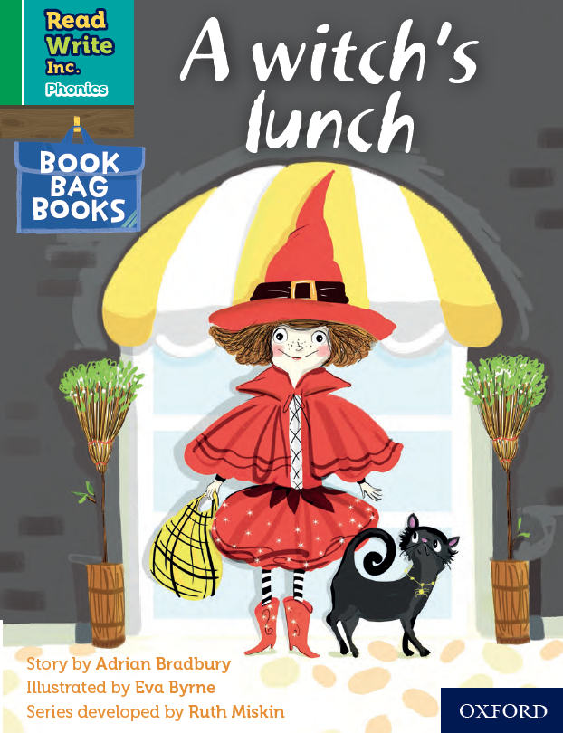
Book Bag Books
Extra reading practice at home
Uniquely matched to the Read Write Inc. Phonics Storybooks.
Reinforce children's learning of phonics at the appropriate level.
Helps to make even faster progress in reading.
Notes:
Only use this slide if you use Book Bag Books in your school.
We use Book Bag Books especially for home reading. They have guidance inside just for you as parents.
They are matched to the books children read in school so provide practice of the same sounds – extra practice at the right level for your child.
They include many of the same reading activities that we use in class.

Slide 11
Please help at home!
Listen to your child read the same Storybook again and again
Encourage them to use ’Special Friends’, ‘Fred Talk’, ‘read the word’
Discuss the story and recap any words they struggled on
Notes:
Provide copies of ‘Reading at Home Booklet 1 or 2’ from Oxford Owl.
Booklet 1 is sound groups and Ditty/ Red Groups and Booklet 2 for Green – Grey Storybooks.

Slide 12
Reading Expectations
Identify which words appear again and again.
Recognise and join in with predictable phrases.
Relate reading to own experiences.
Re-read if reading does not make sense.
Re-tell with considerable accuracy.
Discuss significance of title and events.
Make predictions on basis of what has been read.
Make inferences on basis of what is being said and done.
Read aloud with pace and expression, i.e. pause at full stop; raise voice for question.
Recognise:
capital letters
full stops
question marks
exclamation marks
Know why the writer has used the above punctuation in a text.
Know difference between fiction and non-fiction texts.

Slide 13
Writing Expectations
Writing
Write clearly demarcated sentences.
Use ‘and’ to join ideas.
Use conjunctions to join sentences (e.g. so, but).
Use standard forms of verbs, e.g. go/went.
Introduce use of:
capital letters
full stops
question marks
exclamation marks
Use capital letters for names and personal pronoun ‘I’.
Write a sequence of sentences to form a short narrative [as introduction to paragraphs].
Use correct formation of lower case – finishing in right place.
Use correct formation of capital letters.
Use correct formation of digits.

Slide 14
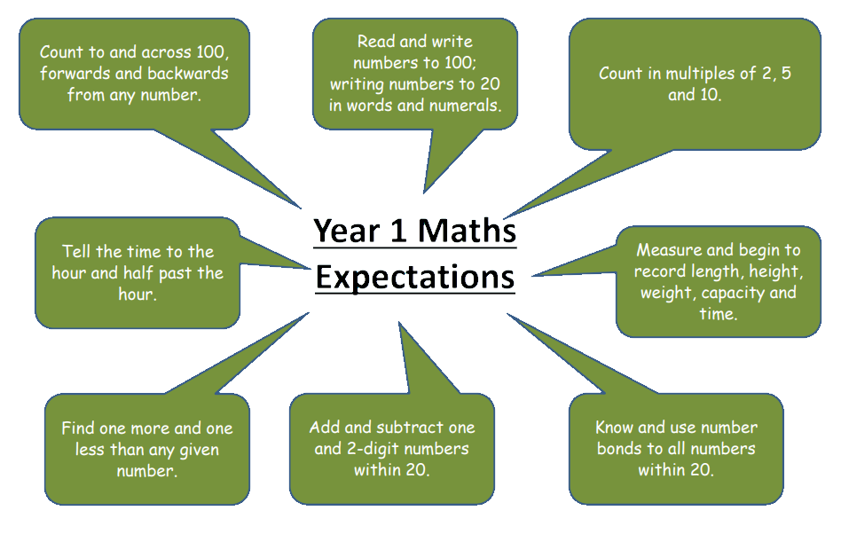
Maths Expectations

Slide 15
In Maths we use a wide range of resources to help the children understand concepts

Slide 16
Useful resources for you to use at home
Letter formation sheet which explains how each letter should be made.
Year 1 common exception words

