Slide 1
Friday

Slide 2
The last day looking at this fabulous book!
Dreamer

Slide 3
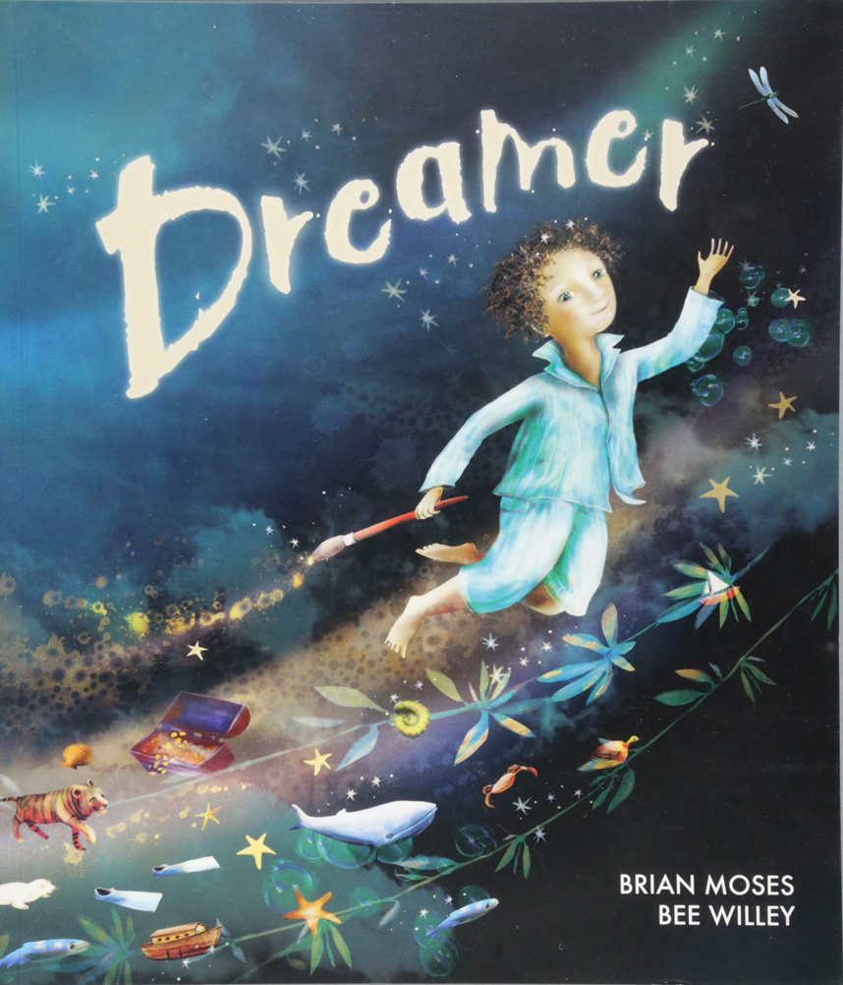

Slide 4
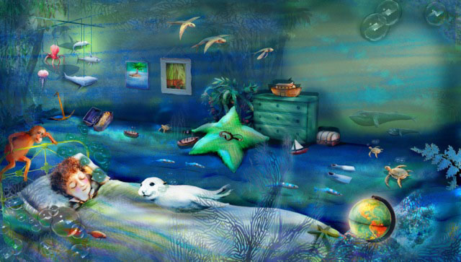
Once I had a dream, a special dream. A dream about our world.

Slide 5
I dreamt I was a whale,
And no hunters chased after me.

Slide 6
I dreamt I was a seal,
And no one wanted fur from me.

Slide 7
I dreamt I was a stream,
And no one poisoned me.

Slide 8
I dreamt I was a lake,
And no one filled me with junk.

Slide 9
I dreamt I was a valley,
And no one built a road across me.

Slide 10
I dreamt I was a rainforest,
And nobody felled a single tree.

Slide 11
I dreamt I was an elephant,
And nobody stole my ivory.

Slide 12
I dreamt I was a panda,
And no one took my territory.

Slide 13
I dreamt I was an island,
And no one ever discovered me.

Slide 15
Friday
Task 1 – write your own Dreamer poem about how we can make a difference – look at the structure of the poem
– I dreamt I was..
And no one… now change that to
- I hope that …
And no one…
Task 2 – with adult help, if possible cook/make something with some left over foods rather than throw it away or put it in the fridge until it has gone off.
Task 3 – to be able to create a line graph with data given (see slides
16 to 20).
Task 4 – Bee Willey, the illustrator of Dreamer has set you a challenge. She would like you to research endangered animals and then either draw/paint/collage them reinstating them to what their environment should be e.g. researching a sea turtle and then drawing it in a clear sea without plastic pollution and a safe place away from poachers etc. I’d like you to use the attached paper (slide 21) with the horizon line so that way when we collate the pictures they will be on a continuous line of sky/land/sea and hopefully we can make a lovely display out of it.
Illustrations would be lovely too! ☺

Slide 16
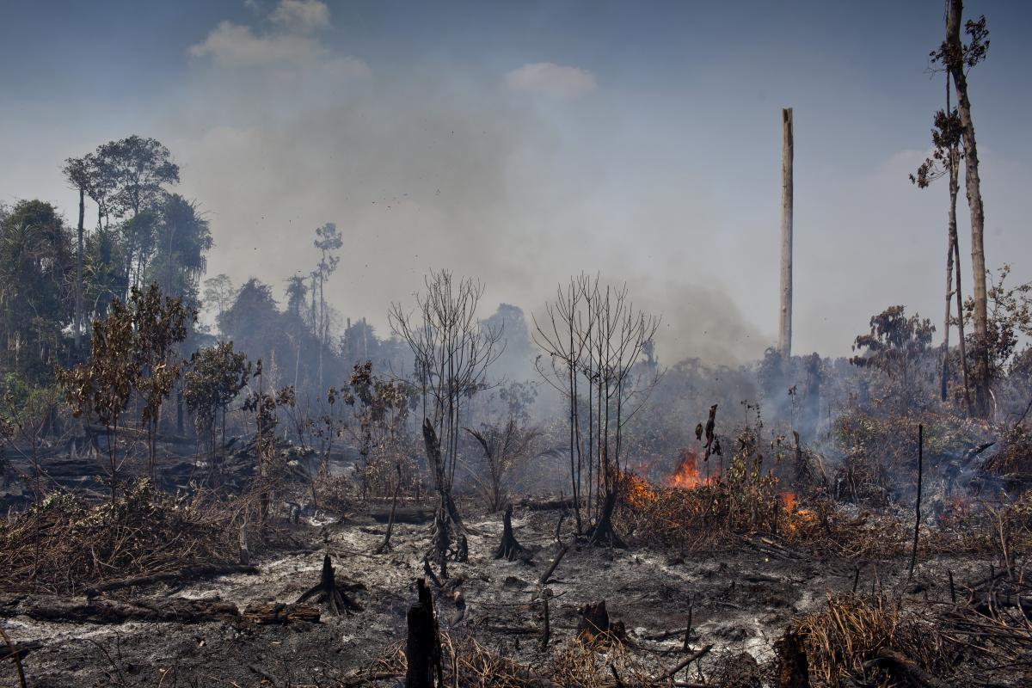
PLANTING OF PALM OIL TREES IS HAVING A DEVASTATING IMPACT ON OUR RAINFORESTS

Slide 17
The habitat of the orangutan, tiger, cassowary and many other species is under threat from unsustainable commercial cultivation of palm oil. The animals’ plight has been highlighted in the media, however the issues surrounding palm oil are complex and cannot simply be dealt with by a simple ban or boycott.
Many conservation organisations believe that promoting the use of sustainably grown palm oil is the best way to tackle the issue. Palm oil itself isn’t the problem – it’s actually a very versatile, efficient and high yielding crop that provides a livelihood for millions of people in tropical countries. It requires far less space than other similar oil crops, which means that if palm oil were banned, you would need to use far more space to grow the next best alternative. The problem arises from how it is grown, and it’s this issue that sustainable palm oil is trying to address. It is essential for the world for children and adults to see that the choices they make can have an impact on wildlife, and wild places, on the other side of the world.
Please access https://www.youtube.com/watch?v=LSumTLrJzdU to watch the devastation that palm oil planting can have on the environment. After that, just have a quick look in your cupboards to see how many things contain palm oil and see if it has the sustainable symbol or not.

Slide 18
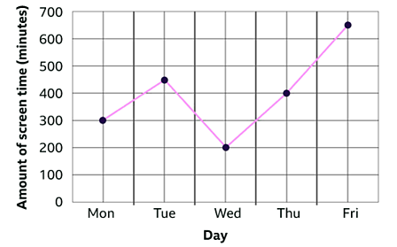
I would like you to create a line graph on the global production of palm oil.
This is an example of a line graph
Please see slide 19 of how to draw your line graph
Please see slide 20 for the data to input on your line graph

Slide 19
Global production of palm oil
45
40
35
30
25
20
15
10
5
0
1970 1975 1980 1985 1990 1995 2000 2005 2010 2015
Production in million tonnes
Years

Slide 20
Global production of palm oil
1970 - 2 million tonnes
1975 - 3 million tonnes
1980 - 5 million tonnes
1985 - 8 million tonnes
1990 - 11 million tonnes
1995 - 15 million tonnes
2000 - 20 million tonnes
2005 - 28 million tonnes
2010 - 34 million tonnes
2015 - 42 million tonnes

Slide 21
Top – sky
Bottom – land/sea

