Slide 1
Monday

Slide 2
We are extending World Book Day to cover a week, so this week we are looking at this fabulous book called
Dreamer

Slide 4
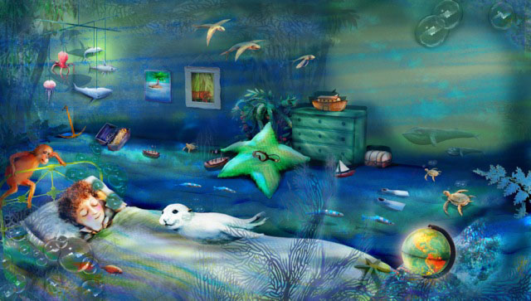
Once I had a dream, a special dream. A dream about our world.

Slide 5
I dreamt I was a whale,
And no hunters chased after me.

Slide 6
I dreamt I was a seal,
And no one wanted fur from me.

Slide 7
I dreamt I was a stream,
And no one poisoned me.

Slide 8
I dreamt I was a lake,
And no one filled me with junk.

Slide 9
I dreamt I was a valley,
And no one built a road across me.

Slide 10
I dreamt I was a rainforest,
And nobody felled a single tree.

Slide 11
I dreamt I was an elephant,
And nobody stole my ivory.

Slide 12
I dreamt I was a panda,
And no one took my territory.

Slide 13
I dreamt I was an island,
And no one ever discovered me.

Slide 14
Isn’t that just a beautiful poem.
I love the simplicity of the language and the illustrations are delightful.

Slide 15
So I have a range of exciting things for you to do this week.
I would love you to send me some outstanding work, as it is all going on display.

Slide 16
Monday
Task 1 - write your own Dreamer poem – look at the structure of the poem
– I dreamt I was..
And no one…
Task 2 – make and complete the fruit smoothie task (see slides 16 - 19) On Wednesday, I will give you more information on Fairtrade.
Task 3 - to create a tally chart based on data collected. Ask an adult to take you to a road which is used regularly by vehicles. Do a survey. Count how many cars, buses, bicycles and pedestrians go past you. Do this for ½ hour stints, example 10-10.30, 12-12.30, 2-2.30. We will be using this data tomorrow.
Task 4 - please access https://kids.kiddle.co/Great_Pacific_garbage_patch#:~:text=The%20Great%20Pacific%20Garbage%20Patch,holds%20floating%20pieces%20of%20plastic
Look at the images on slide 21 which show the plastics and rubbish in some of our oceans and then I want you to invent a machine that would take all the plastic and rubbish out of the oceans. After drawing and labelling your machine, write an explanation text of how it works. Be as creative as possible. If you are unsure how to do this, watch The Shirt Machine on https://www.youtube.com/watch?v=rliGlp4ddXs to understand how to write it.

Slide 17
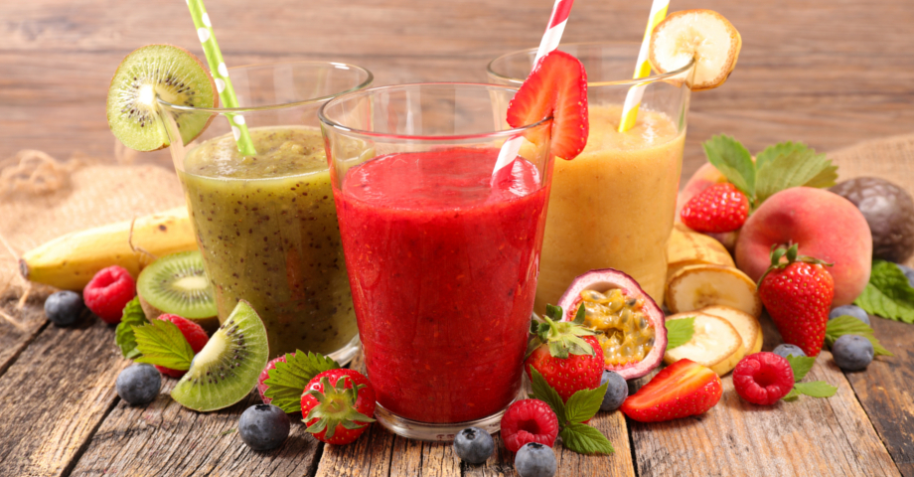
Fruit Smoothie
I would like you to make a fruit smoothie. On slide 19, I have given you a price list of Fairtrade fruits. Using the price list, calculate how much it cost to make your fruit smoothie. (This information is also in your pack).
Then enjoy your fruit smoothie and happy calculating!

Slide 18
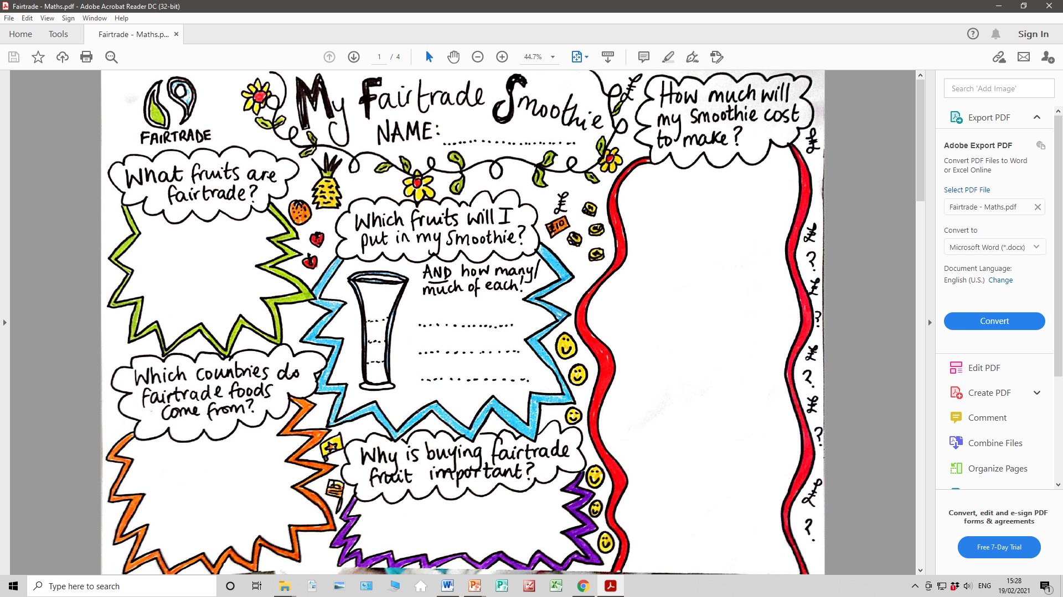

Slide 21
