Slide 2
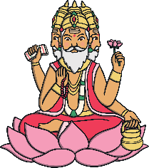
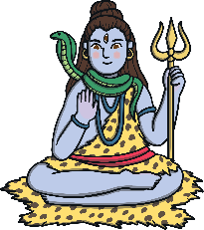
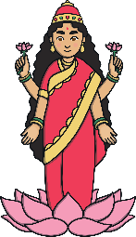
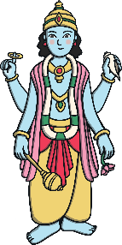
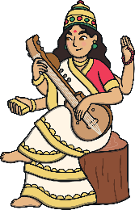
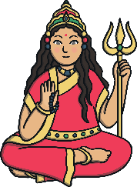
Hinduism
Hinduism is the oldest religion in the world and followers are known as Hindus. Hindus live all over the world.
Hindus believe there is a supreme God called Brahman. The other gods and goddesses of Hinduism are different parts of Brahman. Hindus can pray to different gods and goddesses for help with different needs. Here are just some of them.
Lord Brahma
Lord Shiva
Goddess Lakshmi
Goddess Saraswati
Goddess Shakti
Lord Vishnu

Slide 3
Hinduism
Hinduism does not have a single holy book but several holy scriptures (holy writings or texts).
The scriptures help Hindus in their life and guide prayer, either at home or at the temple (mandir).

Slide 4
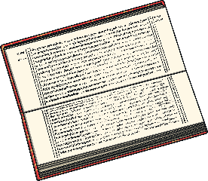
The Four Vedas
Many Hindus think of the Vedas as the most important sacred texts.
The Vedas are believed to have existed as long as Brahman. They were heard by people when meditating thousands of years ago. Meditation is quiet thinking time.
They were then passed down orally (spoken) and eventually written down in Vedic Sanskrit, an ancient language of India.
The four Vedas are:
Rig Veda - hymns praising the gods and goddesses
Yajur Veda - instructions for priests during rituals, such as marriage and prayer
Sama Veda - melodies and songs to be sung during rituals
Atharva Veda - hymns and charms to be said during rituals (these could be for protection or luck)
Some Hindus read some or one of the texts each day during worship. Others might read texts related to a particular deity (god or goddess) on special days linked with that deity.

Slide 5
The Four Vedas
Each of the four holy texts has four sections:
The Samhitas - over 1,000 hymns of praise
The Brahmanas - rituals and prayers to guide the priests in their duties
The Aranyakas - a guide about worship and meditation
The Upanishads - teachings of Hinduism, such as reincarnation. Hindus believe a soul cannot be destroyed so when a Hindu dies, their soul enters a new living being.

