Slide 1





Year 1
at Ellington Primary School

Slide 2

Ellington Primary School
Parent / carer welcome information booklet
2023-2024

Slide 3
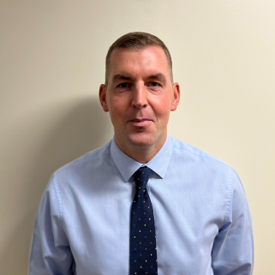
A message from Mr Hodgson...
My name is Mr Hodgson. I have been the Headteacher at Ellington Primary since September 2021. All of the team and I will continue to do all we can to make sure Ellington gives your child the very best primary experience.

Slide 4

The School day and routines.
Our school day begins with registration at 8:45am with the doors opening at 8:40am.
The school day ends at 3:15pm.
Our Nursery sessions run from 8:45am - 11:45am (Morning session) and 12:15pm - 3:15pm (Afternoon session) and 8:45am - 3:15pm for full day sessions.

Slide 5

Attendance
In order for children to achieve their full potential, it is essential that they attend school regularly. The expectation is that children will attend for at least 96% of the time, taking into account illness. We work closely with our Eduction Welfare Officer and if a child’s attendance becomes a concern we will inform parents/carers and meet with them to try and resolve the situation. However, if progress is not made, the Governors will be informed and the process may become official.

Slide 6
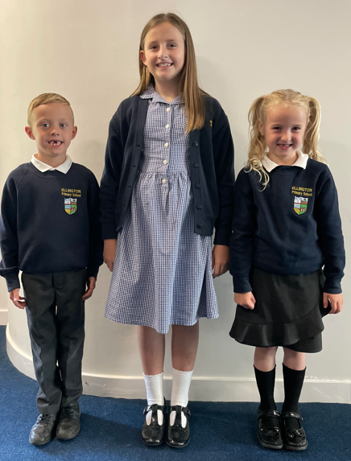
School Uniform
➢ Navy blue jumpers/cardigans
➢ White polo-shirts/shirt.
➢ Black or charcoal skirt, shorts or trousers.
➢ Blue gingham summer dress.
➢ Black school shoes

Slide 7

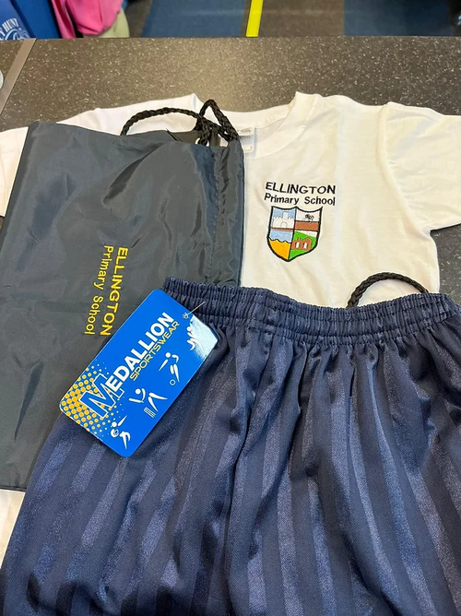
PE Kit
All classes will have two PE lessons per week from September as part of our active school approach. Your child's PE day will be on a Tuesday and Wednesday Children need to come to school wearing their PE kit so that they are ready for their lesson. This avoids wasting valuable time.
Children must wear:
➢ School PE Kit consisting of a white t-shirt with embroidered badge and navy/black shorts
Or
➢ Plain white t-shirt and plain navy/black shorts.
➢ Plain navy jogging bottoms.
➢ School PE hoody or plain navy hoody.
➢ Children can wear any comfortable trainers on their PE day.

Slide 8
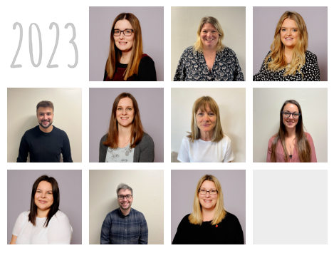
Meet the Teachers
These are the teachers at Ellington Primary School.

Slide 9
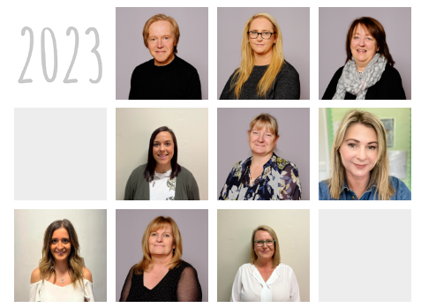

Meet the Support Staff
These are the support staff at Ellington Primary School.

Slide 10

Other Staff

Slide 11

Welcome to Year 1
In this booklet, you will be introduced to teaching staff in Year 1 and important information for:
  Getting ready for Year 1
  Class Routines
  The school curriculum
  How to support your child at home
Please also take a look at our website where you will find lots of useful information about Ellington Primary School!

Slide 12
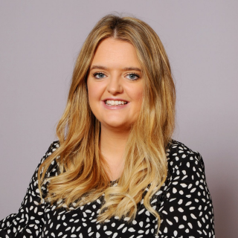

Meet the Year 1 Staff
I am Mrs Horsley, your Year 1 teacher. I have been teaching at Ellington for 7 years and I'm also our school PSHE Leader.
I'm Mrs Strachan, the teaching assistant working in Year 1. I will also be working with children across the school to help improve their phonics skills in interventions.

Slide 13

Curriculum Enrichment

Slide 14


Reading in Year 1
Over the summer holidays please ensure you read regularly with your child. Reading stories they can sound blend themselves and stories that you read to them.
Please can you also practise the following sounds to ensure they are ready for when they come back in September.

Slide 15
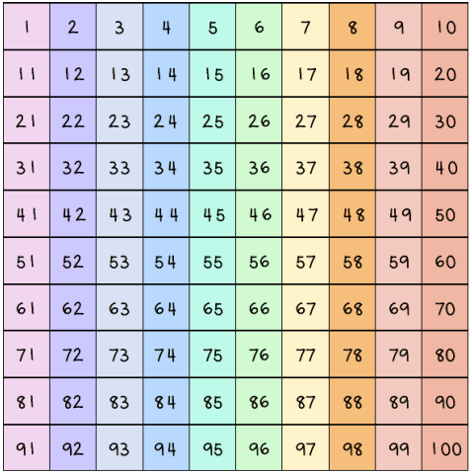
Maths in Year 1
In Year 1 we will build up to working with numbers to 100. Over the summertime please practise counting up to 100. If your child is confident in this then please challenge them to counting on and back from any given number within 100.

Slide 16


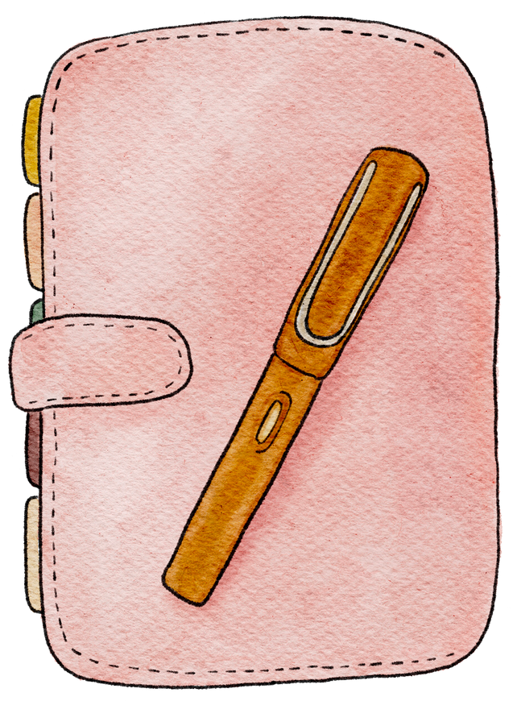
Getting Ready for Year 1
What can you do to get ready for Year 1?
Washing and drying your hands
Putting on your shoes and coat and fastening them independently
Using a knife, fork and spoon correctly
Taking turns in a game
Asking an adult for help and explaining what is wrong.
Following simple instructions.
Asking and answering questions
Using scissors to cut paper following a line or cutting out shapes.
Writing your name and practising the correct pencil hold

Slide 17



Contact Me
You can find me outside Year 1 every morning before school and at hometime. You can also contact me via Class Dojo for anything informal (Please note Dojo will only be accessed by staff between 8am and 5pm Monday to Friday). Additionally, if you would like to contact the school office to discuss any questions you may have you can do so by contacting....
01670 860769
admin@ellington.northumberland.sch.uk

